Slide 1
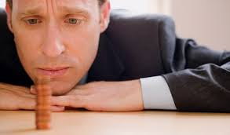
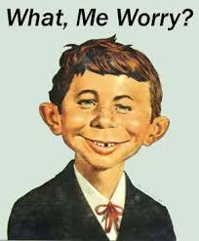
Victory over worry
We don’t want to call it that.
But we do worry.
How can it stop it?

Slide 2
Matthew 6:25-27
²⁵ "Therefore I say to you, do not worry about your life, what you will eat or what you will drink; nor about your body, what you will put on. Is not life more than food and the body more than clothing? ²⁶ Look at the birds of the air, for they neither sow nor reap nor gather into barns; yet your heavenly Father feeds them. Are you not of more value than they? ²⁷ Which of you by worrying can add one cubit to his stature?

Slide 3
Matthew 6:28-30
²⁸ So why do you worry about clothing? Consider the lilies of the field, how they grow: they neither toil nor spin; ²⁹ and yet I say to you that even Solomon in all his glory was not arrayed like one of these. ³⁰ Now if God so clothes the grass of the field, which today is, and tomorrow is thrown into the oven, will He not much more clothe you, O you of little faith?

Slide 4
Matthew 6:31-34
³¹ Therefore do not worry, saying, 'What shall we eat?' or 'What shall we drink?' or 'What shall we wear?' ³² For after all these things the Gentiles seek. For your heavenly Father knows that you need all these things. ³³ But seek first the kingdom of God and His righteousness, and all these things shall be added to you. ³⁴ Therefore do not worry about tomorrow, for tomorrow will worry about its own things. Sufficient for the day is its own trouble.

Slide 5
Introduction
All of us worry – at times
We justify it with a distinction between worry and concern
Worry is a rocking chair – keeps you busy but goes nowhere
Big things we handle – the little things eat at us
It is not the tornadoes – it’s the termites

Slide 6
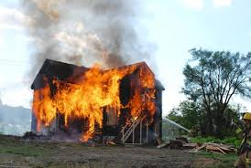
1 Realize what is important
Get our priorities straight
Figure out what is most important
Loss of everything in a house fire
But we are all alive and will rebuild

Slide 7
2 Put the spiritual first
We might lose a friend or our job
But we keep our faith
Job lost all but kept his integrity
Job 27:5 Far be it from me That I should say you are right; Till I die I will not put away my integrity from me.

Slide 8
3 Don’t waste time on secondary things
We are easily distracted from the important
The urgent often gets in the way
We must learn what is secondary – before we know what should be first

Slide 9
4 Don’t panic
Something happens and we get out feathers ruffled
We go into a “tizzy” with worry about it
We do not think clearly when we are in a panic

Slide 10
5 god is still in charge
This is the message from Matthew 6:25-34
God is still in charge of this world
Forget this – and you will worry yourself sick

Slide 11
Learn to trust the knowledge of god
God knows what we need
He may wait for us to realize what is needed
4 Illustrations
Birds are fed
Can’t add to your height
Flowers grow in fields
Even rocks can look good – God clothes them

Slide 12
Learn to live one day at a time
Don’t dwell on the past
Learn to start each morning – fresh, new day
V. 34 Therefore do not worry about tomorrow, for tomorrow will worry about its own things. Sufficient for the day is its own trouble.

Slide 13
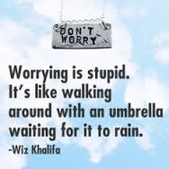

Slide 14
Practical suggestions
Have a “worry” box
Write down what to worry about
But it in the box
Later – read what you worried about

Slide 15
Final point
Worry is the opposite of faith
Philippians 4:6-7 ⁶ Be anxious for nothing, but in everything by prayer and supplication, with thanksgiving, let your requests be made known to God; ⁷ and the peace of God, which surpasses all understanding, will guard your hearts and minds through Christ Jesus.

