Slide 1
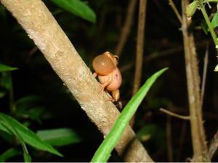
Wood Frogs and the Resurrection
HOW IMPORTANT IS THE RESURRECTION TO YOU?
WHAT DOES RESURRECTION MEAN TO YOU?

Slide 2
The Wood Frog
Live from Tennessee up north to above the Artic Circle
Frogs are cold blooded – their body will adjust to the temperature around them
But these frogs can live at 50 degrees below zero
Most of their body literally freezes and they die
No breathing, no heart beat

Slide 3
The Wood Frog
Some organ tissue has an antifreeze
Female frogs have antifreeze for the eggs they will lay in the spring
As the weather goes above freezing – they wake up
The first frogs you hear in the early spring – wood frog
They died – and were resurrected

Slide 4
Spring = Resurrection
Flowers, trees, animals all seem to come alive and become more active.
Now that you know about the resurrection of the Wood Frog - - -
What does the resurrection mean to you?

Slide 5
Resurrection Means:
Life is not over
This life is not all there is.
This life is temporary, but we will live on.

Slide 6
Resurrection Means:
We are eternal
Genesis 1:26
You will live forever – someplace
It is your choice where you live forever
Heaven with God and His angels
Hell with Satan and his angels

Slide 7
Resurrection Means:
I have an immortal soul
Mathew 10:28
What (Who) should we fear?

Slide 8
Resurrection Means:
I will see my brethren again
David – infant son
Paul – saints at Phillipi and Corinth
Godly men and women I have known
Christians who influenced my life

Slide 9
Resurrection Means:
I will see people of faith in the Bible
Abraham, Isaac and Jacob
David, Hezekiah, Elijah, Daniel
Paul, Peter, John, Barnabas
Prophets – Jeremiah, Ezekiel

Slide 10
Resurrection Means:
I will NOT be with all the wicked of this world
2Thessalonians 1:7-9
Matthew 25:41, 46
Revelation 21:7-8

Slide 11
Resurrection Means:
I will be with Jesus
Phillippians 1:22-23

Slide 12
Wood Frogs = Resurrection
HOW IMPORTANT IS RESURRECTION TO YOU?
WHAT DOES RESURRECTION MEAN TO YOU?

