Slide 1
Widen the Plate?
Should we just change the rules?

Slide 2
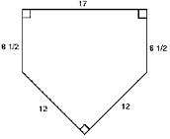
Home Plate – 17”

Slide 3
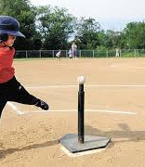
In T-Ball
Home Plate – 17”

Slide 4
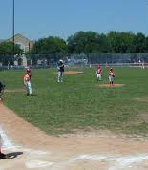
In Little League
Home Plate – 17”

Slide 5
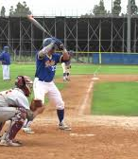
In High School
Home Plate – 17”

Slide 6
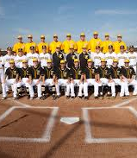
In College
Home Plate – 17”

Slide 7
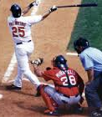
In Major Leagues
Home Plate – 17”

Slide 8
Baseball has a Standard size for home plate
At every level the home plate is 17” wide.
But there are some pitchers that have a difficult time getting the ball over the plate for a strike.
Talk with the coach. “If you could widen the plate to 22” or 24” I could throw more strikes.”
Coach – “If you can’t get the ball over the plate, I will put in another pitcher.
MESSAGE – YOU MUST CONFORM TO THE RULES – NOT CHANGE THEM.

Slide 9
LEARN THESE IMPORTANT LESSONS
There are rules (standards).
We must accept the standards, live by the rules.
Society can not change the rules to fit you.
You must change your life to fit the rules.

Slide 10
LEARN THESE IMPORTANT LESSONS
There are rules in America.
There are rules in the state of Tennessee.
There are rules in the city and county.
There are rules for our spiritual life.

Slide 11
LEARN THESE IMPORTANT LESSONS
School – There are rules – grades, dress code
To attend school – you must live by the rules
Do not try to “widen the plate”

Slide 12
LEARN THESE IMPORTANT LESSONS
School – There are rules – grades, dress code
To attend school – you must live by the rules
Do not try to “widen the plate”
Work – There is a rule book (manual)
To work there – you must follow the rules
Do not try to “widen the plate”

Slide 13
LEARN THESE IMPORTANT LESSONS
Sports – There are rule books with detailed rules, standards
To play that sport – you must live by the rules
Do not try to “widen the plate”

Slide 14
LEARN THESE IMPORTANT LESSONS
Sports – There are rule books with detailed rules, standards
To play that sport – you must live by the rules
Do not try to “widen the plate”
God – There is a rule book (the Bible)
To please God – live by the rules
Do not try to change the rules

Slide 15
APPLICATIONS
Church is a denomination
  Many are trying to make the Lords’ church just another denomination.
  1 Corinthians 12:20 But now indeed there are many members, yet one body.
  Ephesians 4:4 There is one body and one Spirit, just as you were called in one hope of your calling
Don’t widen the plate

Slide 16
APPLICATIONS
Church is a denomination
  1 Corinthians 12:25 that there should be no schism in the body, but that the members should have the same care for one another.
  Ephesians 2:16 and that He might reconcile them both to God in one body through the cross, thereby putting to death the enmity.
Don’t widen the plate

Slide 17
APPLICATIONS
Instrumental Music
  God has rules – sing and make melody
  Ephesians 5:19 speaking to one another in psalms and hymns and spiritual songs, singing and making melody in your heart to the Lord
  Colossians 3:16 Let the word of Christ dwell in you richly in all wisdom, teaching and admonishing one another in psalms and hymns and spiritual songs, singing with grace in your hearts to the Lord.
Don’t widen the plate

Slide 18
APPLICATIONS
Communion – 1st Day of the Week
  God has rules – Lord’s Day (1st day of the week)
  Not on Saturday; Not on Thursday
  Not just on special holidays
  Acts 20:7 Now on the first day of the week, when the disciples came together to break bread, Paul, ready to depart the next day, spoke to them and continued his message until midnight.
Don’t widen the plate

Slide 19
APPLICATIONS
Women preachers / elders
  God has rules – about the role of women in church
  1 Timothy 2:11-12 ¹¹ Let a woman learn in silence with all submission. ¹² And I do not permit a woman to teach or to have authority over a man, but to be in silence.
Don’t widen the plate

Slide 20
Don’t Widen the Plate
God has rules to become a Christian
  Believe in Jesus
  Turn from a life of sin
  Be baptized for forgiveness of sins
There are rules for when we sin
  Repent of the sin
  Pray for forgiveness

