Slide 1
Why are they leaving?
Not just Cades or churches of Christ, but across the religious world.
Baptist, Methodist, Pentecostal, Catholic, J. W., Mormon
Name a “Christian” group and they are losing members!

Slide 2
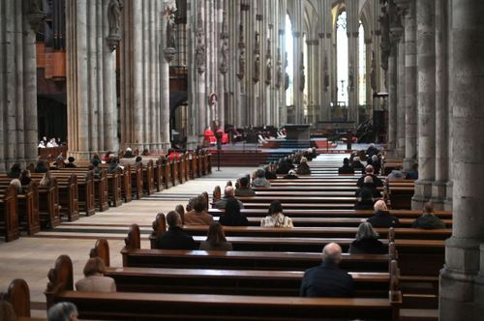
NYC Catholic Church Good Friday service.

Slide 3
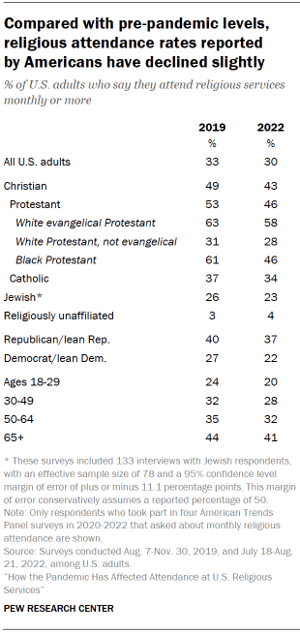

Slide 4
Jesus had many stop following Him!
(John 6:66) From that time many of His disciples went back and walked with Him no more.
(John 6:67) Then Jesus said to the twelve, "Do you also want to go away?"
(John 6:68) But Simon Peter answered Him, "Lord, to whom shall we go? You have the words of eternal life.
(John 6:69) Also we have come to believe and know that You are the Christ, the Son of the living God."

Slide 5
Why are they leaving?
They are not leaving the Baptists to become Mormons.
They are leaving religion – PERIOD.
They are leaving God, religion, the Bible, and faith.
A recent survey asked some – “Why did you leave?”

Slide 6
Here are some of their answers.
1. God just never shows up.
Natural disasters, war, hardship, hunger, crime
2. Their prayers were not answered.
3. They don’t believe the Bible is from God.
4. How could a loving God send people to Hell?

Slide 7
Here are some of their answers.
5. They all claim to be right. They can’t all be right.
This is a true observation.
Issue is to find the truth, not reject all.
6. They see no evidence of a supernatural God.
7. Christianity is just teachings borrowed from older religions and pagan cults.
8. Christianity is too oppressive / restrictive.

Slide 8
Here are some of their answers.
9. The Bible contradicts science and nature.
10. The Bible contradicts itself.
11. Christians are no better than non-Christians.
12. Some had bad experiences.
Corruption, greed, gossip, abuse

Slide 9
Here is our text for this lesson
(John 6:66) From that time many of His disciples went back and walked with Him no more.
(John 6:67) Then Jesus said to the twelve, "Do you also want to go away?"

Slide 10
What about us – here - today?
Since many are leaving religion with these reasons or excuses:
Why are you here today?

Slide 11
What about us – here - today?
Since many are leaving religion with these reasons or excuses:
Why are you here today?
Are some of the reasons given – valid?

Slide 12
What about us – here - today?
Since many are leaving religion with these reasons or excuses:
Why are you here today?
Are some of the reasons given – valid?
Could you be the reason someone rejects the church?

Slide 13
What about us – here - today?
Since many are leaving religion with these reasons or excuses:
Why are you here today?
Are some of the reasons given – valid?
Could you be the reason someone rejects the church?
Does your life attract or detract?

