Slide 1
Why don’t more obey?
What has changed that makes evangelism more difficult?

Slide 2
Current Trend
Gospel Meetings are not what they used to be
We stopped bringing the lost
Preachers stopped preaching to the lost
What has changed?

Slide 3
Has the gospel changed?
1 Corinthians 15:1-4 ¹ Moreover, brethren, I declare to you the gospel which I preached to you, which also you received and in which you stand, ² by which also you are saved, if you hold fast that word which I preached to you--unless you believed in vain. ³ For I delivered to you first of all that which I also received: that Christ died for our sins according to the Scriptures, ⁴ and that He was buried, and that He rose again the third day according to the Scriptures

Slide 4
Has the gospel changed?
Romans 1:16 For I am not ashamed of the gospel of Christ, for it is the power of God to salvation for everyone who believes, for the Jew first and also for the Greek.
The message is the same.
The power to save is still available.
The gospel has not changed.

Slide 5
Has preaching changed?
Style of preaching
Length of sermons
Emphasis

Slide 6
Has preaching changed?
Competition – sports, TV, movies, other activities
Many sermons are less Bible / more social
Most have already “heard it all.”
“Tell us something new.”

Slide 7
Have people changed?
We have less time
More concern for the material than spiritual
Attitude toward religion / church has changed

Slide 8
Have people changed?
Generational changes
  Baby Boomers – Right after World War 2
  Gen X – Born in the 60’s to 80’s
  Millennials – Born in the 90’s and 2K

Slide 9
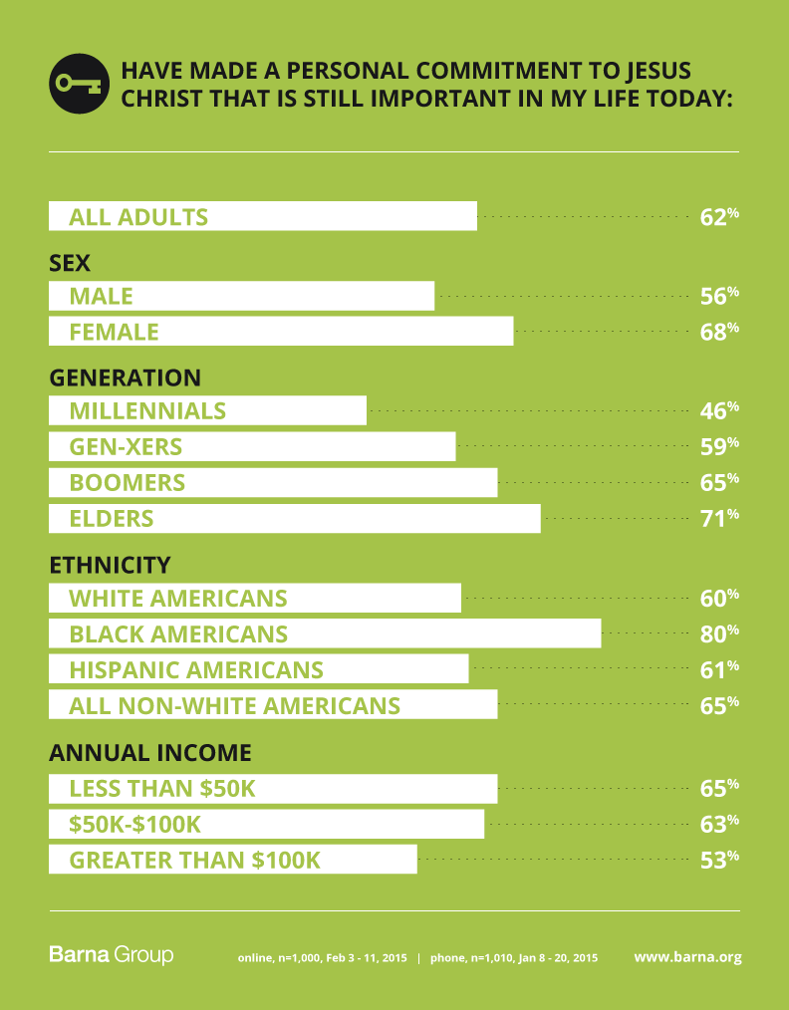

Slide 10
Has the church changed?
Are we trying to be like the world?
  1 Samuel 8:4-5 ⁴ Then all the elders of Israel gathered together and came to Samuel at Ramah, ⁵ and said to him, "Look, you are old, and your sons do not walk in your ways. Now make us a king to judge us like all the nations."
  Like all the nations
  This was their downfall

Slide 11
Has the church changed?
Are we more internal than external?
  More emphasis on us – food, fellowship, fun
  Less emphasis on others – help others, teach lost, encourage the weak

Slide 12
Has the world changed?
Attitude toward religion in general
Indifference / Apathy
Interest only late in life / serious illness

Slide 13
Has the world changed?
Busy with other things
Felix – Acts 24:25 Now as he reasoned about righteousness, self-control, and the judgment to come, Felix was afraid and answered, "Go away for now; when I have a convenient time I will call for you."

