Slide 1
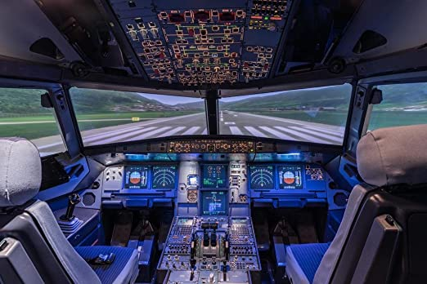
Who is at the controls?

Slide 2
Who makes your decisions?
Bumper sticker – God is my Co-Pilot
Someone added – You need to swap seats
It matters not how strait the gate,
How charged with punishment the scroll,
I am the master of my fate,
I am the captain of my soul.

Slide 3
1 – I am in control
Frank Sinatra song – I did it my way
“ I make my own choices – nobody tells me what to do.”
Nebuchadnezzar – lost his kingdom
Moses – kept out of the promised land
Felix and Agrippa – kept control of their lives
Prodigal Son – made his own choice

Slide 4
1 – I am in control
Luke 12:17-19 And he thought within himself, saying, 'What shall I do, since I have no room to store my crops?’ 18 So he said, 'I will do this: I will pull down my barns and build greater, and there I will store all my crops and my goods. 19 And I will say to my soul, "Soul, you have many goods laid up for many years; take your ease; eat, drink, and be merry." '

Slide 5
1 – I am in control
1Corinthians 10:24 Let no one seek his own, but each one the other's well-being.
Philippians 2:3-5 Let nothing be done through selfish ambition or conceit, but in lowliness of mind let each esteem others better than himself. 4 Let each of you look out not only for his own interests, but also for the interests of others. 5 Let this mind be in you which was also in Christ Jesus,

Slide 6
2 – others are in control
Puplic opinion, peer pressure
1 Samuel 15:24 Then Saul said to Samuel, "I have sinned, for I have transgressed the commandment of the LORD and your words, because I feared the people and obeyed their voice.
Adam put the blame on Eve.
Aaron made Golden Calf by public demand

Slide 7
2 – others are in control
Pilate wanted to set Jesus free
Peter and Barnabas were hypocrites – Galatians 2:11-13
Galatians 1:10 For do I now persuade men, or God? Or do I seek to please men? For if I still pleased men, I would not be a bondservant of Christ.

Slide 8
2 – others are in control
Luke 16:15 And He said to them, "You are those who justify yourselves before men, but God knows your hearts. For what is highly esteemed among men is an abomination in the sight of God.

Slide 9
3 – God is in control
IF GOD IS YOUR CO-PILOT – SWAP SEATS!
Luke 16:13 "No servant can serve two masters; for either he will hate the one and love the other, or else he will be loyal to the one and despise the other. You cannot serve God and mammon."

Slide 10
Is god in control of your life?
There are 3 choices
Yourself, Others or God
If God is not in control
Your life has no pilot!

