Slide 1
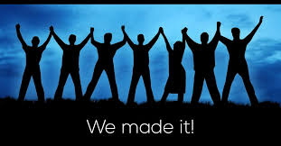
We Made It - 2021
2020 was a difficult year for all of us
BUT WE SURVIVED!

Slide 2
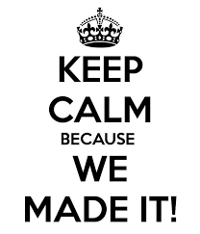
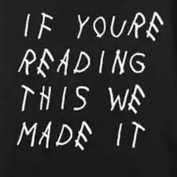

Slide 3
2021 – Has the crisis ended?
NO, we are not completely over all the issues
There are still challenges ahead of us, more hills to climb, more obstacles to overcome
But the first step has been reached, WE MADE IT OUT OF 2020!

Slide 4
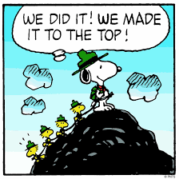
2021 – We survived 2020!
We have vaccines on the way.
We can soon try to find the “new normal”
When one comes through a crisis – there is a time to celebrate, reflect and mostly – REJOICE!
Let’s see how others made it.

Slide 5
AFTER THE FLOOD
(Genesis 8:18-21) So Noah went out, and his sons and his wife and his sons' wives with him. (19) Every animal, every creeping thing, every bird, and whatever creeps on the earth, according to their families, went out of the ark. (20) Then Noah built an altar to the LORD, and took of every clean animal and of every clean bird, and offered burnt offerings on the altar. (21) And the LORD smelled a soothing aroma. Then the LORD said in His heart, "I will never again curse the ground for man's sake, although the imagination of man's heart is evil from his youth; nor will I again destroy every living thing as I have done.

Slide 6
OUT OF EGYPTIAN BONDAGE
(Exodus 15:1-3) Then Moses and the children of Israel sang this song to the LORD, and spoke, saying: "I will sing to the LORD, For He has triumphed gloriously! The horse and its rider He has thrown into the sea! (2) The LORD is my strength and song, And He has become my salvation; He is my God, and I will praise Him; My father's God, and I will exalt Him. (3) The LORD is a man of war; The LORD is His name.

Slide 7
OUT OF EGYPTIAN BONDAGE
(Exodus 15:20-21) Then Miriam the prophetess, the sister of Aaron, took the timbrel in her hand; and all the women went out after her with timbrels and with dances. (21) And Miriam answered them: "Sing to the LORD, For He has triumphed gloriously! The horse and its rider He has thrown into the sea!"

Slide 8
ENTER THE PROMISED LAND
(Joshua 4:21-24) Then he spoke to the children of Israel, saying: "When your children ask their fathers in time to come, saying, 'What are these stones?’ (22) then you shall let your children know, saying, 'Israel crossed over this Jordan on dry land’; (23) for the LORD your God dried up the waters of the Jordan before you until you had crossed over, as the LORD your God did to the Red Sea, which He dried up before us until we had crossed over, (24) that all the peoples of the earth may know the hand of the LORD, that it is mighty, that you may fear the LORD your God forever."

Slide 9
OUT OF BABYLONIAN CAPTIVITY
(Nehemiah 2:17) Then I said to them, "You see the distress that we are in, how Jerusalem lies waste, and its gates are burned with fire. Come and let us build the wall of Jerusalem, that we may no longer be a reproach."
(Nehemiah 4:6) So we built the wall, and the entire wall was joined together up to half its height, for the people had a mind to work.

Slide 10
PAUL ESCAPES DAMASCUS
(Acts 9:23-25) Now after many days were past, the Jews plotted to kill him. (24) But their plot became known to Saul. And they watched the gates day and night, to kill him. (25) Then the disciples took him by night and let him down through the wall in a large basket.

Slide 11
PETER OUT OF PRISON
(Acts 12:11-12) And when Peter had come to himself, he said, "Now I know for certain that the Lord has sent His angel, and has delivered me from the hand of Herod and from all the expectation of the Jewish people.“ (12) So, when he had considered this, he came to the house of Mary, the mother of John whose surname was Mark, where many were gathered together praying.

Slide 12
PAUL ESCAPES THE RIOT AT EPHESUS
(Acts 20:1-2) After the uproar had ceased, Paul called the disciples to himself, embraced them, and departed to go to Macedonia. (2) Now when he had gone over that region and encouraged them with many words, he came to Greece

Slide 13
THIS IS OUR TIME TO CELEBRATE
After the disaster is over – rejoice
After the danger has passed – make merry
After the predicament has ended – praise God
After the threat has ceased - express joy
After the crisis – it is time to worship God in celebration

