Slide 1
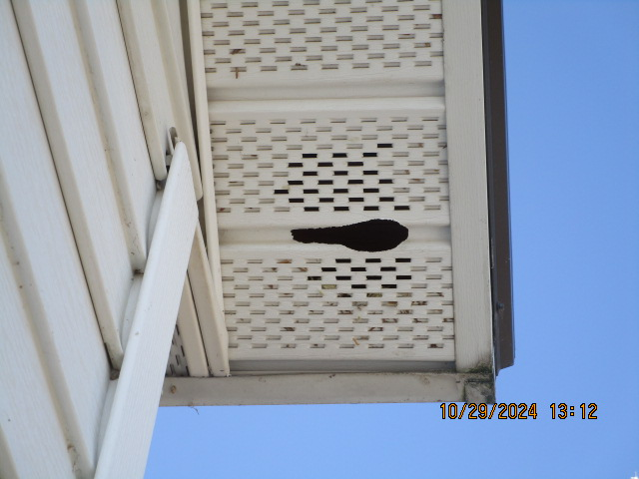
The Preacher’s work Stop the Squirrels

Slide 2
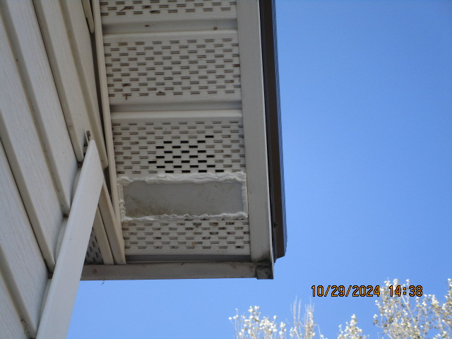
The Preacher’s work Stop the Squirrels

Slide 3
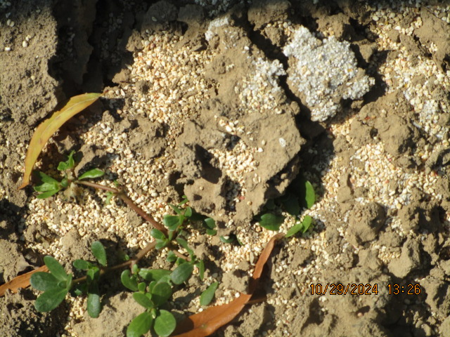
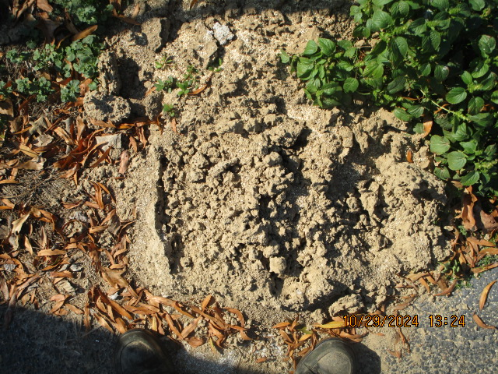
The Preacher’s work Kill Fire Ants – attempt #3 to kill these mounds

Slide 4
Vision for A lost world
Luke 24:45-47

Slide 5
LUKE 24:45-47
(45) And He opened their understanding, that they might comprehend the Scriptures.
(46) Then He said to them, "Thus it is written, and thus it was necessary for the Christ to suffer and to rise from the dead the third day,
(47) and that repentance and remission of sins should be preached in His name to all nations, beginning at Jerusalem.

Slide 6
introduction
We know about the Great Commission
The Apostles were commanded to go into all the world and preach the gospel.
Then they were to teach the converts to do the same.
This is a perpetual command – passed on to us in 2024.
What is our response to this command from Christ?

Slide 7
Three facts to know
1. All not baptized are lost!
Mark 16:16 – believe + baptism = salvation
Acts 22:16 – baptism washes away sins
1 Peter 3:21 – baptism saves us

Slide 8
Three facts to know
1. All not baptized are lost!
2. The Gospel is the only power to save.
(Romans 1:16) For I am not ashamed of the gospel of Christ, for it is the power of God to salvation for everyone who believes, for the Jew first and also for the Greek.

Slide 9
Three facts to know
1. All not baptized are lost!
2. The Gospel is the only power to save.
3. Christians are God’s only messengers.
(Romans 10:14) How then shall they call on Him in whom they have not believed? And how shall they believe in Him of whom they have not heard? And how shall they hear without a preacher?

Slide 10
Three things to understand
1. Value of a soul – Matthew 16:26
(Mat 16:26) For what profit is it to a man if he gains the whole world, and loses his own soul? Or what will a man give in exchange for his soul?
2. Length of eternity
3. Meaning of hell

Slide 11
Three powers to use
1. Heart – love – Psalm 126:6 Go even weeping
2. Head – think, reason (not argue) – Isaiah 1:18
3. Foot – Go, Ask, Seek, Knock

Slide 12
Three Motives to move us
1. Punishment of Hell
2. Hope of heaven
3. Love of God

Slide 13
Three attitudes to have
1. Optimistic
NOT: You don’t want to study the Bible, do you?
2. Golden Rule
IF you were lost, what you want someone to do for you?
3. Meekness – Gentle, kind

