Slide 1
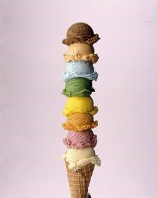
Don’t Order Vanilla
There are many choices and options. We don’t have to settle for plain vanilla Christianity.

Slide 2
Far Side Cartoon
The wife is speaking to her husband in full battle armor ready for war.
She says, “I want you to be more assertive. I’m tired of everyone calling you Alexander the Pretty Good.”

Slide 3
The famous chain of ice cream stores advertise “31 Flavors” to choose from.
With all those delicious choices – We do not have to settle for the plain, common, ordinary – vanilla.
NOTE: Nothing wrong with vanilla. But there are more options available.

Slide 4
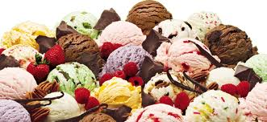
Worship is not Vanilla
SINGING
Learn new songs
Our singing should “shake the rafters” off the building.
Sing with spirit – 1 Corinthians 14:15b - I will sing with the spirit, and I will also sing with the understanding.

Slide 5
Worship is not Vanilla
SINGING
SINGING – With no excitement or enthusiasm = VANILLA
SINGING – Without knowing or meaning what we sing = VANILLA

Slide 6
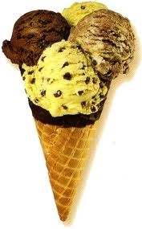
Worship is not Vanilla
PRAYER
When we have a puny faith – we will pray puny prayers.
Challenge – Let’s try to “out ask” God.
Now to Him who is able to do exceedingly abundantly above all that we ask or think, according to the power that works in us, Ephesians 3:20

Slide 7
Worship is not Vanilla
PRAYER
We must pray in faith.
We must pray without doubting.
We must learn to pray with boldness.
Let us therefore come boldly to the throne of grace, that we may obtain mercy and find grace to help in time of need. Hebrews 4:16

Slide 8
Worship is not Vanilla
PRAYER
Vain repetitions = VANILLA
Pious platitudes = VANILLA
Prayer without faith, prayer without conviction = VANILLA

Slide 9
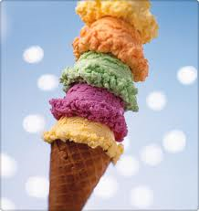
Worship is not Vanilla
COMMUNION
“Do this in remembrance of me.”
Discern the Lord’s body
Not - - -
Just a habit we do every week
Just a routine
Just a ceremony
Just a filler in the worship service.

Slide 10
Worship is not Vanilla
COMMUNION
²⁷ Therefore whoever eats this bread or drinks this cup of the Lord in an unworthy manner will be guilty of the body and blood of the Lord. ²⁸ But let a man examine himself, and so let him eat of the bread and drink of the cup. ²⁹ For he who eats and drinks in an unworthy manner eats and drinks judgment to himself, not discerning the Lord's body. 1 Corinthians 11:27-29

Slide 11
Worship is not Vanilla
COMMUNION
If we approach the Lord’s Supper as mundane, routine, ho-hum: If we fail to focus on the death, burial and resurrection of Jesus:
THEN: We have made communion = VANILLA

Slide 12
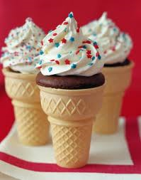
Worship is not Vanilla
STUDY
We must make the Bible come alive.
We must learn what God wants me to do.
Today:
Sermonettes will make Christianettes
Preachers don’t have the right to bore you to death
Teachers and preachers try to entertain everyone instead of instructing and edifying us

Slide 13
Worship is not Vanilla
STUDY
The study of the Bible
Private, personal daily study
Class, sermon, meeting – public study
We must keep the message ALIVE
The Bible is not a dead letter
If Bible study is dull, boring = VANILLA

Slide 14
Worship is not Vanilla
GIVING
Giving is the most genuine act of worship
We give as we appreciate God’s blessings
We give according to how we Thank God
Our contribution tells God how much we appreciate all the spiritual and material blessings God gave to us.

Slide 15
Worship is not Vanilla
GIVING
We are to give with a genuine feeling of joy, with deep down happiness, with real cheerfulness
So let each one give as he purposes in his heart, not grudgingly or of necessity; for God loves a cheerful giver. 2 Corinthians 9:7

Slide 16
Worship is not Vanilla
GIVING
³ And they received from Moses all the offering which the children of Israel had brought for the work of the service of making the sanctuary. So they continued bringing to him freewill offerings every morning. ⁴ Then all the craftsmen who were doing all the work of the sanctuary came, each from the work he was doing, Exodus 36:3-4

Slide 17
Worship is not Vanilla
GIVING
⁵ and they spoke to Moses, saying, "The people bring much more than enough for the service of the work which the Lord commanded us to do." ⁶ So Moses gave a commandment, and they caused it to be proclaimed throughout the camp, saying, "Let neither man nor woman do any more work for the offering of the sanctuary." And the people were restrained from bringing, Exodus 36:5-6

Slide 18
Worship is not Vanilla
GIVING
⁷ for the material they had was sufficient for all the work to be done--indeed too much. Exodus 36:7
When was the last time the elders asked you to STOP giving?
Has the preacher begged to to quit giving so much?

Slide 19
Worship is not Vanilla
GIVING
When we give a piddling amount:
When we give God the “leftovers”:
When we give because we have to:
THEN: We our giving = VANILLA

Slide 20
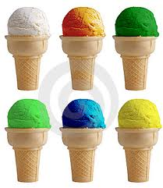
Don’t Order Vanilla
WORSHIP
This sermon is about worship – not ice cream.
You can eat vanilla ice cream any time you desire.
WHEN IT COMES TO OUR WORSHIP - - DON’T ORDER VANILLA!

