Slide 1
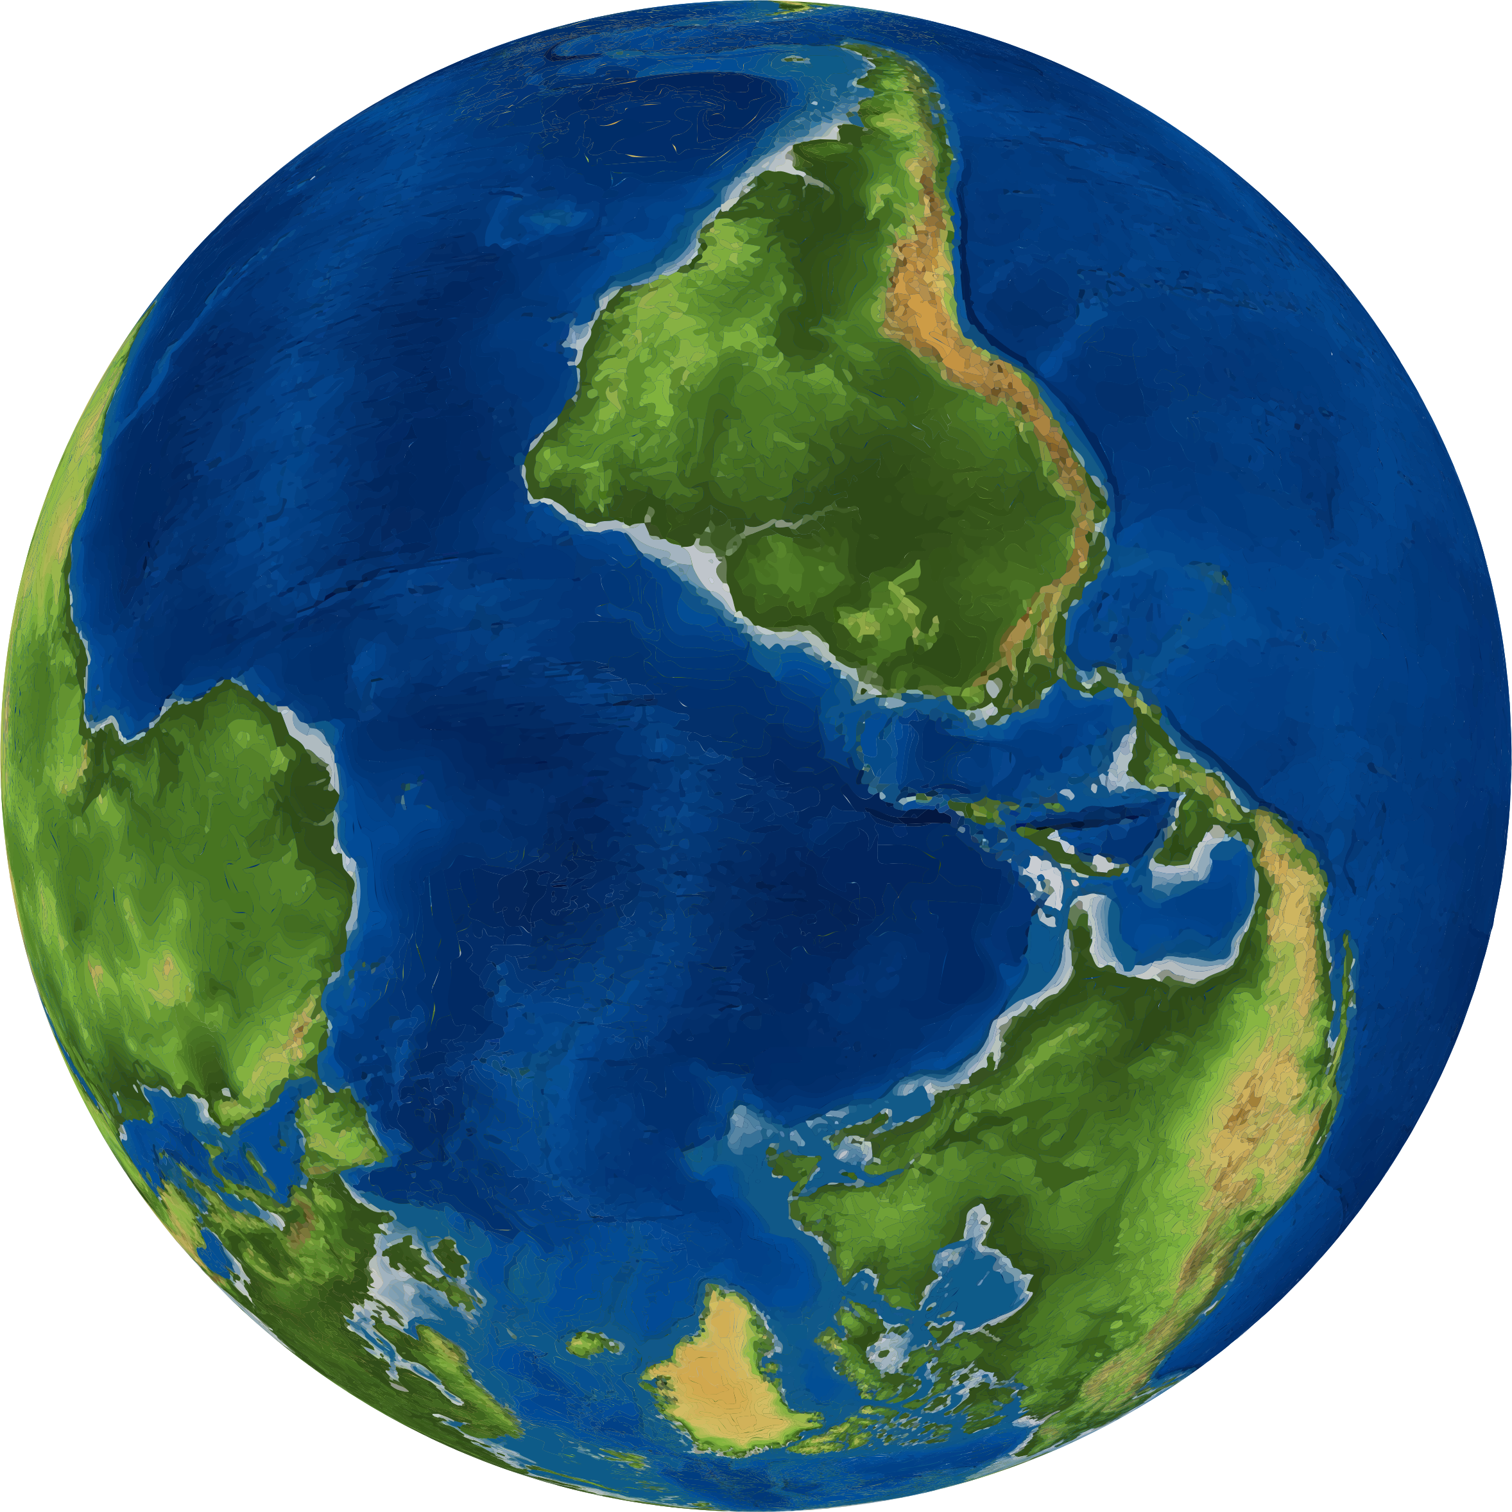
A World upside down
Acts 17:5-6

Slide 2
Acts 17:5-6
(Act 17:5) But the Jews who were not persuaded, becoming envious, took some of the evil men from the marketplace, and gathering a mob, set all the city in an uproar and attacked the house of Jason, and sought to bring them out to the people.
(Act 17:6) But when they did not find them, they dragged Jason and some brethren to the rulers of the city, crying out, "These who have turned the world upside down have come here too.

Slide 3
Introduction
THEY TURNED THE WORLD UPSIDE DOWN IN ORDER TO GET IT RIGHT SIDEUP.
WHAT WRONGS DO WE NEED TO STAND UP FOR?
ARE WE WILLING TO GO TO JAIL? WILLING TO DIE? WORK FOR THE CAUSE OF CHRIST?

Slide 4
Introduction
THEY TURNED THE WORLD UPSIDE DOWN IN ORDER TO GET IT RIGHT SIDE UP.
While we live in a very different world, we face the same issues. Our challenge is to get the world right side up with God.
IS OUR WORLD UPSIDE DOWN?

Slide 5
WHAT IS UPSIDE DOWN? GOD
God is upside down in our world.
God’s name in vain
Profanity, vulgar speech

Slide 6
WHAT IS UPSIDE DOWN? GOD
God is upside down in our world.
God’s name in vain
Profanity, vulgar speech
Evolution – deny creation

Slide 7
WHAT IS UPSIDE DOWN? GOD
God is upside down in our world.
God’s name in vain
Profanity, vulgar speech
Evolution – deny creation
Providence – many scoff at prayer

Slide 8
WHAT IS UPSIDE DOWN? jesus
Jesus is upside down in our world.
Reject His miracles

Slide 9
WHAT IS UPSIDE DOWN? jesus
Jesus is upside down in our world.
Reject His miracles
Deny the virgin birth

Slide 10
WHAT IS UPSIDE DOWN? jesus
Jesus is upside down in our world.
Reject His miracles
Deny the virgin birth
Don’t believe in the resurrection

Slide 11
WHAT IS UPSIDE DOWN? jesus
Jesus is upside down in our world.
Reject His miracles
Deny the virgin birth
Don’t believe in the resurrection
Not ready for 2nd Coming

Slide 12
WHAT IS UPSIDE DOWN? church
Church is upside down in our world.
One church – not thousands
(Eph 4:4) There is one body and one Spirit, just as you were called in one hope of your calling;
(Col 1:18) And He is the head of the body, the church, who is the beginning, the firstborn from the dead, that in all things He may have the preeminence.

Slide 13
WHAT IS UPSIDE DOWN? church
Church is upside down in our world.
What many object to is the “church” as it is in the world – divided, oppose each other, disagree
(Eph 4:3) endeavoring to keep the unity of the Spirit in the bond of peace.
(Eph 4:13) till we all come to the unity of the faith and of the knowledge of the Son of God, to a perfect man, to the measure of the stature of the fullness of Christ;

Slide 14
WHAT IS UPSIDE DOWN? bible
Bible is upside down in our world.
Word of God vs. contains the will of God
(2Ti 3:16) All Scripture is given by inspiration of God, and is profitable for doctrine, for reproof, for correction, for instruction in righteousness,
(Joh 17:17) Sanctify them by Your truth. Your word is truth.

Slide 15
WHAT IS UPSIDE DOWN? bible
Bible is upside down in our world.
Bible is a good guide, but not rules to obey.
(Mat 4:4) But He answered and said, "It is written, 'MAN SHALL NOT LIVE BY BREAD ALONE, BUT BY EVERY WORD THAT PROCEEDS FROM THE MOUTH OF GOD.’ “
(1Jn 2:16-17) For all that is in the world—the lust of the flesh, the lust of the eyes, and the pride of life—is not of the Father but is of the world. (17) And the world is passing away, and the lust of it; but he who does the will of God abides forever.

Slide 16
WHAT IS UPSIDE DOWN? bible
Bible is upside down in our world.
The Bible is NOT of human origin.
(2Pe 1:21) for prophecy never came by the will of man, but holy men of God spoke as they were moved by the Holy Spirit.

Slide 17
Our task – get it right side up
Just like those in Acts 17, we are in a world that is upside down about:
God
Jesus
Church
Bible

Slide 18
Our task – get it right side up
Just like those in Acts 17, we are in a world that is upside down.
Our challenge is to turn the world upside down, to get it right side up!

