Slide 1
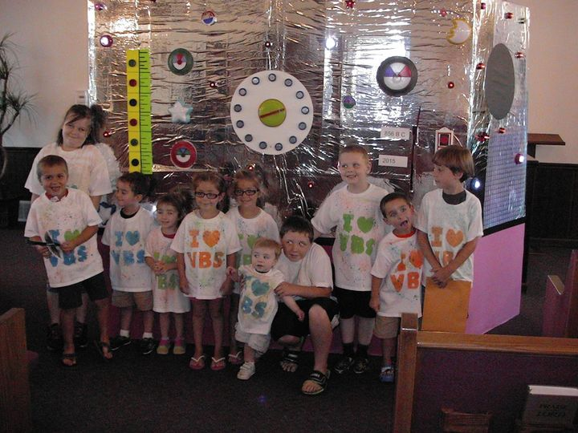
VBS at Cades 7 years ago Do you recognize anybody?

Slide 2
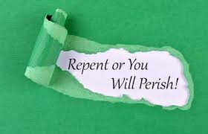

Slide 3
Luke 13:1-3
(Luke 13:1) There were present at that season some who told Him about the Galileans whose blood Pilate had mingled with their sacrifices.
(Luke 13:2) And Jesus answered and said to them, "Do you suppose that these Galileans were worse sinners than all other Galileans, because they suffered such things?
(Luke 13:3) I tell you, no; but unless you repent you will all likewise perish.

Slide 4
Luke 13:4-5
(Luke 13:4) Or those eighteen on whom the tower in Siloam fell and killed them, do you think that they were worse sinners than all other men who dwelt in Jerusalem?
(Luke 13:5) I tell you, no; but unless you repent you will all likewise perish."

Slide 5
1) Jesus preached – Current Events
War, storms, disasters
Mass shootings, riots
Some Galileans were killed by Pilate
18 died in a construction accident
WHAT CAN WE LEARN FROM CURRENT EVENTS?
We will die of something, at sometime.
We must be ready to meet God.

Slide 6
2) Jesus preached that sin is deadly
Sin is spiritually deadly
Sin will be eternally punished
Jesus did not “sugar coat” the message
Gehenna – Greek word for eternal fire – 12 times in the NT
11 of the 12 times were spoken by Jesus
10 of the 11 times Jesus used this word was in a public setting

Slide 7
3) Jesus supports government as God’s agent
He did not condemn Pilate
(Romans 13:1) Let every soul be subject to the governing authorities. For there is no authority except from God, and the authorities that exist are appointed by God.
(Romans 13:2) Therefore whoever resists the authority resists the ordinance of God, and those who resist will bring judgment on themselves.
(Romans 13:3) For rulers are not a terror to good works, but to evil. Do you want to be unafraid of the authority? Do what is good, and you will have praise from the same.

Slide 8
4) Jesus taught that God punishes
Some deaths are accidents, terror attacks, war
God is aware of all that happens
(Psalms 139:4) For there is not a word on my tongue, But behold, O LORD, You know it altogether.
(Psalms 139:5) You have hedged me behind and before, And laid Your hand upon me.
(Psalms 139:6) Such knowledge is too wonderful for me; It is high, I cannot attain it.

Slide 9
5) When lost men die – judgment is next
(Hebrews 9:27) And as it is appointed for men to die once, but after this the judgment,
THERE IS NO SECOND CHANCE AFTER DEATH.
THE SECOND CHANCE IS NOW – BEFORE WE DIE.
(2 Corinthians 6:2) For He says: "IN AN ACCEPTABLE TIME I HAVE HEARD YOU, AND IN THE DAY OF SALVATION I HAVE HELPED YOU." Behold, now is the accepted time; behold, now is the day of salvation.

Slide 10
6) Jesus preached – Repent or Perish
Repent was preached through out the Bible.
Moses to Israel
Jonah to Nineveh
John the Baptizer to Judah
Jesus to his listeners
Peter on Pentecost
Paul on Mars Hill in Athens, Greece

Slide 11
6) Jesus preached – Repent or Perish
(Acts 2:38) Then Peter said to them, "Repent, and let every one of you be baptized in the name of Jesus Christ for the remission of sins; and you shall receive the gift of the Holy Spirit.
(Acts 17:30) Truly, these times of ignorance God overlooked, but now commands all men everywhere to repent,

Slide 12
6) Jesus preached – Repent or Perish
(Acts 3:19) Repent therefore and be converted, that your sins may be blotted out, so that times of refreshing may come from the presence of the Lord,
(2 Peter 3:9) The Lord is not slack concerning His promise, as some count slackness, but is longsuffering toward us, not willing that any should perish but that all should come to repentance.

