Slide 1
Transfer the Mantle
1 Kings 19:19; 2 Kings 3:29-31

Slide 2
Introduction
I began preaching part-time in 1959 (65 years ago).
I have been preaching full-time since 1966 (58 years).
I have worked with 10 congregations in 4 states and 3 foreign countries.

Slide 3
Introduction
The situation here is unique.
We have a new preacher coming, but I am still here.
The purpose of this sermon is to “Transfer the Mantle” to a new minister.
There are several examples in the NT.

Slide 4
Elijah to Elisha
1 Kings 19:19 So, he departed from there, and found Elisha the son of Shaphat, who was plowing with twelve yoke of oxen before him, and he was with the twelfth. Then Elijah passed by him and threw his mantle on him.
This is symbolic of a transfer of power from Elijah to Elisha.

Slide 5
2 Kings 3:8-11
(8) Now Elijah took his mantle, rolled it up, and struck the water; and it was divided this way and that, so that the two of them crossed over on dry ground. (9) And so it was, when they had crossed over, that Elijah said to Elisha, "Ask! What may I do for you, before I am taken away from you?" Elisha said, "Please let a double portion of your spirit be upon me.“ (10) So he said, "You have asked a hard thing. Nevertheless, if you see me when I am taken from you, it shall be so for you; but if not, it shall not be so.“ (11) Then it happened, as they continued on and talked, that suddenly a chariot of fire appeared with horses of fire, and separated the two of them; and Elijah went up by a whirlwind into heaven.

Slide 6
2 Kings 3:12-14
(12) And Elisha saw it, and he cried out, "My father, my father, the chariot of Israel and its horsemen!" So he saw him no more. And he took hold of his own clothes and tore them into two pieces. (13) He also took up the mantle of Elijah that had fallen from him, and went back and stood by the bank of the Jordan. (14) Then he took the mantle of Elijah that had fallen from him, and struck the water, and said, "Where is the LORD God of Elijah?" And when he also had struck the water, it was divided this way and that; and Elisha crossed over.

Slide 7
Moses to Joshua
(Deu 31:7) Then Moses called Joshua and said to him in the sight of all Israel, "Be strong and of good courage, for you must go with this people to the land which the LORD has sworn to their fathers to give them, and you shall cause them to inherit it.
(Deu 31:14) Then the LORD said to Moses, "Behold, the days approach when you must die; call Joshua, and present yourselves in the tabernacle of meeting, that I may inaugurate him." So Moses and Joshua went and presented themselves in the tabernacle of meeting.

Slide 8
Moses to Joshua
(Deu 32:44) So Moses came with Joshua the son of Nun and spoke all the words of this song in the hearing of the people.
(Deu 34:9) Now Joshua the son of Nun was full of the spirit of wisdom, for Moses had laid his hands on him; so the children of Israel heeded him, and did as the LORD had commanded Moses.

Slide 9
John the Baptist to Christ
(Joh 1:29) The next day John saw Jesus coming toward him, and said, "Behold! The Lamb of God who takes away the sin of the world!
(Joh 1:30) This is He of whom I said, 'After me comes a Man who is preferred before me, for He was before me.'

Slide 10
John the Baptist to Christ
(Joh 3:29-31) He who has the bride is the bridegroom; but the friend of the bridegroom, who stands and hears him, rejoices greatly because of the bridegroom's voice. Therefore, this joy of mine is fulfilled. (30) He must increase, but I must decrease. (31) He who comes from above is above all; he who is of the earth is earthly and speaks of the earth. He who comes from heaven is above all.

Slide 11
Mary from Jesus to John
(Joh 19:25) Now there stood by the cross of Jesus His mother, and His mother's sister, Mary the wife of Clopas, and Mary Magdalene.
(Joh 19:26) When Jesus therefore saw His mother, and the disciple whom He loved standing by, He said to His mother, "Woman, behold your son!"
(Joh 19:27) Then He said to the disciple, "Behold your mother!" And from that hour that disciple took her to his own home.

Slide 12
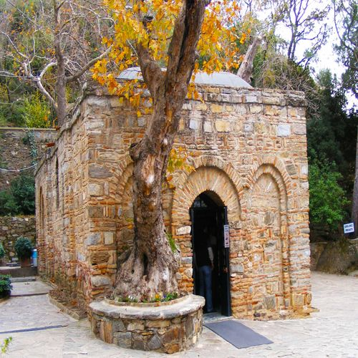
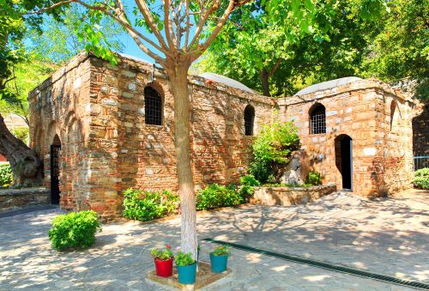
Mary from Jesus to John
In the city of Ephesus is this house that belonged to Mary. It is next door to a larger house that belonged to John.

Slide 13
Transfer the Mantle
I pray that the Dustin Semore can help this church.
I hope that the church will support him and love him as you have Janet and me.

Slide 14
Conclusion
There will always be a need to “Transfer the Mantle” because we all face death.
(1Corinthians 15:22) For as in Adam all die, even so in Christ all shall be made alive.

