Slide 1
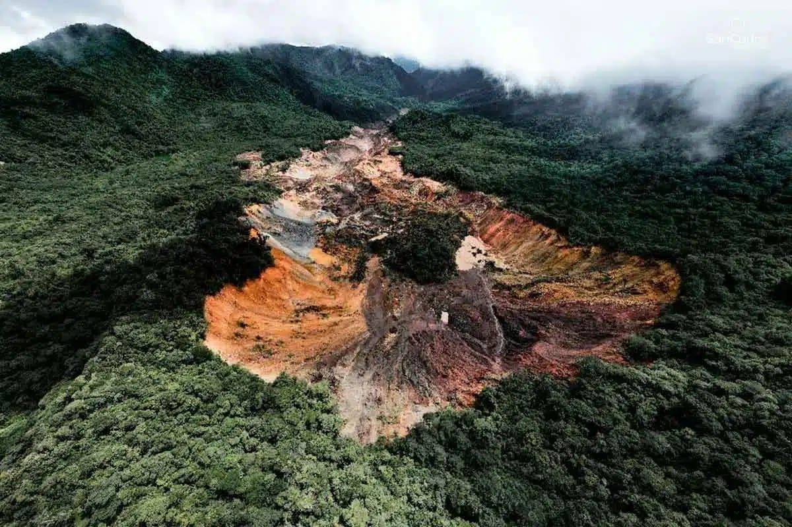
Heavy rain, flash flooding

Slide 2
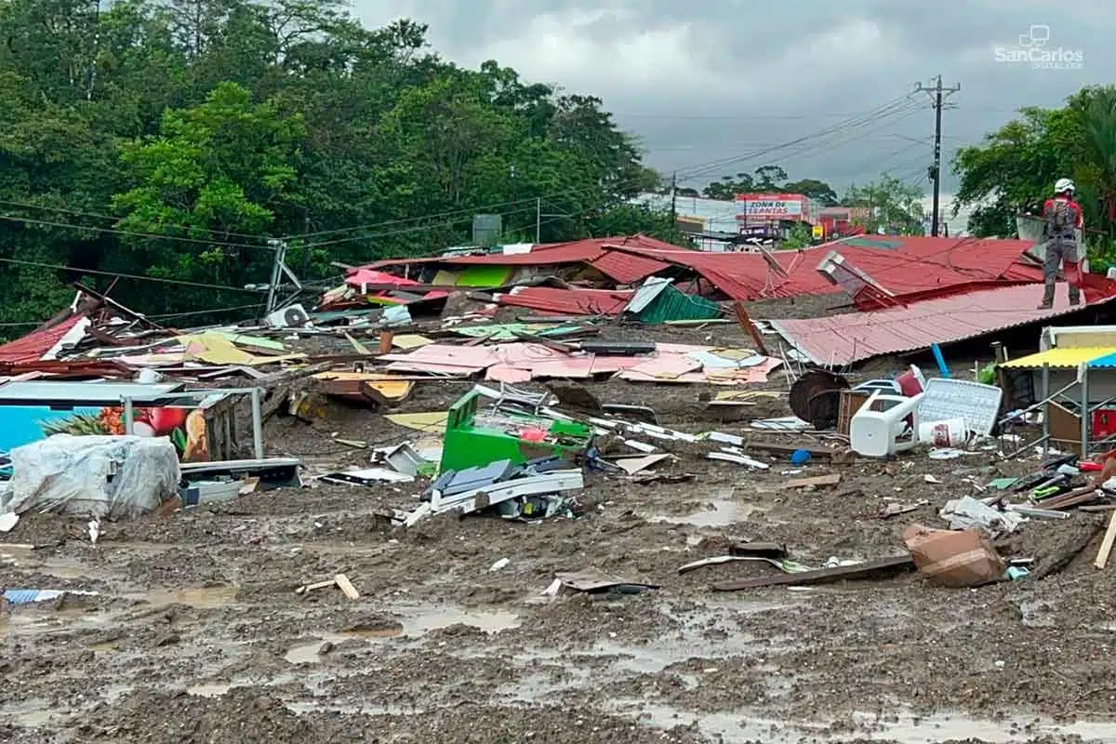
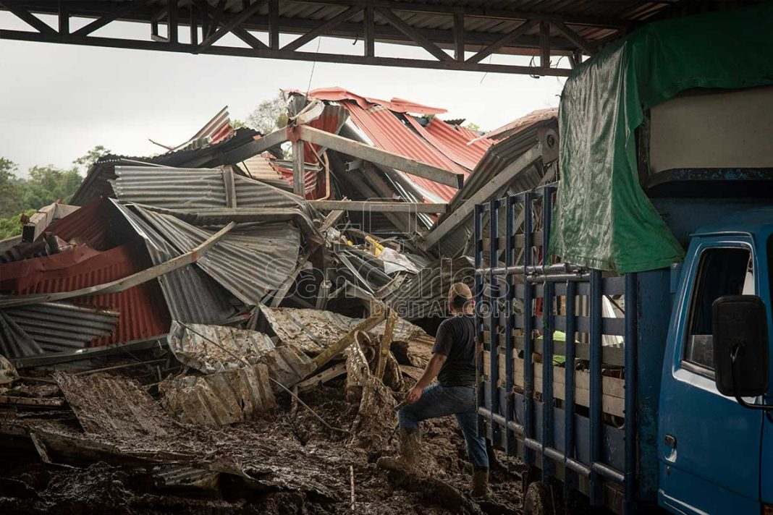
Many buildings destroyed

Slide 3
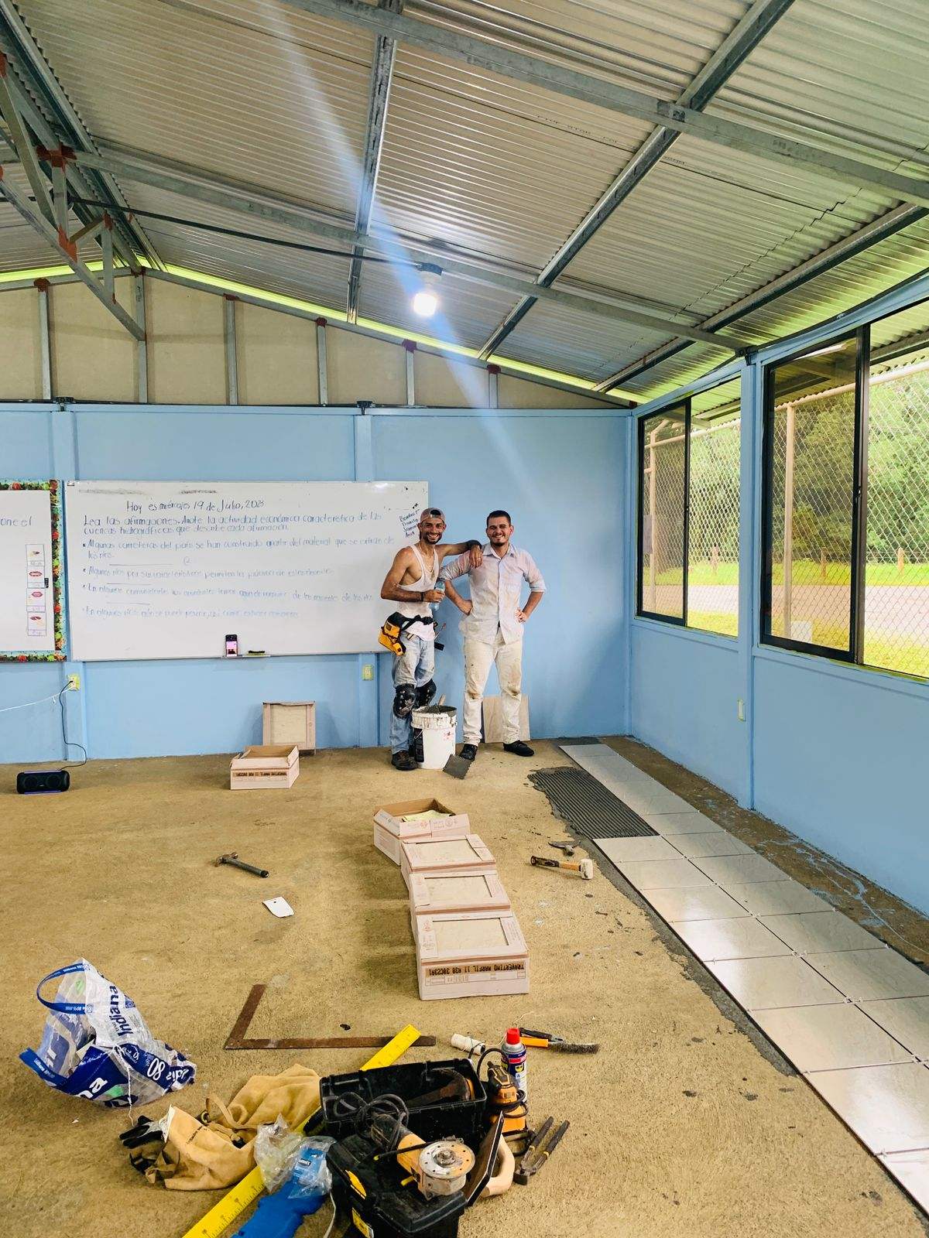
Help with a school flooring

Slide 4
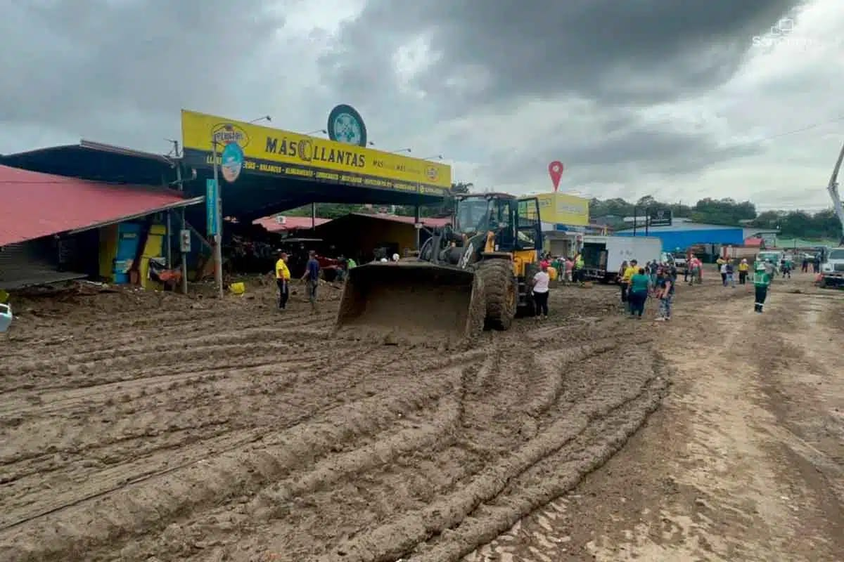
Beginning clean up

Slide 5
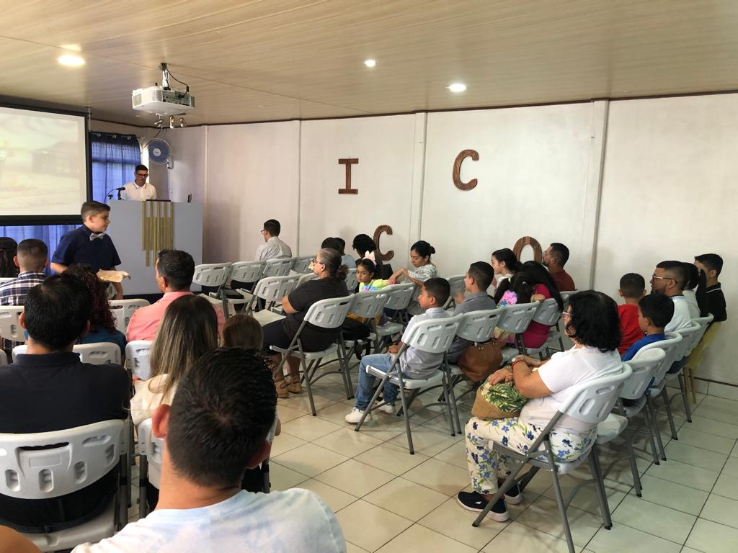
Sunday at Quesada I count 43

Slide 6
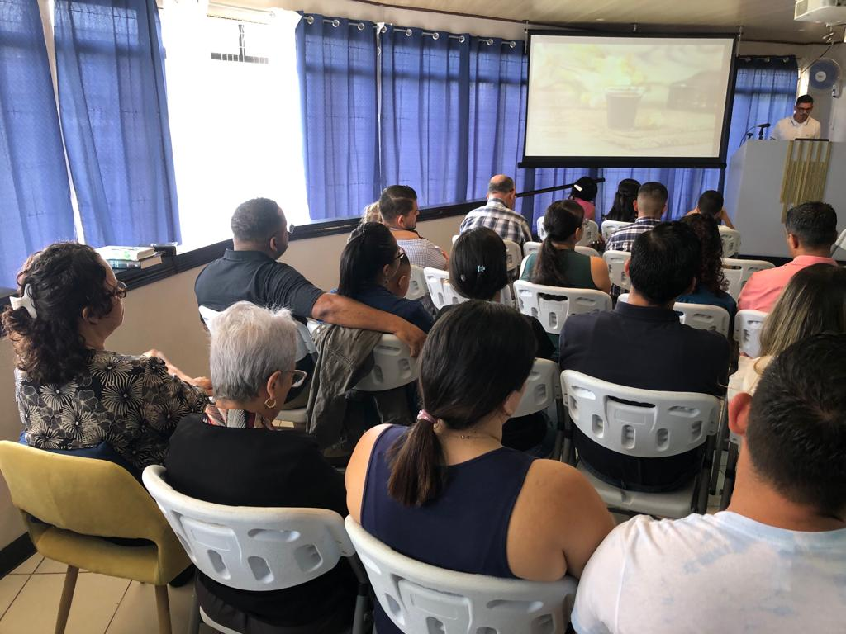
Same time; Other side

Slide 7
This is that
ACTS 2:14-18

Slide 8
Acts 2:14-18
(14) But Peter, standing up with the Eleven, lifted up his voice and said to them, Men, Jews, and all who dwell at Jerusalem, let this be known to you, and listen to my words.
(15) For these are not drunk as you suppose, for it is the third hour of the day.
(16) But this is that which was spoken by the prophet Joel:
(17) "And it shall be in the last days, says God, I will pour out of My Spirit upon all flesh. And your sons and your daughters shall prophesy, and your young men shall see visions, and your old men shall dream dreams.
(18) And in those days I will pour out My Spirit upon My slaves and My slave women, and they shall prophesy.

Slide 9
Background
50 days after the resurrection of Christ
10 days after Jesus returned to Heaven
Pentecost = 50 days after Jewish Passover
Thousands were present because of the Jewish Holy Day
Apostles were speaking in languages they had not learned
Some think they are drunk –
It is only 9 AM.
All fermented wine was thrown out.
Drunk on NEW wine is not a real possibility.

Slide 10
1 This is That
Prophecy from Joel 2
Fulfilled in your presence
Not some, not close, not almost
THIS IS THAT
Jesus fulfilled EVERY prophecy
Jigsaw Puzzle
Many pieces look similar
But only one FITS.

Slide 11
2 THIS (now, today) is NOT THAT
Now, this moment, this event
Not talking about miracle, tongues, healing, etc.
(Joh 14:12) Truly, truly, I say to you, He who believes on Me, the works that I do he shall do also, and greater works than these he shall do, because I go to My Father.
These miracles became “show”, “look at me”
See 1 Corinthians 12-14
OUR GREATER WORK IS STILL AVAILABLE!!!

Slide 12
2 THIS (now, today) is NOT THAT
Let’s talk about Conviction, Boldness, Willing to work, Commitment
We are NOT the first century church
In love, compassion, caring
In evangelism, restoring those fallen away
In active faith, conviction, boldness
In commitment to the cause of Christ
What has happened to that power?

Slide 13
3 THIS (now, today) COULD BE THAT
God promised; He has not changed His mind.
The Power of the Gospel is still available.
(Act 2:38) Then Peter said to them, "Repent, and let every one of you be baptized in the name of Jesus Christ for the remission of sins; and you shall receive the gift of the Holy Spirit.
(Act 5:32) And we are His witnesses to these things, and so also is the Holy Spirit whom God has given to those who obey Him."
(Rom 1:16) For I am not ashamed of the gospel of Christ, for it is the power of God to salvation for everyone who believes, for the Jew first and also for the Greek.

Slide 14
3 THIS (now, today) COULD BE THAT
God promised; He has not changed His mind.
The Power of the Gospel is still available.
(1Co 2:4) And my speech and my preaching were not with persuasive words of human wisdom, but in demonstration of the Spirit and of power,
(1Co 2:5) that your faith should not be in the wisdom of men but in the power of God.
(Eph 3:20) Now to Him who is able to do exceedingly abundantly above all that we ask or think, according to the power that works in us,

Slide 15
4 THIS CAN BE THAT
We must plug into the power that is available to us.
Our TV only works when it is plugged into the power source.
Indian chief, with oil wells on the land rides in a huge limousine, pulled by a horse.
Use the POWER available to us.
Use that POWER to build God’s church.

Slide 16
CONCLUSION
Would you like to live in a house without electic power?
The POWER is available to us.
If we lack the power, it is our fault.
WHAT ABOUT YOUR SPIRITUAL LIFE?
THE POWER IS AVAILABLE – PLUG IN

