Slide 1
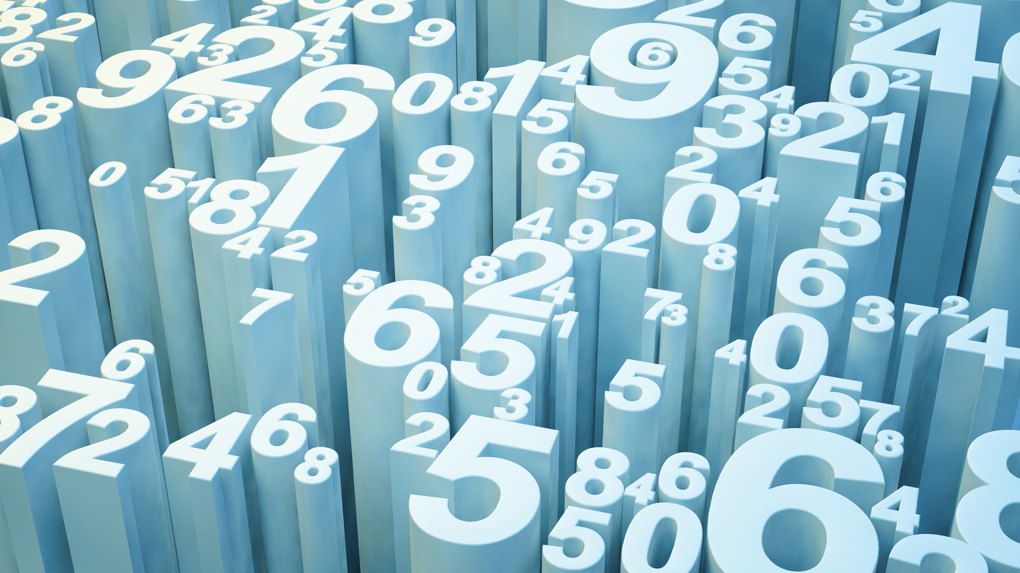
THE PARABLE OF TALENTS
MATTHEW 25:14-30

Slide 2
WHO DO YOU TRUST?
WHAT IF YOU HAD $$$$$$ AND WANTED OTHERS TO MANAGE FOR YOU WHILE YOU ARE OUT OF THE COUNTRY?
WHO WOULD YOU TRUST?
PICK 3 PEOPLE YOU TRUST – WHO GETS THE MOST, LEAST?
WHAT INSTRUCTIONS WOULD YOU GIVE THEM?

Slide 3
PARABLES OF JESUS
JESUS OFTEN TAUGHT IN PARABLES
PARABLE – TO LAY ONE THING BESIDE ANOTHER TO COMPARE OR CONTRANST
PARABLES TAKE SOMETHING WE KNOW AND UNDERSTAND TO TEACH DEEPER SPIRITUAL LESSONS

Slide 4
PARABLES OF JESUS
EACH PARABLE SHOULD BE SUMMARIZED IN ONE SENTENCE.
THIS PARABLE TEACHES –
ALL WHO DO NOT DO THEIR SHARE OF THE WORK IN THE KINGDOM OF GOD WILL BE CAST INTO OUTER DARKNESS

Slide 5
WHAT IS A “TALENT”?
HERE A TALENT WAS A COIN WITH A HIGH VALUE.
2 WAYS TO COMPARE COIN VALUES TODAY
1 – WAGES – DAY, WEEK, MONTH
2 – PURCHASE POWER – WHAT WILL IT BUY?
TALENT IS NOT ABOUT OUR ABILITY, SKILL, CRAFT OR KNOW HOW

Slide 6
COMPARE THE 3 MEN
TWO MEASUREMENTS TO THINK ABOUT:
1 – WHAT WE ARE NOW
2 – WHAT WE CAN BE

Slide 7
COMPARE THE 3 MEN
MAN #1 – 5 BECOMES 10
MUCH ABILITY
TALENTED
TRUSTED
RELIABLE

Slide 8
COMPARE THE 3 MEN
MAN #2 – 2 BECOMES 4
SEVERAL ABILITIES
TRUSTED WITH LESS CONFIDENCE
CAN’T BE LIKE MAN #1

Slide 9
COMPARE THE 3 MEN
MAN #3 – 1 STAYS 1
SOME ABILITY
LESS TRUST AND CONFIDENCE
LAZY OR FEARFUL

Slide 10
JUDGMENT DAY
ACCORDING TO WHAT WE HAVE DONE
(Matthew 16:27) For the Son of Man will come in the glory of His Father with His angels, and then He will reward each according to his works.
(2 Corinthians 5:10) For we must all appear before the judgment seat of Christ, that each one may receive the things done in the body, according to what he has done, whether good or bad.

Slide 11
JUDGMENT DAY
ACCORDING TO ABILITY & OPPORTUNITY
(John 3:19) And this is the condemnation, that the light has come into the world, and men loved darkness rather than light, because their deeds were evil.
(Mark 6:11) And whoever will not receive you nor hear you, when you depart from there, shake off the dust under your feet as a testimony against them. Assuredly, I say to you, it will be more tolerable for Sodom and Gomorrah in the day of judgment than for that city!"

Slide 12
JUDGMENT DAY
SOME DO MUCH WITH LITTLE
SOME DO LITTLE WITH MUCH

Slide 13
OUTER DARKNESS
HELL IS REAL FOR MAN WITH 1 TALENT
HE IS CALLED AN UNPROFITABLE SERVANT
HE IS CAST INTO OUTER DARKNESS
DARKNESS = ABSENCE OF GOD
JUDE 6 - DARKNESS
JUDE 13 – BLACKNESS OF DARKNESS

Slide 14
OUTER DARKNESS
WEEPING OVER LOST OPPORTUNITIES
WEEKPING OVER WASTED LIFE
GNASHING OF TEETH (CLINCHED TEETH)

