Slide 1
The Moon God: Allah
Is Allah the God of the Bible?

Slide 2
1 John 2:23
1 John 2:23 Whoever denies the Son does not have the Father either; he who acknowledges the Son has the Father also.
It is claimed that Christians, Jews and Muslims all worship the same God – the God of Abraham.
These are the three great monotheistic religions
Do we worship the same God?

Slide 3
Why the claim?
They descend from Abraham
They claim to worship the God of Abraham
NOTE: They do not claim Isaac or Jacob
They teach a strict moral code
Just a different name – Allah or Jehovah

Slide 4
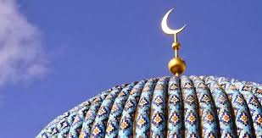
Is Allah in the Bible?
YES! The Moon God crescent (as seen on Mosques and Muslim flags worldwide).

Slide 5
Is Allah in the Bible?
Judges 8:21b So Gideon arose and killed Zebah and Zalmunna, and took the crescent ornaments that were on their camels' necks.
NOTE: KJV uses “ornaments”
Brown, Driver, Briggs (the Thayer of Hebrew OT) says – “Saharon – 1) moon, crescent 1a) as an ornament – Part of speech – noun masculine”

Slide 6
Judges 8:26
Now the weight of the gold earrings that he requested was one thousand seven hundred shekels of gold, besides the crescent ornaments, pendants, and purple robes which were on the kings of Midian, and besides the chains that were around their camels' necks.

Slide 7
Isaiah 3:18
In that day the Lord will take away the finery: The jingling anklets, the scarves, and the crescents
In the Bible – the Crescent Moon is a false god, spoken against

Slide 8
Exodus 20:4
You shall not make for yourself a carved image, or any likeness of anything that is in heaven above, or that is in the earth beneath, or that is in the water under the earth
Is this crescent moon of Muslims today the same as the crescent moon worship in the Bible?

Slide 9
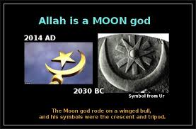

Slide 10
Job 31:26-28
²⁶ If I have observed the sun when it shines, Or the moon moving in brightness, ²⁷ So that my heart has been secretly enticed, And my mouth has kissed my hand; ²⁸ This also would be an iniquity deserving of judgment, For I would have denied God who is above.

Slide 11
Lunar / Lucina
Latin names for the Moon - Lunar or Lucina is the female deity
Lunus is the male name
Many believed the moon controlled their mood and actions
We get words – lunatic and lunacy from this belief
In crescent form – Lunette – in Arabia he is a male god, elsewhere female

Slide 12
Romans 1:20-21
²⁰ For since the creation of the world His invisible attributes are clearly seen, being understood by the things that are made, even His eternal power and Godhead, so that they are without excuse, ²¹ because, although they knew God, they did not glorify Him as God, nor were thankful, but became futile in their thoughts, and their foolish hearts were darkened.

Slide 13
Romans 1:24-25
²⁴ Therefore God also gave them up to uncleanness, in the lusts of their hearts, to dishonor their bodies among themselves, ²⁵ who exchanged the truth of God for the lie, and worshiped and served the creature rather than the Creator, who is blessed forever. Amen.

