Slide 1
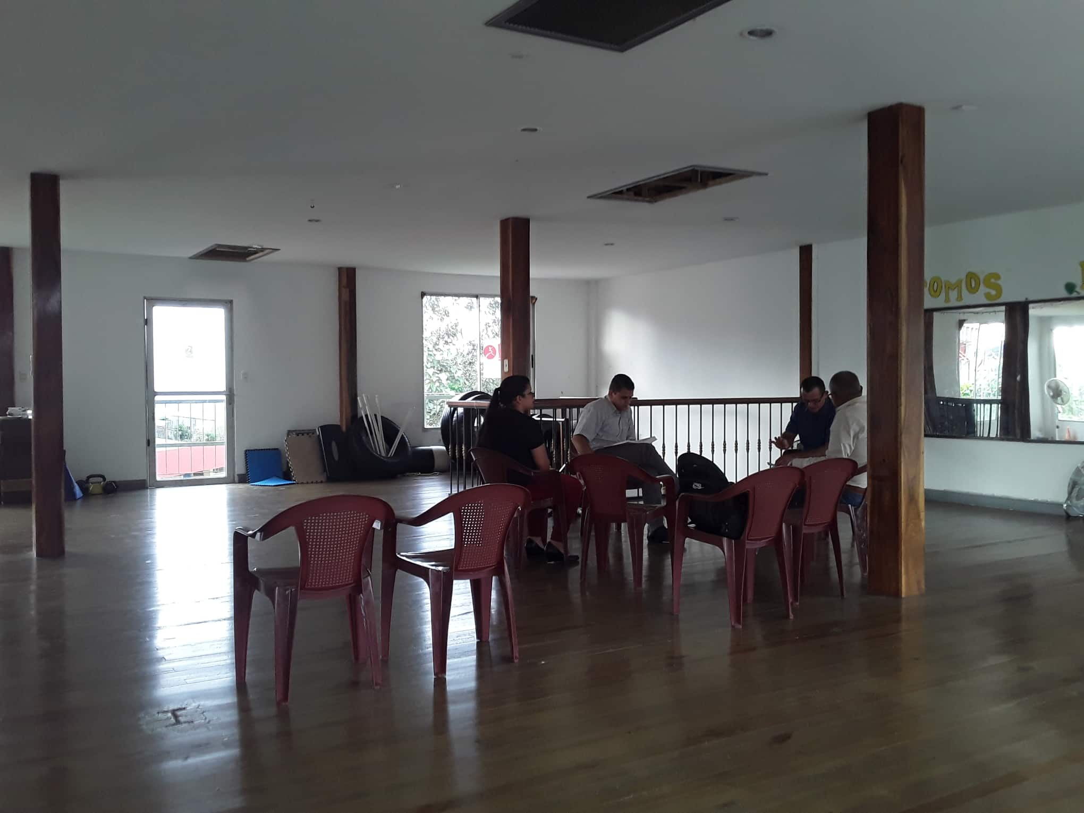
First worship in Quesada, Costa Rica

Slide 2
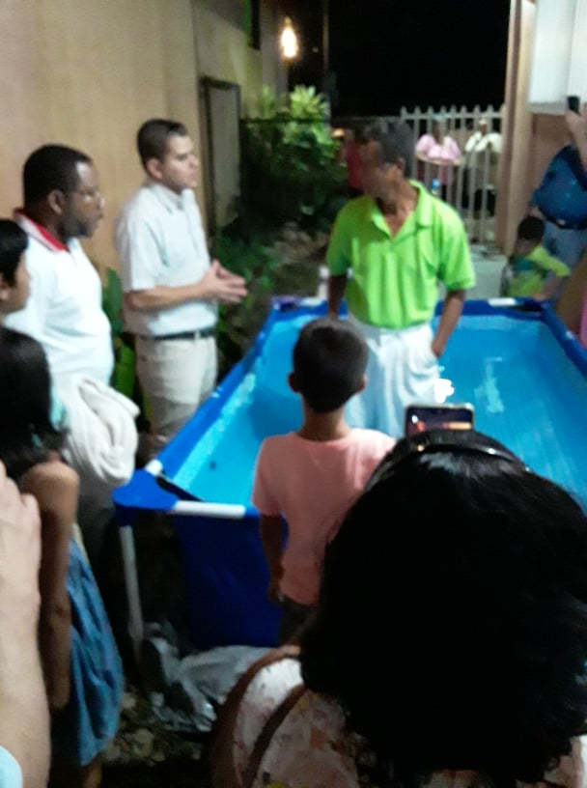
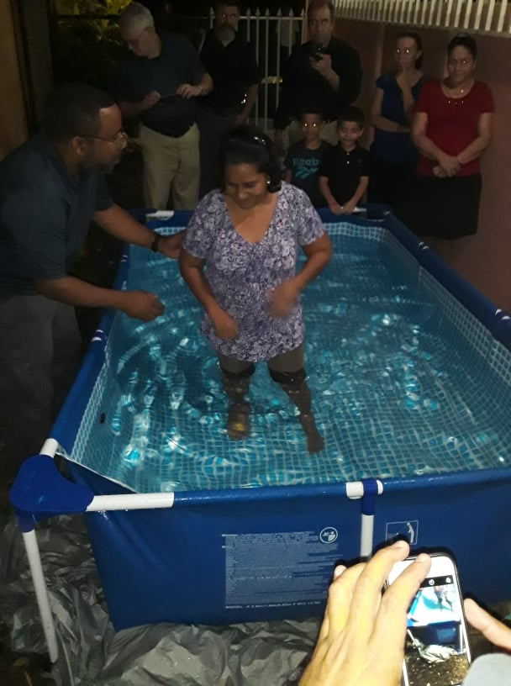
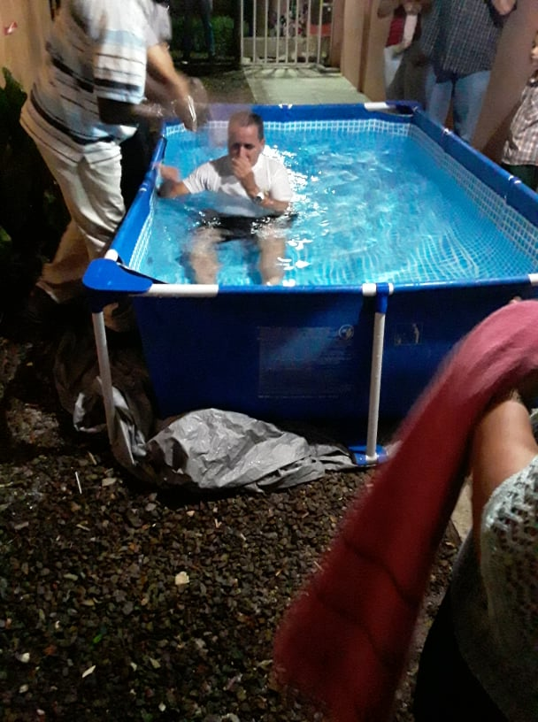
3 Baptisms in La Fortuna + several studies in progress

Slide 3
The Gospel Plan
Can you see god’s plan for your salvation?

Slide 4
Gospel = Heart of the Bible
Sin entered the world
God already had a plan to rescue us
Seed of Woman – Genesis 3:15
Abraham – father of a great nation
Judah – tribe of kings
Jesus born of a virgin

Slide 5
Gospel = Heart of the Bible
He taught, lived and died as men die
Raised from the dead to prove that He is the Son of God. (Romans 1:4)
Established His church, purchased with His blood (Acts 20:28)

Slide 6
Plan to enter the church
Hear the gospel
And a voice came out of the cloud, saying, "This is My beloved Son. Hear Him!" (Luke 9:35)

Slide 7
Plan to enter the church
Hear the gospel
Believe that Jesus is the Son of God
Therefore I said to you that you will die in your sins; for if you do not believe that I am He, you will die in your sins." (John 8:24)

Slide 8
Plan to enter the church
Hear the gospel
Believe that Jesus is the Son of God
Turn from a life of sin
I tell you, no; but unless you repent you will all likewise perish. (Luke 13:3)

Slide 9
Plan to enter the church
Hear the gospel
Believe that Jesus is the Son of God
Turn from a life of sin
Confess your faith
Romans 10:9-10; Matthew 10:32-33

Slide 10
Plan to enter the church
Hear the gospel
Believe that Jesus is the Son of God
Turn from a life of sin
Confess your faith
Be baptized for the forgiveness of sins
Acts 2:38; Mark 16:16; 1 Peter 3:21

Slide 11
Plan to enter the church
Hear the gospel
Believe that Jesus is the Son of God
Turn from a life of sin
Confess your faith
Be baptized for the forgiveness of sins
Worship and live faithfully for Christ
Revelation 2:10

Slide 12
Still the Plan Today
Acts 2:39-41
For the promise is to you and to your children, and to all who are afar off, as many as the Lord our God will call." 40 And with many other words he testified and exhorted them, saying, "Be saved from this perverse generation." 41 Then those who gladly received his word were baptized; and that day about three thousand souls were added to them.

