Slide 1
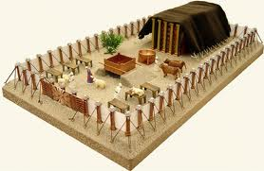
THE TABERNACLE A TYPE OF THE CHURCH

Slide 2
TYPE AND ANTITYPE
Many things in the Old Testament are a shadow or type of things in the New Testament
Type = prefigure some event in the New Testament
From the perspective of the Bible, a type was a model or symbol of something or someone that would exist at a future time.

Slide 3
TYPE AND ANTITYPE
Dr. John Sampley, “A type may properly be defined as a person, institution, or event in the old dispensation which was designed to prefigure a corresponding person, institution or event in the New.”

Slide 4
TYPE AND ANTITYPE
Antitype = The later person or thing was called the antitype.
Nevertheless death reigned from Adam to Moses, even over those who had not sinned according to the likeness of the transgression of Adam, who is a type of Him who was to come. Romans 5:14

Slide 5
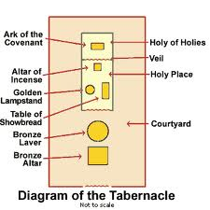
THE TABERNACLE

Slide 6
THE TABERNACLE
TYPE – TABERNACLE
The place of worship for Israel
ANTITYPE – CHURCH
And I heard a loud voice from heaven saying, "Behold, the tabernacle of God is with men, and He will dwell with them, and they shall be His people. God Himself will be with them and be their God. Rev elation 21:3

Slide 7
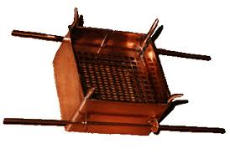
BURNT OFFERING ALTAR
ANTITYPE – CHRIST THE SACRIFICE
¹³ For if the blood of bulls and goats and the ashes of a heifer, sprinkling the unclean, sanctifies for the purifying of the flesh, ¹⁴ how much more shall the blood of Christ, who through the eternal Spirit offered Himself without spot to God, cleanse your conscience from dead works to serve the living God? Hebrews 9:13-14
TYPE – BURNT OFFERING ALTAR
Sacrifice for sins

Slide 8
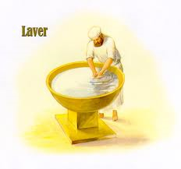
LAVER
ANTITYPE – BAPTISM
through the washing of regeneration and renewing of the Holy Spirit, Titus 3:5b
And now why are you waiting? Arise and be baptized, and wash away your sins, calling on the name of the Lord.' Acts 22:16
TYPE – LAVER
Cleansing before entering the tabernacle

Slide 9
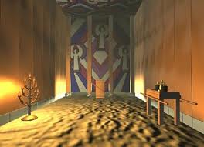
HOLY PLACE
TYPE – HOLY PLACE
Daily Worship
ANTITYPE – CHURCH
but exhort one another daily, while it is called "Today," lest any of you be hardened through the deceitfulness of sin. Hebrews 3:13

Slide 10
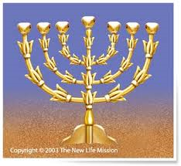
LAMPSTAND
TYPE – LAMPSTAND
Light for those in the Holy Place
ANTITYPE – BIBLE
Your word is a lamp to my feet And a light to my path. Psalms 119:105

Slide 11
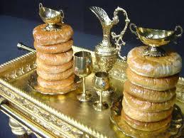
TABLE OF SHOWBREAD
ANTITYPE – LORD’S SUPPER
²⁶ And as they were eating, Jesus took bread, blessed and broke it, and gave it to the disciples and said, "Take, eat; this is My body." ²⁷ Then He took the cup, and gave thanks, and gave it to them, saying, "Drink from it, all of you. ²⁸ For this is My blood of the new covenant, which is shed for many for the remission of sins. Matthew 26:26-28
TYPE – TABLE OF SHOWBREAD
Unleavened bread for those in the tabernacle

Slide 12
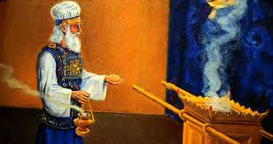
INCENSE
TYPE – INCENSE
Sweet smelling aroma – through the veil – into Most Holy Place
ANTITYPE – PRAYER
Now when He had taken the scroll, the four living creatures and the twenty-four elders fell down before the Lamb, each having a harp, and golden bowls full of incense, which are the prayers of the saints. Revelation 5:8

Slide 13
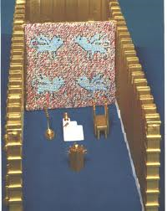
VEIL
TYPE – VEIL
Separates church from presence of God
ANTITYPE – WAY TO HEAVEN
¹⁹ Therefore, brethren, having boldness to enter the Holiest by the blood of Jesus, ²⁰ by a new and living way which He consecrated for us, through the veil, that is, His flesh, Hebrews 10:19-20

Slide 14
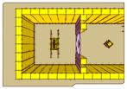
HOLY OF HOLIES
TYPE – HOLY OF HOLIES
Dwelling place of God
ANTITYPE – HEAVEN ITSELF
For Christ has not entered the holy places made with hands, which are copies of the true, but into heaven itself, now to appear in the presence of God for us; Hebrews 9:24

Slide 15
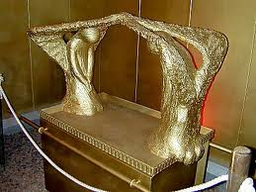
ARK OF THE COVENANT
TYPE – ARK OF THE COVENANT
Presence of God
ANTITYPE – CHRIST IS OUR COVENANT
⁷ For if that first covenant had been faultless, then no place would have been sought for a second. ⁸ Because finding fault with them, He says: "Behold, the days are coming, says the Lord, when I will make a new covenant with the house of Israel and with the house of Judah– Hebrews 8:7-8

Slide 16
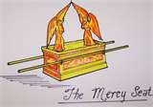
MERCY SEAT
ANTITYPE – CHRIST IS AT RIGHT HAND OF GOD
And there I will meet with you, and I will speak with you from above the mercy seat, from between the two cherubim which are on the ark of the Testimony, about everything which I will give you in commandment to the children of Israel. Exodus 25:22
TYPE – MERCY SEAT
Presence of God

Slide 17
THE SHADOW / SUBSTANCE?
For the law, having a shadow of the good things to come, and not the very image of the things, can never with these same sacrifices, which they offer continually year by year, make those who approach perfect. Hebrews 10:1
¹⁶ So let no one judge you in food or in drink, or regarding a festival or a new moon or sabbaths, ¹⁷ which are a shadow of things to come, but the substance is of Christ. Colossians 2:16-17

