Slide 1

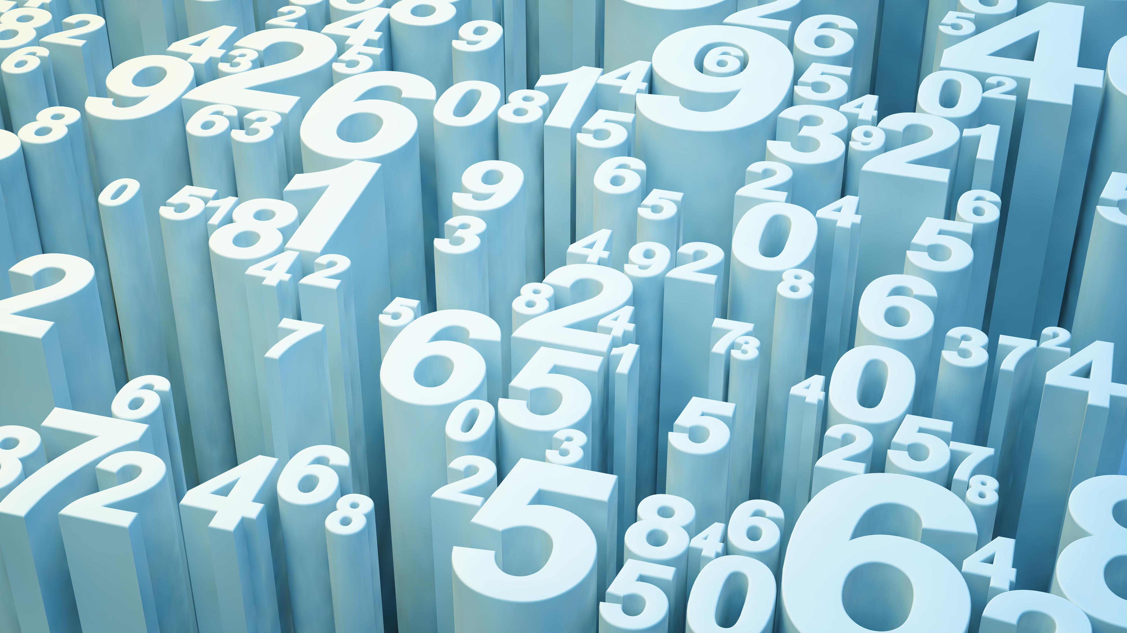
Who Switched the Price Tag?
Some bargains are NOT a bargain.

Slide 2
John 8:44
(44) You are of your father the devil, and the desires of your father you want to do. He was a murderer from the beginning, and does not stand in the truth, because there is no truth in him. When he speaks a lie, he speaks from his own resources, for he is a liar and the father of it.

Slide 3
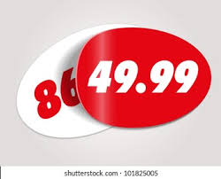
John 8:45-46
(45) But because I tell the truth, you do not believe Me.
(46) Which of you convicts Me of sin? And if I tell the truth, why do you not believe Me?

Slide 4

Can you imagine?
Walk into a store and nothing has the correct price tag. A small lamp is $5,000 and a large recliner sofa is $30.
Someone has switched all the price tags!
Someone is also switching life’s price tags.
Many things are not valued they way they should be.

Slide 5
1. The value of life
Life used to be sacred, highly regarded, of great value.
(Genesis 9:6) "Whoever sheds man's blood, By man his blood shall be shed; For in the image of God He made man.
(Acts 17:24) God, who made the world and everything in it, since He is Lord of heaven and earth, does not dwell in temples made with hands. (25) Nor is He worshiped with men's hands, as though He needed anything, since He gives to all life, breath, and all things.
Life is something to be held as sacred and of great value.

Slide 6
1. The value of life
Contrast this with the “price tag” of human life today.
1. Abortion – taking the life of an unborn child
2. Euthanasia – “Mercy killing” is growing for many
3. Murder – the willful taking of a human life continues to be a major problem in many areas of the nation

Slide 7
2. The value of sin
The Bible is clear on this subject.
(2Th 2:9) The coming of the lawless one is according to the working of Satan, with all power, signs, and lying wonders,
(2Th 2:10) and with all unrighteous deception among those who perish, because they did not receive the love of the truth, that they might be saved.
(2Th 2:11) And for this reason God will send them strong delusion, that they should believe the lie,
(2Th 2:12) that they all may be condemned who did not believe the truth but had pleasure in unrighteousness.

Slide 8
2. The value of sin
(Romans 1:28-32) And even as they did not like to retain God in their knowledge, God gave them over to a debased mind, to do those things which are not fitting; (29) being filled with all unrighteousness, sexual immorality, wickedness, covetousness, maliciousness; full of envy, murder, strife, deceit, evil-mindedness; they are whisperers, (30) backbiters, haters of God, violent, proud, boasters, inventors of evil things, disobedient to parents, (31) undiscerning, untrustworthy, unloving, unforgiving, unmerciful; (32) who, knowing the righteous judgment of God, that those who practice such things are deserving of death, not only do the same but also approve of those who practice them.

Slide 9
2. The value of sin
(Isaiah 5:20) Woe to those who call evil good, and good evil; Who put darkness for light, and light for darkness; Who put bitter for sweet, and sweet for bitter!
The price tag has been changed!

Slide 10
3. The value of truth
(John 8:32) And you shall know the truth, and the truth shall make you free."
(Proverbs 23:23) Buy the truth, and do not sell it, Also wisdom and instruction and understanding.
(Psalm 119:72) The law of Your mouth is better to me Than thousands of coins of gold and silver.

Slide 11
3. The value of truth
The value of TRUTH has been greatly reduced.
This is a basic problem today, and in all generations.
Truth is not highly regarded today.
(John 8:44) You are of your father the devil, and the desires of your father you want to do. He was a murderer from the beginning, and does not stand in the truth, because there is no truth in him. When he speaks a lie, he speaks from his own resources, for he is a liar and the father of it.

Slide 12
Conclusion
We all go through the “store of life.”
We are making choices daily, purchasing attitudes, buying morals, trading eternity for a bowl of soup.
We must make the right choices.
(Jeremiah 6:16) Thus says the LORD: "Stand in the ways and see, And ask for the old paths, where the good way is, And walk in it; Then you will find rest for your souls. But they said, 'We will not walk in it.'

Slide 13
Conclusion
LET US ASK FOR THE
“BOOK PRICE.”
GOD’S VALUES ARE TRUE.

