Slide 1
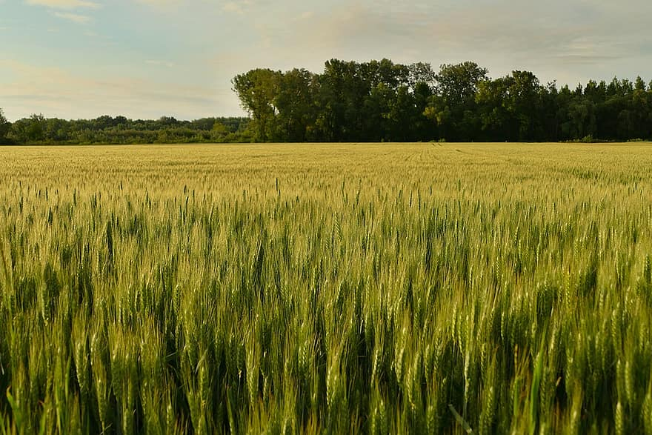
SOIL TESTING
THE PARABLE OF SOILS
MATT. 13; MARK 4; LUKE 8

Slide 2
Jesus used stories to communicate
Parable = to lay beside, to compare, to use the known to explain the unknown
(Mar 4:33) And with many such parables He spoke the word to them as they were able to hear it.
(Mar 4:34) But without a parable He did not speak to them. And when they were alone, He explained all things to His disciples.
Sometimes the apostles did not understand the message behind the parable.

Slide 3
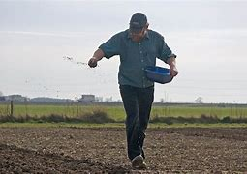
Seed is good
(Luk 8:11) "Now the parable is this: The seed is the word of God.
The fields were usually small.
The method of sowing seed was to scatter, by hand.
Much of the seed would be wasted.

Slide 4
What kind of soil am I?
Jesus identifies 4 kinds of soil.
Wayside, path, packed hard – nothing grows
Rocky, stones, little dirt
Thorny, weeds take over
Good, seed grows, matures and produces the crop.

Slide 5
What kind of soil am I?
Which of the 4 am I?
YES. At different times I might be any one of the 4 soils.
NOTE: There is a progression. We can move from wayside, to rocky, to thorns, to good ground.
AND: Sometimes we might go backwards.

Slide 6
I have a choice about which soil I am!
Pathway
Why do some not receive the Word?
Rebellion, heart has hardened
(Heb 3:13) but exhort one another daily, while it is called "TODAY," lest any of you be hardened through the deceitfulness of sin.

Slide 7
I have a choice about which soil I am!
Pathway
Why do some not receive the Word?
2. Believe false teaching
(Mat 15:13) But He answered and said, "Every plant which My heavenly Father has not planted will be uprooted.
(Mat 15:14) Let them alone. They are blind leaders of the blind. And if the blind leads the blind, both will fall into a ditch."

Slide 8
I have a choice about which soil I am!
Pathway
Why do some not receive the Word?
3. Keep seed on surface
Does not sink into intellect, into emotions, to the will, that produces change.
(Mat 15:8) 'THESE PEOPLE DRAW NEAR TO ME WITH THEIR MOUTH, AND HONOR ME WITH THEIR LIPS, BUT THEIR HEART IS FAR FROM ME.
(Mat 15:9) AND IN VAIN THEY WORSHIP ME, TEACHING AS DOCTRINES THE COMMANDMENTS OF MEN.' "

Slide 9
I have a choice about which soil I am!
Pathway
Why do some not receive the Word?
4. Apply to others, not to themselves
(Luk 18:9) Also He spoke this parable to some who trusted in themselves that they were righteous, and despised others:
(Luk 18:10) "Two men went up to the temple to pray, one a Pharisee and the other a tax collector.
(Luk 18:11) The Pharisee stood and prayed thus with himself, 'God, I thank You that I am not like other men—extortioners, unjust, adulterers, or even as this tax collector.
(Luk 18:12) I fast twice a week; I give tithes of all that I possess.'

Slide 10
I have a choice about which soil I am!
Pathway
Why do some not receive the Word?
5. Procrastinate, not now, maybe later
(Jas 4:13) Come now, you who say, "Today or tomorrow we will go to such and such a city, spend a year there, buy and sell, and make a profit";
(Jas 4:14) whereas you do not know what will happen tomorrow. For what is your life? It is even a vapor that appears for a little time and then vanishes away.
(Jas 4:15) Instead you ought to say, "If the Lord wills, we shall live and do this or that."

Slide 11
Conclusion
We all begin as hard, packed soil.
All that we now understand, at one time we didn’t understand.
All that we believe, we once did not believe.
Are you ready to be responsive to the seed (Word of God) today?

