Slide 1
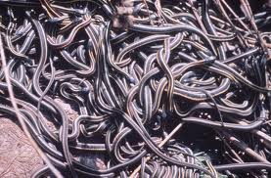
Snakes and Salvation
Numbers 21:4-9

Slide 2
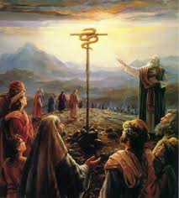
Familiar Story
I am sure most of you have heard of this story
Israel complained AGAIN
God sent poisonous snakes to bite the people
They cried for help
God instructed Moses to make a brass serpent, put it on a pole
All who look on it will live

Slide 3
Familiar Story
I am sure most of you have heard of this story
THE REAL STORY HERE IS ONE WORD
DISCOURAGEMENT
Discouragement does great damage to our lives
Why do we become discouraged?

Slide 4
DISCOURAGEMENT: The Past
For Israel – the past 40 years
Dust
Disappointment
Death
For us – “Here we go again”
We see the pattern beginning again and we don’t like where it is taking us

Slide 5
DISCOURAGEMENT: The Past

Slide 6
DISCOURAGEMENT: Hardships
For Israel – They were constantly in need
Food
Water
Hot – no shade
For us – The economy, unemployment, heart attack, cancer, death in family
Hills, bumps, rocks, potholes
When will life get better?

Slide 7
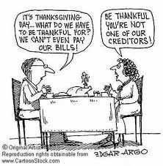
DISCOURAGEMENT: Hardships

Slide 8
DISCOURAGEMENT: Lack of Progress
For Israel – 40 years going nowhere
Wandering
Move from place to place
Promised land it just past that city
For us – Hamster on a wheel
The hurrier I go, the behinder I get!
Where is life headed? Will I ever get there? Kids – “Are we there yet?”

Slide 9
DISCOURAGEMENT: Family Problems
For Israel – The obstacle was Edom
Edom is Esau
Esau is Jacob’s twin brother
They were refused passage to Canaan
For us – Marriage, Family, Children
These are more discouraging than other areas of our life

Slide 10
DISCOURAGEMENT: Family Problems
For Israel – “We will have to go the long way around the land of Edom.”
For us – Take the long way
There are no “quick fixes” for marriages, raising children, having a happy family
It is a long road – slow progress – continual setbacks

Slide 11
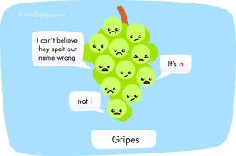
DISCOURAGEMENT LEADS TO COMPLAINTS
They complained about everything
In Egypt
At the Red Sea
About the water
About the food
About Moses
About lack of progress
Everything that happens is someone’s fault.

Slide 12
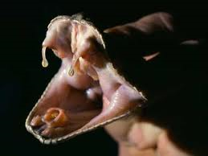
COMPLAINTS LED TO DESTRUCTION
Fiery serpents came among the people
The Lord SENT the snakes
The snake bite was fatal
Natural reaction – Complain some more

Slide 13
GOD’S PLAN IS NOT LOGICAL
Make a snake out of brass, put on a pole
All who look will live.
Numbers 21:8 ⁸ Then the Lord said to Moses, "Make a fiery serpent, and set it on a pole; and it shall be that everyone who is bitten, when he looks at it, shall live."
DOES THIS MAKE ANY SENSE?

Slide 14
GOD’S PLAN IS NOT LOGICAL
DOES THIS MAKE ANY SENSE?
I have heard the same comment about the plan of salvation in the NT.
Baptism does not make any sense.

Slide 15
CONCLUSION
BE ALERT
Discouragement can show up in our lives
We must recognize and overcome it
LOOK AND LIVE
Look to God – not other sources
Look in faith
You can have eternal life with God

