Slide 2
Matthew 25:20-23
(20) "So he who had received five talents came and brought five other talents, saying, 'Lord, you delivered to me five talents; look, I have gained five more talents besides them.’ (21) His lord said to him, 'Well done, good and faithful servant; you were faithful over a few things, I will make you ruler over many things. Enter into the joy of your lord.’ (22) He also who had received two talents came and said, 'Lord, you delivered to me two talents; look, I have gained two more talents besides them.’ (23) His lord said to him, 'Well done, good and faithful servant; you have been faithful over a few things, I will make you ruler over many things. Enter into the joy of your lord.'

Slide 3
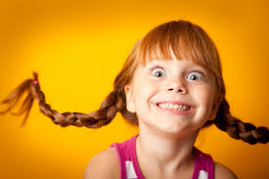
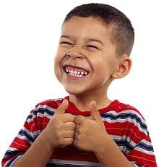
SMILE
It takes more muscles to frown than to smile.
Some people brighten a room by leaving it.
Even alone – they are in bad company.
An insincere smile is better than a sincere frown.

Slide 4
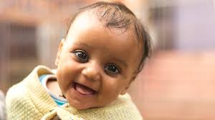
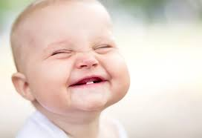
SMILE
A smile is not a lie – it is the truth ahead of time.
Mama skunk passing a garbage dump – “Something really stinks around here.”
Aren’t you glad you’re a Christian?
Some need to notify their face!

Slide 5
Miserable Christians
Some have left Christ to “enjoy life.”
(Hebrews 6:4) For it is impossible for those who were once enlightened, and have tasted the heavenly gift, and have become partakers of the Holy Spirit,
(Hebrews 6:5) and have tasted the good word of God and the powers of the age to come,
(Hebrews 6:6) if they fall away, to renew them again to repentance, since they crucify again for themselves the Son of God, and put Him to an open shame.

Slide 6
Miserable Christians
Those who leave the faith are miserable everywhere – here and in eternity.
Those who remain faithful to Christ - - - are miserable anywhere else.
Don’t be a miserable Christian!!!

Slide 7
THE phARISEES
Known for making rules, strict rules.
Demanding everyone keep the letter of their rules.
They were not happy unless they were sharing their misery with others.

Slide 8
THE phARISEES
(Matthew 23:13) "But woe to you, scribes and Pharisees, hypocrites! For you shut up the kingdom of heaven against men; for you neither go in yourselves, nor do you allow those who are entering to go in.
(Matthew 23:14) Woe to you, scribes and Pharisees, hypocrites! For you devour widows' houses, and for a pretense make long prayers. Therefore you will receive greater condemnation.
(Matthew 23:15) "Woe to you, scribes and Pharisees, hypocrites! For you travel land and sea to win one proselyte, and when he is won, you make him twice as much a son of hell as yourselves.

Slide 9
What about us?
We all have our share of problems, suffering, misery.
We also have a choice – we can curse the darkness OR we can light a candle.
You can attend worship like you were eating green persimmons OR you can enter worship like it is a joy to be here.
(Psalms 122:1) I was glad when they said to me, "Let us go into the house of the LORD."

Slide 10
Why are some miserable?
Many know God’s law – but not God’s love.
They know justice – but not mercy.
A lot are in the Word – but the Word is not in them.
Some obey intellectually – but not emotionally (the heart).
Many are on the fringe – but not involved in the work.

Slide 11
What does the Bible say?
(Psalms 118:24) This is the day the LORD has made; We will rejoice and be glad in it.
Matthew 25:21, 23 – Enter the joy of the Lord.
(Acts 8:38) So he commanded the chariot to stand still. And both Philip and the eunuch went down into the water, and he baptized him.
(Acts 8:39) Now when they came up out of the water, the Spirit of the Lord caught Philip away, so that the eunuch saw him no more; and he went on his way rejoicing.

Slide 12
What does the Bible say?
Rejoice about the past
Acts 2:38 – baptism is for the remission of sins
Rejoice about the future
(Psalms 23:6) Surely goodness and mercy shall follow me All the days of my life; And I will dwell in the house of the LORD Forever.
(John 3:16) For God so loved the world that He gave His only begotten Son, that whoever believes in Him should not perish but have everlasting life. (17) For God did not send His Son into the world to condemn the world, but that the world through Him might be saved.

Slide 13
What does the Bible say?
Rejoice now
(John 10:10) The thief does not come except to steal, and to kill, and to destroy. I have come that they may have life, and that they may have it more abundantly.
(Luke 18:29) So He said to them, "Assuredly, I say to you, there is no one who has left house or parents or brothers or wife or children, for the sake of the kingdom of God, (30) who shall not receive many times more in this present time, and in the age to come eternal life."

Slide 14
What does the Bible say?
Rejoice now
(Philippians 3:1a) Finally, my brethren, rejoice in the Lord.
(Philippians 4:4) Rejoice in the Lord always. Again I will say, rejoice!
(1 Thessalonians 5:16) Rejoice always,

