Slide 1
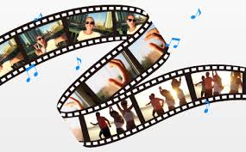
Your Sizzle Reel
2 Corinthians 3:1-2

Slide 2
Define: Sizzle Reel
In sports – the short 2 to 4 seconds of an important play, shown before going to a commercial break
In TV, movies, or business – a short 2 or 3 minute video that sells the idea or product

Slide 3
Sizzle Reels in the Bible
There are many “sizzle reels” in the Bible
Hebrews 11 is filled with “sizzle reels” about men of faith
How do you summarize a long life and pack it into a few seconds of film?
What would be on your “sizzle reel”?

Slide 4
Sizzle Reels in Hebrews 11
Enoch –
23 So all the days of Enoch were three hundred and sixty-five years. 24 And Enoch walked with God; and he was not, for God took him. (Genesis 5:23-24)
How do you sizzle reel 365 years?

Slide 5
Sizzle Reels in Hebrews 11
Enoch –
By faith Enoch was taken away so that he did not see death, "AND WAS NOT FOUND, BECAUSE GOD HAD TAKEN HIM"; for before he was taken he had this testimony, that he pleased God. (Hebrews 11:5)

Slide 6
Sizzle Reels in Hebrews 11
Noah –
Built an ark, cared for all the animals on board, survived a year at sea
He was a preacher for 120 years
He saved his family from the flood

Slide 7
Sizzle Reels in Hebrews 11
Noah –
By faith Noah, being divinely warned of things not yet seen, moved with godly fear, prepared an ark for the saving of his household, by which he condemned the world and became heir of the righteousness which is according to faith. (Hebrews 11:7)

Slide 8
Sizzle Reels in Hebrews 11
Joseph –
Ridiculed by brothers, sold into slavery
Falsely accused, put in prison, forgotten
Interprets dream of the king
Saves his family from the famine

Slide 9
Sizzle Reels in Hebrews 11
Joseph –
How do you “sizzle reel” his life?
By faith Joseph, when he was dying, made mention of the departure of the children of Israel, and gave instructions concerning his bones. (Hebrews 11:22)

Slide 10
Sizzle Reels in Hebrews 11
Moses –
Saved from death as an infant, killed an Egyptian, escaped the country 40 years,
Freed Israel from slavery, became the great law giver, led them to Caanan

Slide 11
Sizzle Reels in Hebrews 11
Moses –
choosing rather to suffer affliction with the people of God than to enjoy the passing pleasures of sin, (Heb 11:25)

Slide 12
Sizzle Reels in Hebrews 11
Many more in Hebrews 11 –
These illustrate how God is able to condense a long, active life into a short “sizzle reel.”

Slide 13
What about your “sizzle reel”?
What if you had 5 to 10 seconds to show the important parts of your life?
What would be on your sizzle reel? What would God put in the video?

Slide 14
2 Corinthians 3:1-2
Do we begin again to commend ourselves? Or do we need, as some others, epistles of commendation to you or letters of commendation from you? 2 You are our epistle written in our hearts, known and read by all men;

Slide 15
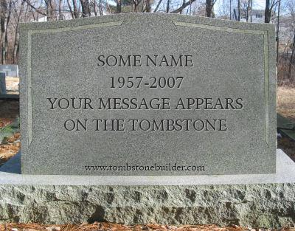
What about your “sizzle reel”?
Tombstone = name
Date of birth – death
But it is the dash in between that is the sum of your life.

Slide 16
What about your “sizzle reel”?
You have the rest of your life to produce your own sizzle reel
What will God choose as important in your life?

