Slide 1
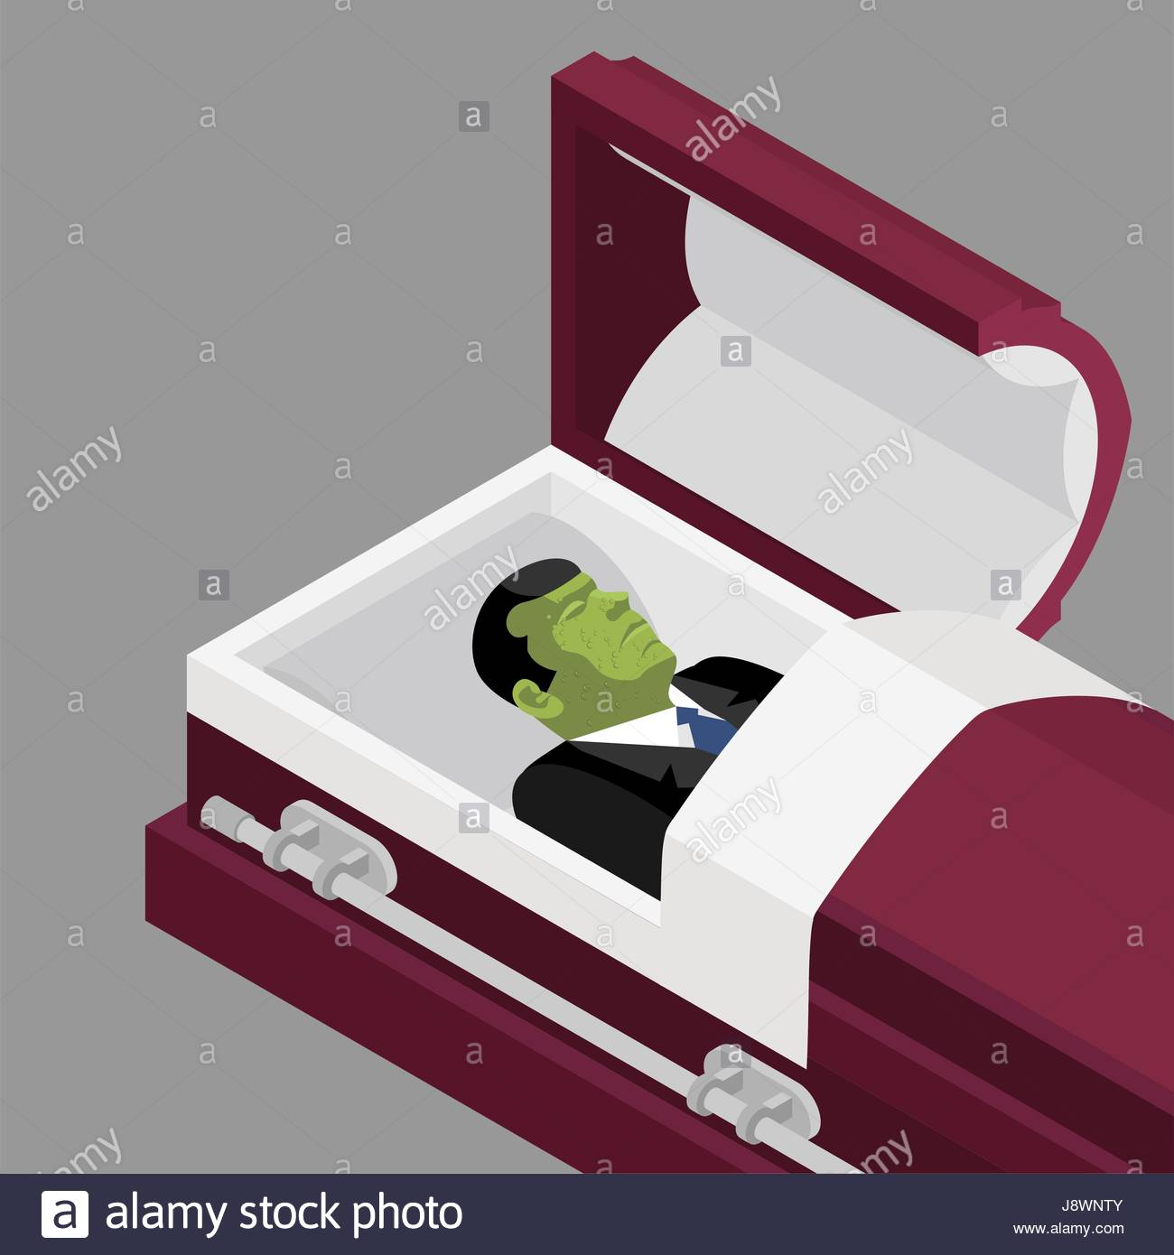
Satan Wants a Corpse
Text:
Jude 1:9

Slide 2
Jude 1:9
Yet Michael the archangel, in contending with the devil, when he disputed about the body of Moses, dared not bring against him a reviling accusation, but said, "The Lord rebuke you!“
Satan argues with an archangel about the body of Moses.
What would Satan have done with that body?
Take it on a tour – charge for viewing.
There are other dead bodies that Satan wants.

Slide 3
SATAN WANTS A DEAD SINNER
(Ephesians 2:1) And you He made alive, who were dead in trespasses and sins, (2) in which you once walked according to the course of this world, according to the prince of the power of the air, the spirit who now works in the sons of disobedience, (3) among whom also we all once conducted ourselves in the lusts of our flesh, fulfilling the desires of the flesh and of the mind, and were by nature children of wrath, just as the others.

Slide 4
SATAN WANTS A DEAD SINNER
Satan wants to keep sinners – sinning
He does not want them to obey the gospel
He wispers in the sinner’s ear:
One church is as good an another.
You can worship on the golf course.
Have fun. That is why you are here.
Satan rejoices when the sinner turns his back on the Lord and refuses to listen to God.

Slide 5
SATAN WANTS A DEAD CHURCH
(Revelation 3:1) "And to the angel of the church in Sardis write, 'These things says He who has the seven Spirits of God and the seven stars: "I know your works, that you have a name that you are alive, but you are dead.

Slide 6
SATAN WANTS A DEAD CHURCH
Sardis was a church that, on the outside, looked alive.
They had activities, dinners, meetings.
They had a reputation in the city.
BUT – They were dead

Slide 7
SATAN WANTS A DEAD CHURCH
Pharisees – pretended to be righteous
BUT – full of dead men’s bones.
(Matthew 23:27) "Woe to you, scribes and Pharisees, hypocrites! For you are like whitewashed tombs which indeed appear beautiful outwardly, but inside are full of dead men's bones and all uncleanness.

Slide 8
SATAN WANTS A DEAD MEMBER
(Ephesians 2:1) And you He made alive, who were dead in trespasses and sins, (2) in which you once walked according to the course of this world, according to the prince of the power of the air, the spirit who now works in the sons of disobedience, (3) among whom also we all once conducted ourselves in the lusts of our flesh, fulfilling the desires of the flesh and of the mind, and were by nature children of wrath, just as the others.

Slide 9
SATAN WANTS A DEAD MEMBER
(Ephesians 2:12) that at that time you were without Christ, being aliens from the commonwealth of Israel and strangers from the covenants of promise, having no hope and without God in the world.
Satan supplies the excuses:
Too busy Too tired
Only day to rest Might get COVID
Cut grass, weed garden Visit relatives

Slide 10
SATAN WANTED THE BODY OF JESUS
More than anything, Satan wanted Jesus dead.
He wanted to prove that Jesus was dead – thus prove that He was a false prophet, false teacher.
He knew that if Jesus is raised from the dead – Satan loses.
(Romans 1:4) and declared to be the Son of God with power according to the Spirit of holiness, by the resurrection from the dead.

Slide 11
SATAN WANTED THE BODY OF JESUS
(1 Corinthians 15:3) For I delivered to you first of all that which I also received: that Christ died for our sins according to the Scriptures, (4) and that He was buried, and that He rose again the third day according to the Scriptures,
(Matthew 28:6) He is not here; for He is risen, as He said. Come, see the place where the Lord lay.

Slide 12
SATAN WANTED THE BODY OF JESUS
(1 Peter 3:21) There is also an antitype which now saves us—baptism (not the removal of the filth of the flesh, but the answer of a good conscience toward God), through the resurrection of Jesus Christ,
(1 Peter 3:22) who has gone into heaven and is at the right hand of God, angels and authorities and powers having been made subject to Him.

Slide 13
WHAT ABOUT YOU?
ARE YOU A DEAD SINNER?
BELIEVE AND OBEY THE GOSPEL!
ARE YOU A DEAD CHURCH MEMBER?
DO LIKE THE PRODIGAL SON!
EVERYONE IS SERVING SATAN OR CHRIST. WHO ARE YOU SERVING?

