Slide 1
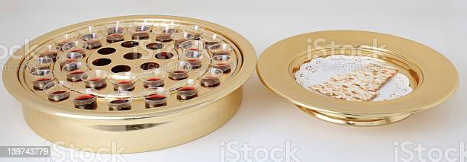
5 Purposes for Communion

Slide 2
Communion
Commanded to be observed each Sunday.
For many, it can become routine. We just go through the motions without any focus on the purpose of what we are doing.

Slide 3
1 Restoration
(1 Corinthians 11:27) Therefore whoever eats this bread or drinks this cup of the Lord in an unworthy manner will be guilty of the body and blood of the Lord. (28) But let a man examine himself, and so let him eat of the bread and drink of the cup. (29) For he who eats and drinks in an unworthy manner eats and drinks judgment to himself, not discerning the Lord's body.

Slide 4
1 Restoration
Time to restore our fellowship with God.
Unworthy manner
Examine yourself – not others
Judgment of God is on those who fail to examine self

Slide 5
2 Harmony
(1 Corinthians 11:18) For first of all, when you come together as a church, I hear that there are divisions among you, and in part I believe it.
(1 Corinthians 11:19) For there must also be factions among you, that those who are approved may be recognized among you.
(1 Corinthians 11:20) Therefore when you come together in one place, it is not to eat the Lord's Supper.
(1 Corinthians 11:21) For in eating, each one takes his own supper ahead of others; and one is hungry and another is drunk.

Slide 6
2 Harmony
Problems in Corinth - - -
No unity, did not wait for others
We are to gather FIRST, then partake of communion.
Communion is not a “drive thru” act

Slide 7
3 Fellowship
(1 Corinthians 11:33) Therefore, my brethren, when you come together to eat, wait for one another.
Share in the celebration
We do this jointly, together
We are in fellowship with God.

Slide 8
4 Remember
(1 Corinthians 11:23) For I received from the Lord that which I also delivered to you: that the Lord Jesus on the same night in which He was betrayed took bread; (24) and when He had given thanks, He broke it and said, "Take, eat; this is My body which is broken for you; do this in remembrance of Me.“ (25) In the same manner He also took the cup after supper, saying, "This cup is the new covenant in My blood. This do, as often as you drink it, in remembrance of Me."

Slide 9
4 Remember
Remember why you are partaking
Remember who you worship
Remember the sacrifice of Jesus
Remember the love of God
Remember His death, burial, and resurrection

Slide 10
5 Thankful
(1 Corinthians 11:24) and when He had given thanks, He broke it and said, "Take, eat; this is My body which is broken for you; do this in remembrance of Me."

Slide 11
5 Purposes for Communion
1 Restoration of our mind
2 Harmony with the church
3 Fellowship with God
4 Remembrance of Jesus
5 Thankful heart

