Slide 1
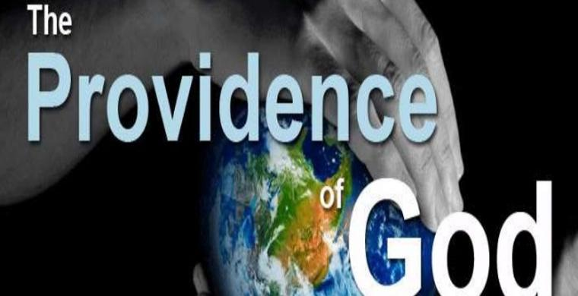

Slide 2
Introduction to Providence
Does God answer prayers in dramatic ways?
Does God intervene in history?
Does God play an active role in our day to day lives?
Was it the providence of God, not just good luck, or coincidence?

Slide 3
Introduction to Providence
Biblical Examples
Joseph in Egypt Daniel Fiery Furnace
Esther Abraham – ram in thicket
Personal stories
Kirov not on our Russian Visa – Russia Parliament changed the law
No connecting flights to NY / Atlanta – Hurricane hit east coast – we flew direct to Atlanta

Slide 4
Define: Providence
How do we define providence?
Greek word – Pronoia – to think before
English root word – to provide
“The continued exercise of Divine energy whereby the creator sustains creation and is operative in all that comes to pass, and directs all things to their appointed end.” Louis Burkhof

Slide 5
Paul Explains Providence
Acts 17:24-26 (24) God, who made the world and everything in it, since He is Lord of heaven and earth, does not dwell in temples made with hands. (25) Nor is He worshiped with men's hands, as though He needed anything, since He gives to all life, breath, and all things. (26) And He has made from one blood every nation of men to dwell on all the face of the earth, and has determined their pre-appointed times and the boundaries of their dwellings,

Slide 6
Paul Explains Providence
Acts 17:27-28 (27) so that they should seek the Lord, in the hope that they might grope for Him and find Him, though He is not far from each one of us;
(28) for in Him we live and move and have our being, as also some of your own poets have said, 'For we are also His offspring.'

Slide 7
In Him we Live
God created us and gave us life
God breathed His Spirit into us
It does not make sense that God would be unwilling to sustain that life

Slide 8
In Him we Live
(Psalms 104:10-14) He sends the springs into the valleys; They flow among the hills. (11) They give drink to every beast of the field; The wild donkeys quench their thirst. (12) By them the birds of the heavens have their home; They sing among the branches. (13) He waters the hills from His upper chambers; The earth is satisfied with the fruit of Your works. (14) He causes the grass to grow for the cattle, And vegetation for the service of man, That he may bring forth food from the earth,

Slide 9
In Him we Live
(Colossians 1:15-17) He is the image of the invisible God, the firstborn over all creation. (16) For by Him all things were created that are in heaven and that are on earth, visible and invisible, whether thrones or dominions or principalities or powers. All things were created through Him and for Him. (17) And He is before all things, and in Him all things consist.
ESV – “in Him all things hold together.”
Hebrews 1:3 upholding all things by the word of His power

Slide 10
In Him we Live
Deists believe that God exists, He created the world, but has no role in the world today.
Acts 17:27b He is not far from each one of us;
(Matthew 6:26) Look at the birds of the air, for they neither sow nor reap nor gather into barns; yet your heavenly Father feeds them. Are you not of more value than they?

Slide 11
In Him we Move
Everything in our universe moves – planets, moon, earth
Plants, animals, human life – have movement
What is the source of that movement?
Rise and fall of nations / rulers

Slide 12
In Him we Move
Rise and fall of nations / rulers
God uses wicked rulers to accomplish His plans
Nebuchadnezzar – 7 years in open fields, eating grass. He learned that God is in control.
(Daniel 4:36) At the same time my reason returned to me, and for the glory of my kingdom, my honor and splendor returned to me. My counselors and nobles resorted to me, I was restored to my kingdom, and excellent majesty was added to me. (37) Now I, Nebuchadnezzar, praise and extol and honor the King of heaven, all of whose works are truth, and His ways justice. And those who walk in pride He is able to put down.

Slide 13
In Him we have our Being
Why do we exist?
Why does the universe exist?
Anthony Flew (famous atheist) The more he studied the universe and its intricacies he realized it could not happen by chance.
Big Bang Theory – Is like a when magician
tries to pull a rabbit out of a hat without a hat and without a rabbit.

Slide 14
Conclusion
We worship an awesome, almighty God.
He created us.
He sustains us.
He cares what happens to his children.
God does not want you to be lost.
He wants all men to come to repentance.

