Slide 1
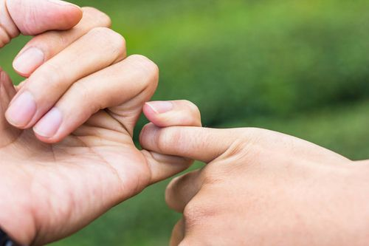
Promises of god
What has God promised?
What must we do to receive the promise?

Slide 2
God has given many promises.
(2Pe 1:2) Grace and peace be multiplied to you in the knowledge of God and of Jesus our Lord,
(2Pe 1:3) as His divine power has given to us all things that pertain to life and godliness, through the knowledge of Him who called us by glory and virtue,
(2Pe 1:4) by which have been given to us exceedingly great and precious promises, that through these you may be partakers of the divine nature, having escaped the corruption that is in the world through lust.

Slide 3
Facts about the promises of God
GOD IS FAITHFUL (Heb 10:23) Let us hold fast the confession of our hope without wavering, for He who promised is faithful.

Slide 4
Facts about the promises of God
GOD IS FAITHFUL (Heb 10:23) Let us hold fast the confession of our hope without wavering, for He who promised is faithful.
GOD IS ABLE (Rom 4:20) He did not waver at the promise of God through unbelief, but was strengthened in faith, giving glory to God,
(Rom 4:21) and being fully convinced that what He had promised He was also able to perform.

Slide 5
Facts about the promises of God
GOD IS FAITHFUL
GOD IS ABLE
GOD IS NOT SLACK (2Pe 3:9) The Lord is not slack concerning His promise, as some count slackness, but is longsuffering toward us, not willing that any should perish but that all should come to repentance.

Slide 6
Some things are NOT promised
Life witout difficulty
God does not promise you a rose garden without the thorns.
(2Ti 3:12) Yes, and all who desire to live godly in Christ Jesus will suffer persecution.

Slide 7
Some things are NOT promised
Life witout difficulty (2Ti 3:12) Yes, and all who desire to live godly in Christ Jesus will suffer persecution.
Save the disobedient (Mat 7:21) "Not everyone who says to Me, 'Lord, Lord,' shall enter the kingdom of heaven, but he who does the will of My Father in heaven.

Slide 8
Some things are NOT promised
Life witout difficulty (2Ti 3:12) Yes, and all who desire to live godly in Christ Jesus will suffer persecution.
Save the disobedient (Mat 7:21) "Not everyone who says to Me, 'Lord, Lord,' shall enter the kingdom of heaven, but he who does the will of My Father in heaven.
Another life on earth (Heb 9:27) And as it is appointed for men to die once, but after this the judgment,

Slide 9
Some promises are UNCONDITIONAL
No universal flood again (Gen 9:11) Thus I establish My covenant with you: Never again shall all flesh be cut off by the waters of the flood; never again shall there be a flood to destroy the earth."
All will be at the Judgment (2Co 5:10) For we must all appear before the judgment seat of Christ, that each one may receive the things done in the body, according to what he has done, whether good or bad.

Slide 10
Some promises are UNCONDITIONAL
Second Coming (Act 1:11) who also said, "Men of Galilee, why do you stand gazing up into heaven? This same Jesus, who was taken up from you into heaven, will so come in like manner as you saw Him go into heaven.“
All raised from dead (Joh 5:28) Do not marvel at this; for the hour is coming in which all who are in the graves will hear His voice (29) and come forth—those who have done good, to the resurrection of life, and those who have done evil, to the resurrection of condemnation.

Slide 11
Some promises are CONDITIONAL
Forgiveness of Sins (Act 2:38) Then Peter said to them, "Repent, and let every one of you be baptized in the name of Jesus Christ for the remission of sins; and you shall receive the gift of the Holy Spirit.
No Condemnation (Rom 8:1) There is therefore now no condemnation to those who are in Christ Jesus, who do not walk according to the flesh, but according to the Spirit.

Slide 12
Some promises are CONDITIONAL
Complete forgiveness (1Jn 1:7) But if we walk in the light as He is in the light, we have fellowship with one another, and the blood of Jesus Christ His Son cleanses us from all sin.
(1Jn 1:9) If we confess our sins, He is faithful and just to forgive us our sins and to cleanse us from all unrighteousness.
Hear our Prayers (1Jn 5:14) Now this is the confidence that we have in Him, that if we ask anything according to His will, He hears us.

Slide 13
Some promises are CONDITIONAL
Our Physical Needs (Mat 6:33) But seek first the kingdom of God and His righteousness, and all these things shall be added to you.
A Crown of Life (Rev 2:10) Do not fear any of those things which you are about to suffer. Indeed, the devil is about to throw some of you into prison, that you may be tested, and you will have tribulation ten days. Be faithful until death, and I will give you the crown of life.

Slide 14
Final Warning
BE SURE YOU ARE STANDING ON THE PROMISES OF GOD; NOT JUST SITTING ON THE PREMISES!

