Slide 1
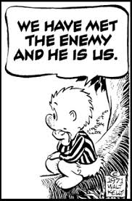
Sing in the spirit of Pogo

Slide 2
Pogo’s Advice
Pogo – comic strip about swamp animals
A group are singing in the swamp
Turtle – What do you think?
Alligator – How do we sound?
Pogo – Well, y’know, it ain’t how good it sounds – it’s how good it feels on the way out.

Slide 3
Introduction
Singing is an important part of our worship.
We can always improve the mechanics of music
God does not require you to have studied music
God does ask that we do the best we can.
We do not have to have a good singing voice
BUT – we are all commanded to sing.

Slide 4
Introduction
(Psalms 150:6) Let everything that has breath praise the LORD. Praise the LORD!
(Psalms 66:1) Make a joyful shout to God, all the earth!
(Psalms 66:1 KJV) Make a joyful noise unto God, all ye lands:
THINK ABOUT SOME TEXTS ON SINGING

Slide 5
Mark 14:26
(Mark 14:26) And when they had sung a hymn, they went out to the Mount of Olives.
Unlearned, fishermen and farmers
Rough, fussing and fighting among themselves.
THEY WERE SINGING WITH JESUS!

Slide 6
1 Corinthians 14:15
(1 Corinthians 14:15) What is the conclusion then? I will pray with the spirit, and I will also pray with the understanding. I will sing with the spirit, and I will also sing with the understanding.
Spirit = with feeling, excitement, meaning
Understanding = pay attention to the words of the song

Slide 7
Ephesians 5:18-19
(Ephesians 5:18) And do not be drunk with wine, in which is dissipation; but be filled with the Spirit,
(Ephesians 5:19) speaking to one another in psalms and hymns and spiritual songs, singing and making melody in your heart to the Lord,
Not drunk with wine, be filled with the Spirit
Make melody in your hearts – (Remember Pogo)

Slide 8
Colossians 3:16-17
(Colossians 3:16) Let the word of Christ dwell in you richly in all wisdom, teaching and admonishing one another in psalms and hymns and spiritual songs, singing with grace in your hearts to the Lord.
(Colossians 3:17) And whatever you do in word or deed, do all in the name of the Lord Jesus, giving thanks to God the Father through Him.
Words of Christ should live in you.
Sing with grace in your hearts. (Remember Pogo)
Do all in the name of the Lord.

Slide 9
Hebrews 2:12
(Hebrews 2:12) saying: "I WILL DECLARE YOUR NAME TO MY BRETHREN; IN THE MIDST OF THE ASSEMBLY I WILL SING PRAISE TO YOU.“
Jesus will sing with us.
He joins in with the church when we sing.

Slide 10
Acts 16:25
(Acts 16:25) But at midnight Paul and Silas were praying and singing hymns to God, and the prisoners were listening to them.
Paul and Silas are in prison
Not professional singers, but praising God in a difficult situation.

Slide 11
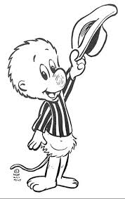
Remember Pogo
“It ain’t how good it sounds – It’s how good it feels on the way out.”
Sing to the best of your ability.
Learn to sing as the song was written.
Sing with spirit
Make melody in your heart.

