Slide 1
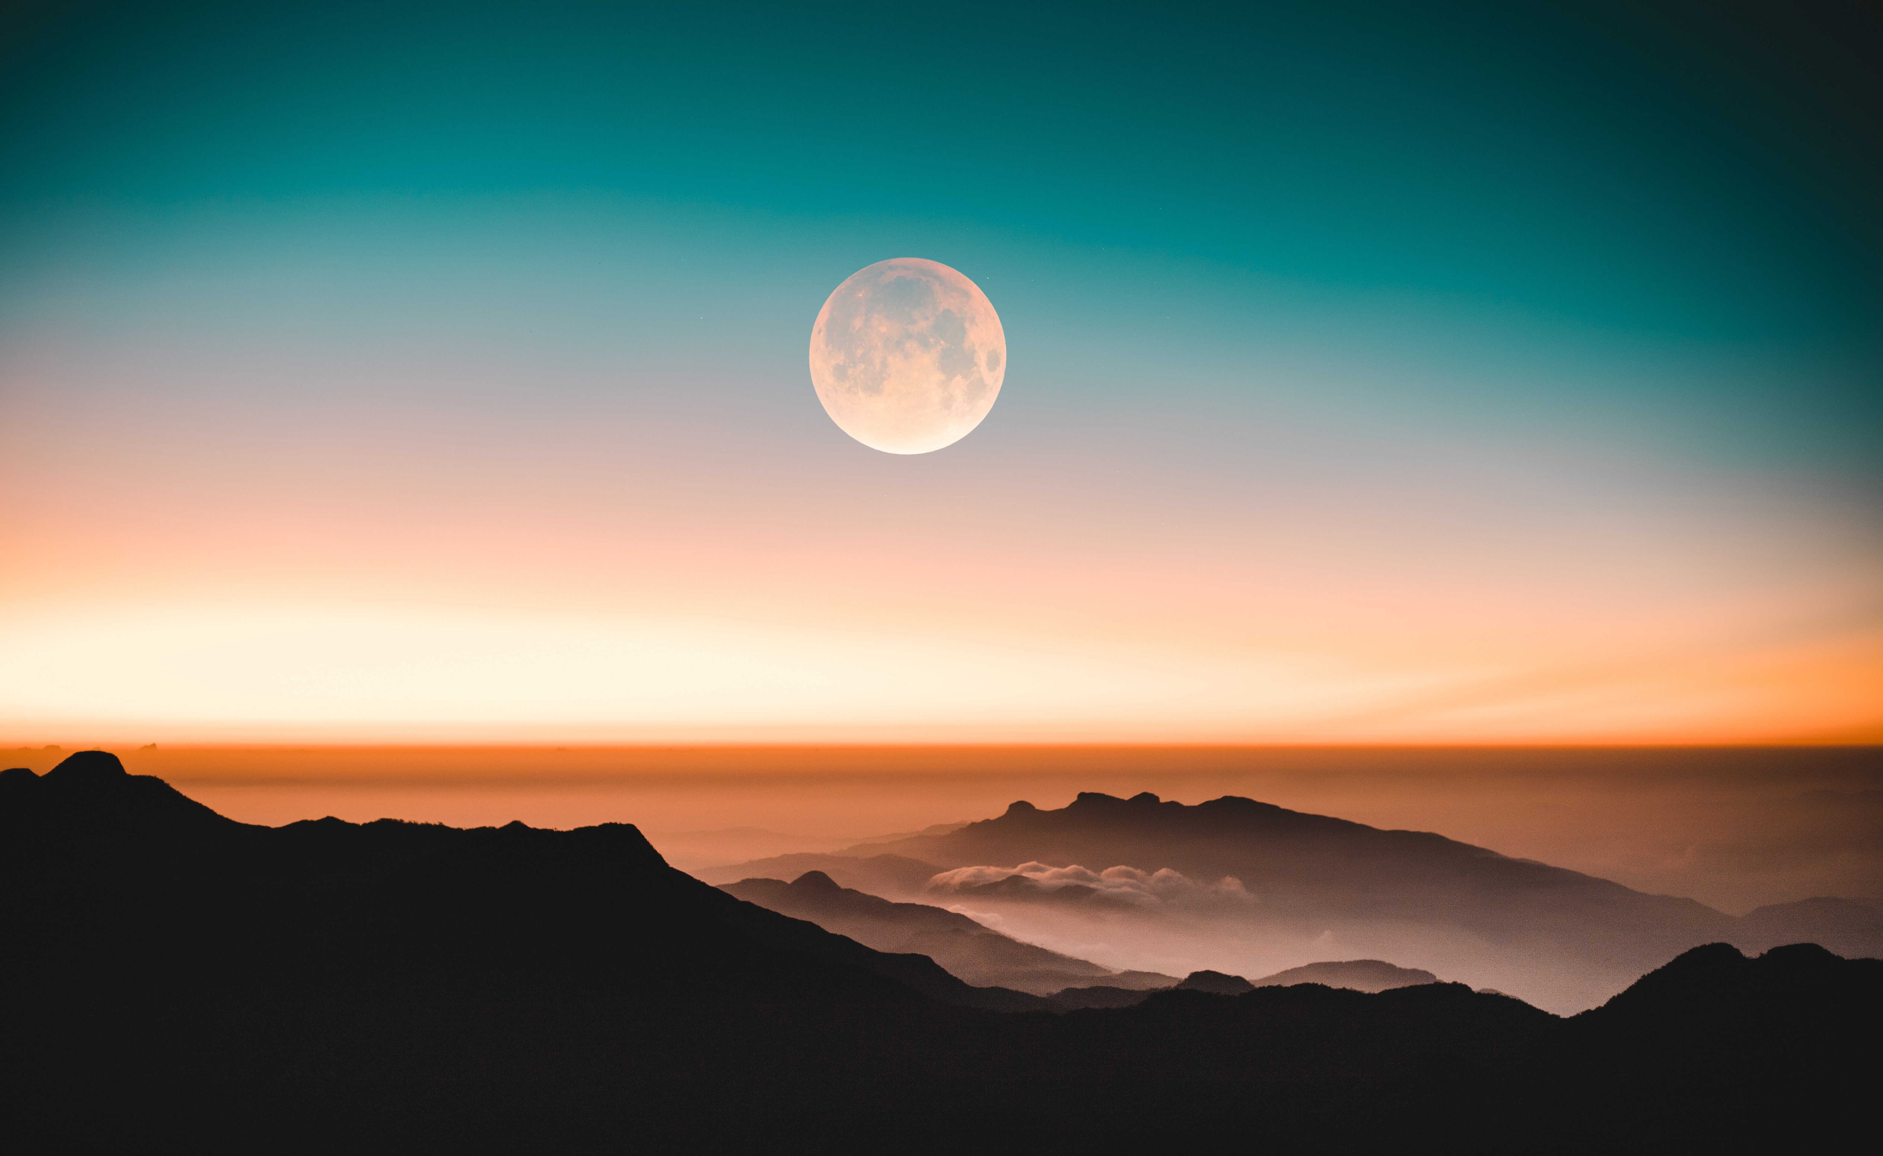
Our Faithful God
From Roy Lanier, Sr.

Slide 2
God Is Faithful
(Deuteronomy 32:3) For I proclaim the name of the LORD: Ascribe greatness to our God.
(Deuteronomy 32:4) He is the Rock, His work is perfect; For all His ways are justice, A God of truth and without injustice; Righteous and upright is He.

Slide 3
God Is Faithful
(Psalm 36:5) Your mercy, O LORD, is in the heavens; Your faithfulness reaches to the clouds.
(Psalm 119:90) Your faithfulness endures to all generations; You established the earth, and it abides.

Slide 4
God Is Faithful
(Lamentations 3:22) Through the LORD's mercies we are not consumed, Because His compassions fail not.
(Lamentations 3:23) They are new every morning; Great is Your faithfulness.

Slide 5
God Keeps His Promises
(Deuteronomy 7:9) "Therefore know that the LORD your God, He is God, the faithful God who keeps covenant and mercy for a thousand generations with those who love Him and keep His commandments;

Slide 6
God Keeps His Promises
(Joshua 21:43) So the LORD gave to Israel all the land of which He had sworn to give to their fathers, and they took possession of it and dwelt in it.

Slide 7
God Keeps His Promises
(Joshua 23:14) "Behold, this day I am going the way of all the earth. And you know in all your hearts and in all your souls that not one thing has failed of all the good things which the LORD your God spoke concerning you. All have come to pass for you; not one word of them has failed.

Slide 8
God Keeps His Promises
(1Kings 8:23) and he said: "LORD God of Israel, there is no God in heaven above or on earth below like You, who keep Your covenant and mercy with Your servants who walk before You with all their hearts.
(1Kings 8:24) You have kept what You promised Your servant David my father; You have both spoken with Your mouth and fulfilled it with Your hand, as it is this day.

Slide 9
God Keeps His Promises
(1Kings 8:25) Therefore, LORD God of Israel, now keep what You promised Your servant David my father, saying, 'You shall not fail to have a man sit before Me on the throne of Israel, only if your sons take heed to their way, that they walk before Me as you have walked before Me.'

Slide 10
God Is Able to Keep His Promises
He is All-Powerful
(Jeremiah 32:17) 'Ah, Lord GOD! Behold, You have made the heavens and the earth by Your great power and outstretched arm. There is nothing too hard for You.
(Jeremiah 32:27) "Behold, I am the LORD, the God of all flesh. Is there anything too hard for Me?

Slide 11
God Is Able to Keep His Promises
He is Unchanging
(Numbers 23:19) "God is not a man, that He should lie, Nor a son of man, that He should repent. Has He said, and will He not do? Or has He spoken, and will He not make it good?
(Malachi 3:6a) "For I am the LORD, I do not change”

Slide 12
God Is Able to Keep His Promises
He is All Knowing
(Isaiah 46:10) Declaring the end from the beginning, And from ancient times things that are not yet done, Saying, 'My counsel shall stand, And I will do all My pleasure,'

Slide 13
Rejoice in God’s Promises
(1Corinthians 1:9) God is faithful, by whom you were called into the fellowship of His Son, Jesus Christ our Lord.

Slide 14
Rejoice in God’s Promises
(1Corinthians 10:13) No temptation has overtaken you except such as is common to man; but God is faithful, who will not allow you to be tempted beyond what you are able, but with the temptation will also make the way of escape, that you may be able to bear it.

Slide 15
Rejoice in God’s Promises
(1John 1:7) But if we walk in the light as He is in the light, we have fellowship with one another, and the blood of Jesus Christ His Son cleanses us from all sin.

Slide 16
Rejoice in God’s Promises
(Hebrews 6:16) For men indeed swear by the greater, and an oath for confirmation is for them an end of all dispute. (17) Thus God, determining to show more abundantly to the heirs of promise the immutability of His counsel, confirmed it by an oath,

Slide 17
Rejoice in God’s Promises
(Hebrews 6:18) that by two immutable things, in which it is impossible for God to lie, we might have strong consolation, who have fled for refuge to lay hold of the hope set before us. (19) This hope we have as an anchor of the soul, both sure and steadfast, and which enters the Presence behind the veil,

