Slide 1
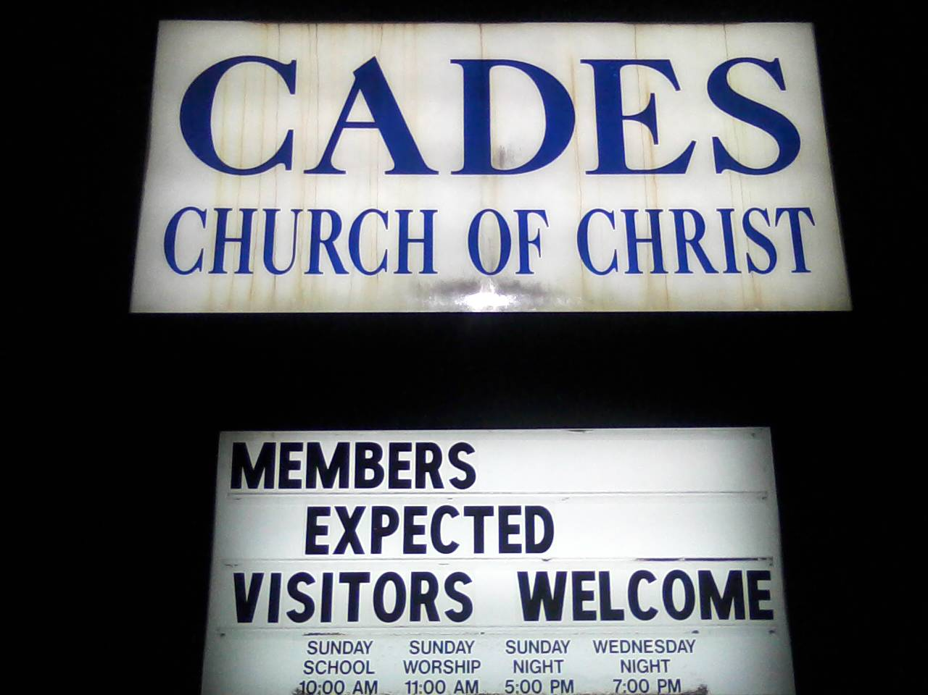
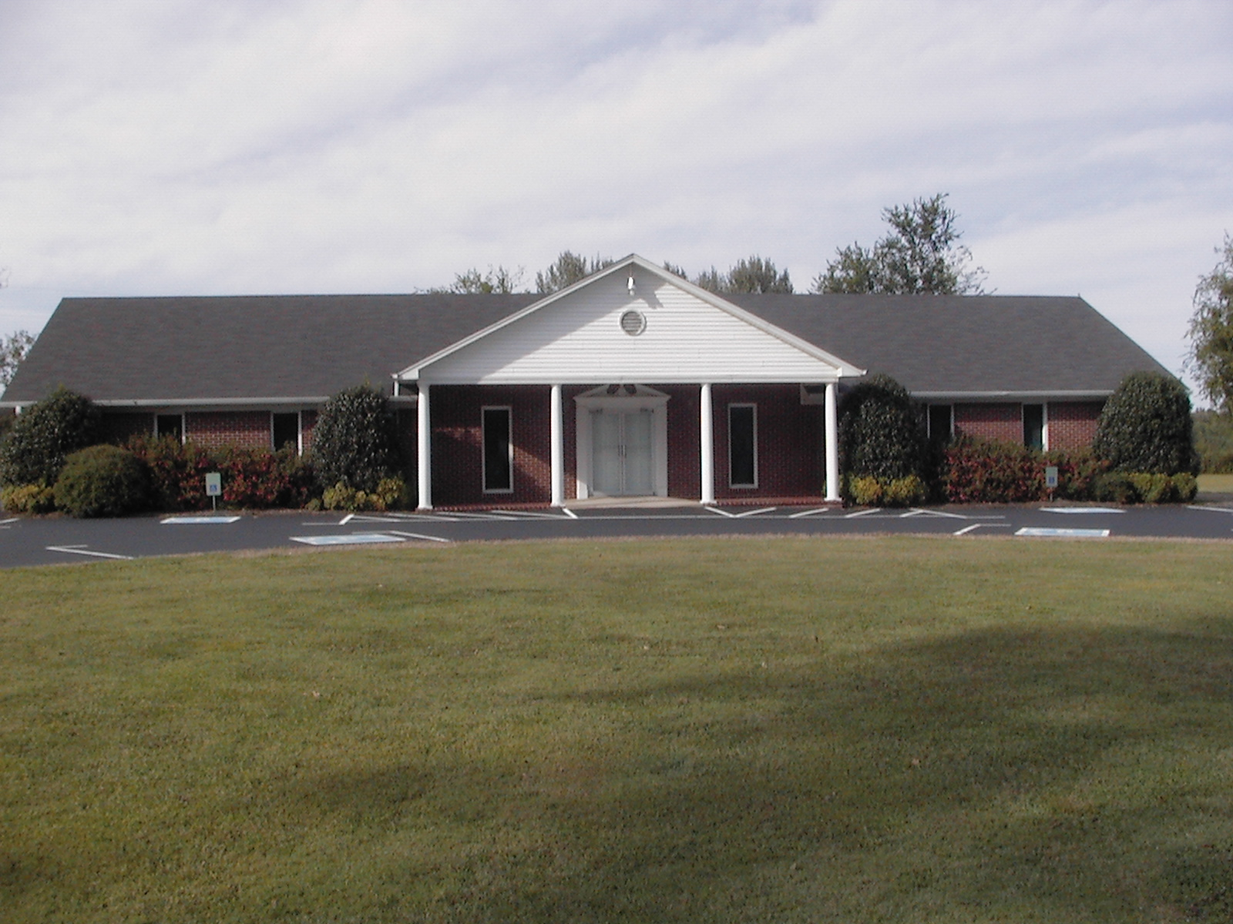
Our Church Home
Church is family
Every Sunday is homecoming

Slide 2
Church is Home / Family
Jehovah is our Father
We are brothers and sisters in Christ
We are born into the family of God
We are of one blood
We are brothers and sisters in Christ
Any where you go – you are home with family

Slide 3
Cades is Home
We are a put-together family
From different places, backgrounds, education
Somehow – we all wound up here – together
We are home at Cades

Slide 4
We have a lot going for us
Bears – for children at the hospital
Activities for Children – Egg Hunt, Trunk or Treat, Vacation Bible School
House to House – mailed to 1,000 in area
Mission Work – Thailand, Laos, Myamar – Daniel Hamm; Kirovo-Chepetsk, Russia
Potter Childrens Home – Pantry full

Slide 5
As a Home we:
Support each other in time of weakness
Exodus 17:12 – Aaron and Hur hold up the hands of Moses

Slide 6
As a Home we:
Support each other in time of weakness
Have Unity
Judges 20:11 So all the men of Israel were gathered against the city, united together as one man.

Slide 7
As a Home we:
Support each other in time of weakness
Have Unity
Accomplish great tasks
2 Kings 6:1-3 Needed to move a whole building – each man carried one board
They moved the whole building

Slide 8
As a Home we:
Support each other in time of weakness
Have Unity
Accomplish great tasks
Have power
Matthew 18:19-20 Again I say to you that if two of you agree on earth concerning anything that they ask, it will be done for them by My Father in heaven. 20 For where two or three are gathered together in My name, I am there in the midst of them.

Slide 9
As a Home we:
Support each other in time of weakness
Have Unity
Accomplish great tasks
Have power
Bring men to Christ
Mark 2:3 – 4 friends bring a man with palsy
John 1:40-45
Andrew brings Peter
Philip brings Nathaniel
I Corinthians 3:6 – Paul planted, Apollos watered, God gave the increase

Slide 10
God’s Family
We are part of the family that’s been born again
Part of the family whose love knows no end;
For Jesus has saved us, and made us his own,
Now we’re part of the family that’s on its way home.

Slide 11
God’s Family
When a brother meets sorrow we all feel his grief;
When he’s passed through the valley we all feel relief;
Together in sunshine, together in rain,
Together in victory through His precious name.

Slide 12
God’s Family
And tho some go before us, we’ll all meet again;
Just inside the city as we enter in;
There’ll be no more parting, with Jesus we’ll be,
Together forever, God’s family

Slide 13
God’s Family
And sometimes we laugh together, sometimes we cry;
Sometimes we share together, heartaches and sighs;
Sometimes we dream together of how it will be
When we all get to Heaven, God’s family.

Slide 14
Are you part of God’s Family?
Are you part of a local congregation?
Do you have a church you call HOME?
Don’t miss out on the joy and blessing of being part of the family

