Slide 1
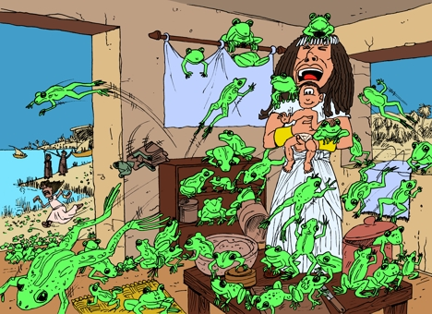
One more night with the frogs
Exodus 8:5-11

Slide 2
Exodus 8:5-11
8 And Pharaoh called for Moses and Aaron, and said, Pray to Jehovah that He may take away the frogs from me and from my people. And I will let the people go, so that they may sacrifice to Jehovah. 9 And Moses said to Pharaoh, Glory over me! When shall I pray for you, and for your servants, and for your people, to destroy the frogs from you and your houses, so that they may remain in the river only? 10 And he said, Tomorrow. And he said, It shall be according to your word, so that you may know that there is none like Jehovah our God. 11 And the frogs shall depart from you, and from your houses, and from your servants, and from your people. They shall remain in the river only.

Slide 3
Plague of Frogs
Frogs everywhere! In Bed. In cooking pots. In clothes. In their drinking water. On the floor.
Pharaoh calls for Moses to get rid of the frogs.
He promises to let the people go.
Moses asks when do you want them only in the river?
Pharaoh said, TOMORROW.

Slide 4
“Tomorrow” is Dangerous: 1] You can miss a relationship with God
Luke 9:59-62 59 And He said to another, Follow Me! But he said, Lord, first allow me to go and bury my father. 60 Jesus said to him, Let the dead bury their dead, but you go and proclaim the kingdom of God. 61 And another also said, Lord, I will follow You, but first allow me to take leave of those in my house. 62 And Jesus said to him, No one, having put his hand to the plow and looking back, is fit for the kingdom of God.

Slide 5
“Tomorrow” is Dangerous: 2] The frogs may not leave
Rich Young Ruler – Mark 10:17-27 – Had great riches
Felix – Acts 24:25 – Looking for a more convenient season
Agrippa – Acts 26:25 – Almost persuaded
Some delay being baptized – “When I get straightened out.”

Slide 6
“Tomorrow” is Dangerous: 3] Something worse will take its place
After the frogs came –
Lice Flies Locusts Boils
Fire Darkness Death of the firstborn
Pride keeps us from surrendering to Christ
Love of money – 1 Timothy 6:10
Jeremiah 2:19 Your own evil shall correct you, and your backslidings shall reprove you

Slide 7
“Tomorrow” is Dangerous: 4] Tomorrow may never come
Proverbs 27:1 Do not boast yourself of tomorrow
James 4:4 For what is your life? For it is a vapor, which appears for a little time, and then disappears.

Slide 8
“Tomorrow” is Dangerous: 4] Tomorrow may never come
Hebrews 4:7 He again marks out a certain day, saying in David, "Today," (after so long a time). Even as it is said, "Today, if you will hear His voice, harden not your hearts."
2 Corinthians 6:2 (For He says, "In an acceptable time I heard you, and in a day of salvation, I helped you;" Behold, now is the accepted time. Behold, now is the day of salvation.)

Slide 9
This Lesson Applies:
Pharaoh and Egypt
Christians about their work in the church
Weak members about church attendance
Lost who need to obey the gospel and be baptized
All who face an unpleasant task
Apply this lesson at: Work, Home, School, Church, Personal life

