Slide 1

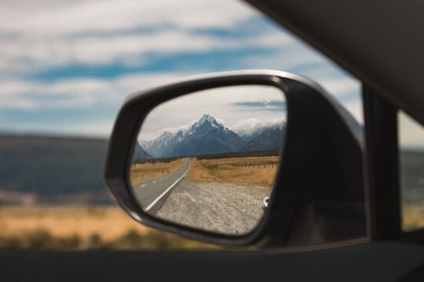
The Enemy called
NOSTALGIA
Are we looking back?

Slide 2
Define:
Nostalgia
A wistful desire to return in thought or in fact to a former time in life.
A desire to return to home or homeland, or go to one’s family or friends.
A sentimental yearning for the happiness of a former time or place in life.

Slide 3
Have you had strong feelings of nostalgia?
It might be a smell, taste, or photograph from the past.
It might be a song you hear.
Reflecting deeply on the past is often a coping mechanism to deal with problems today.

Slide 4
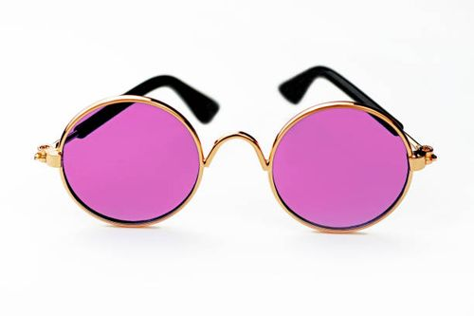
Nostalgia can be dangerous.
The good old days were not as good as we remember.
We often look through rose colored classes.

Slide 5
Nostalgia can be dangerous.
Thinking about the past leads to dissatisfaction with the present.
It can lead to a defeated attitude toward life.
Don’t forget the past.
But you can’t live there.

Slide 6
Nostalgia has hurt God’s people in the past.
At Sodom – Lot’s wife
(Gen 19:26) But his wife looked back behind him, and she became a pillar of salt.

Slide 7
Nostalgia has hurt God’s people in the past.
At Sodom – Lot’s wife
Israel leaving Egypt
(Exo 14:12) Is this not the word that we told you in Egypt, saying, 'Let us alone that we may serve the Egyptians'? For it would have been better for us to serve the Egyptians than that we should die in the wilderness."

Slide 8
Nostalgia has hurt God’s people in the past.
At Sodom – Lot’s wife
Israel leaving Egypt
In the wilderness
(Num 14:3) Why has the LORD brought us to this land to fall by the sword, that our wives and children should become victims? Would it not be better for us to return to Egypt?“ (4) So they said to one another, "Let us select a leader and return to Egypt."

Slide 9
Nostalgia has hurt God’s people in the past.
At Sodom – Lot’s wife
Israel leaving Egypt
In the wilderness
After 70 years in captivity
(Ezra 3:12) But many of the priests and Levites and heads of the fathers' houses, old men who had seen the first temple, wept with a loud voice when the foundation of this temple was laid before their eyes. Yet many shouted aloud for joy,

Slide 10
Nostalgia has hurt God’s people in the past.
At Sodom – Lot’s wife
Israel leaving Egypt
In the wilderness
After 70 years in captivity
(Haggai 2:3) 'Who is left among you who saw this temple in its former glory? And how do you see it now? In comparison with it, is this not in your eyes as nothing?

Slide 11
Nostalgia still hurts the church.
Remember when we were growing?
Remember how full this place was each Sunday?
Remember when we had 65-70 every week?
We talk about the “glory days” of the past.

Slide 12
Nostalgia still hurts the church.
No preacher can live up to the sermons of the past.
When members begin to idolize the past - - - they paralyze the the present.
The church can’t be like Israel, always looking back.

Slide 13
Solomon wrote -
Ecclesiastes 7:10
Do not say, "Why were the former days better than these?" For you do not inquire wisely concerning this.

Slide 14
Solomon was
RIGHT!
Let’s learn from the past.
Celebrate the past.
Stop trying to live in the past.
Let’s be God’s church today.

Slide 15
SERVE GOD IN THE PRESENT
We can’t live in the past. We must seize the present and serve God –
NOW!
WHERE WE ARE!

