Slide 1
UNPARDONABLE SIN?
Is there such a thing as a sin that can not be forgiven?

Slide 2
Introduction
²⁸ "Assuredly, I say to you, all sins will be forgiven the sons of men, and whatever blasphemies they may utter; ²⁹ but he who blasphemes against the Holy Spirit never has forgiveness, but is subject to eternal condemnation"– Mark 3:28-29

Slide 3
Introduction
Many misunderstand this passage.
What is it?
Have I done it?
Why can’t God forgive it?
Does this idea contradict other passages that say ALL sin can be forgiven?

Slide 4
The Charge
His power is from false gods.
And the scribes who came down from Jerusalem said, "He has Beelzebub," and, "By the ruler of the demons He casts out demons." Mark 3:22
Beelzebub = Lord of the flies

Slide 5
The Responses
Jesus answers with 3 arguments
Can Satan cast out Satan? ²⁴ If a kingdom is divided against itself, that kingdom cannot stand. ²⁵ And if a house is divided against itself, that house cannot stand. ²⁶ And if Satan has risen up against himself, and is divided, he cannot stand, but has an end. Mark 3:24-26

Slide 6
The Responses
Jesus answers with 3 arguments
Can Satan cast out Satan?
Robber must overpower to rob the house. No one can enter a strong man's house and plunder his goods, unless he first binds the strong man. And then he will plunder his house. Mark 3:27

Slide 7
The Responses
Jesus answers with 3 arguments
Can Satan cast out Satan?
Robber must overpower to rob the house.
All sin is forgiven – IF: Assuredly, I say to you, all sins will be forgiven the sons of men, and whatever blasphemies they may utter Mark 3:28

Slide 8
ALL SIN CAN BE FORGIVEN
But if we walk in the light as He is in the light, we have fellowship with one another, and the blood of Jesus Christ His Son cleanses us from all sin. 1 John 1:7
If we confess our sins, He is faithful and just to forgive us our sins and to cleanse us from all unrighteousness. 1 John 1:9

Slide 9
The Result
Blaspheme = contemptuous speech, to rail, revile
NOT – just to speak against
IS – total, complete rejection, contempt
Holy Spirit – 3rd person in trinity
God the Father – Patriarchal Age
God the Son – Mosaical Age
God the Holy Spirit – Christian Age

Slide 10
The Result
⁴ For it is impossible for those who were once enlightened, and have tasted the heavenly gift, and have become partakers of the Holy Spirit, ⁵ and have tasted the good word of God and the powers of the age to come, ⁶ if they fall away, to renew them again to repentance, since they crucify again for themselves the Son of God, and put Him to an open shame. Hebrews 6:4-6

Slide 11
The Result
If we confess our sins, He is faithful and just to forgive us our sins and to cleanse us from all unrighteousness. 1 John 1:9
NOT – Unpardonable
BUT – Unpardoned
REASON – Will not confess or repent

Slide 12
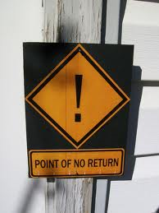
The Lessons to Learn
There is a point of no return – Don’t pass it.

Slide 13
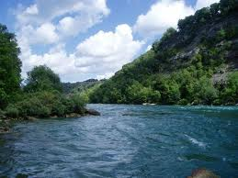
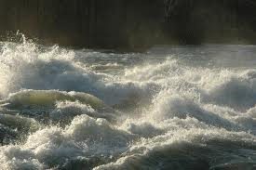
The Lessons to Learn
Calm river – becomes rapids
Reject, reject, reject – You will run out of offers, help, rescue

Slide 14
The Lessons to Learn
There is a point of no return – Don’t pass it.
God is always ready to forgive
We are not always ready to seek forgiveness, to repent, to change

Slide 15
The Lessons to Learn
There is a point of no return – Don’t pass it.
God is always ready to forgive
We are not always ready to seek forgiveness, to repent, to change
If you are concerned – you have not gone too far.

