Slide 1
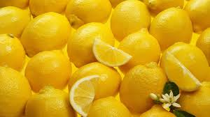
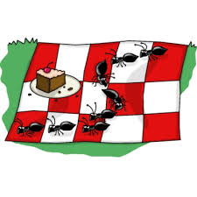
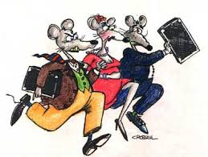
3 Life Lessons
Lemons Ants Rats

Slide 2
The fruit of the Spirit is not Lemons
Lots of life is sour
Lots of lemons in our life
Do we spend too much time thinking about the bad stuff and miss the good things in life?

Slide 3
The fruit of the Spirit is not Lemons
FOCUS ON: Galatians 5:21-22
LOVE JOY
PEACE
LONGSUFFERING (PATIENCE)
KINDNESS GOODNESS
FAITHFULNESS GENTLENESS
SELF-CONTROL

Slide 4
Even the ants take time to go to a picnic
Is your life going by too fast?
We miss a lot – take time to smell the roses, hear the birds sing, watch a squirrel scamper up a tree, play with a child
Even the busy ants take time for a picnic.

Slide 5
Even the ants take time to go to a picnic
COME APART – OR YOU WILL !!!
Mark 6:31 And he said unto them, Come ye yourselves apart into a desert place, and rest a while: for there were many coming and going, and they had no leisure so much as to eat. (KJV)

Slide 6
If you win the rat race, you are still a rat.
When this life ends – what will you be?
No matter what is said at your funeral
No matter what you possess – money, property, things, fame
Win the rat race – you’re still a rat.

Slide 7
If you win the rat race, you are still a rat.
Philippians 1:21-23 ²¹ For to me, to live is Christ, and to die is gain. ²² But if I live on in the flesh, this will mean fruit from my labor; yet what I shall choose I cannot tell. ²³ For I am hard pressed between the two, having a desire to depart and be with Christ, which is far better.
YOU WILL STILL BE YOU !

