Slide 1
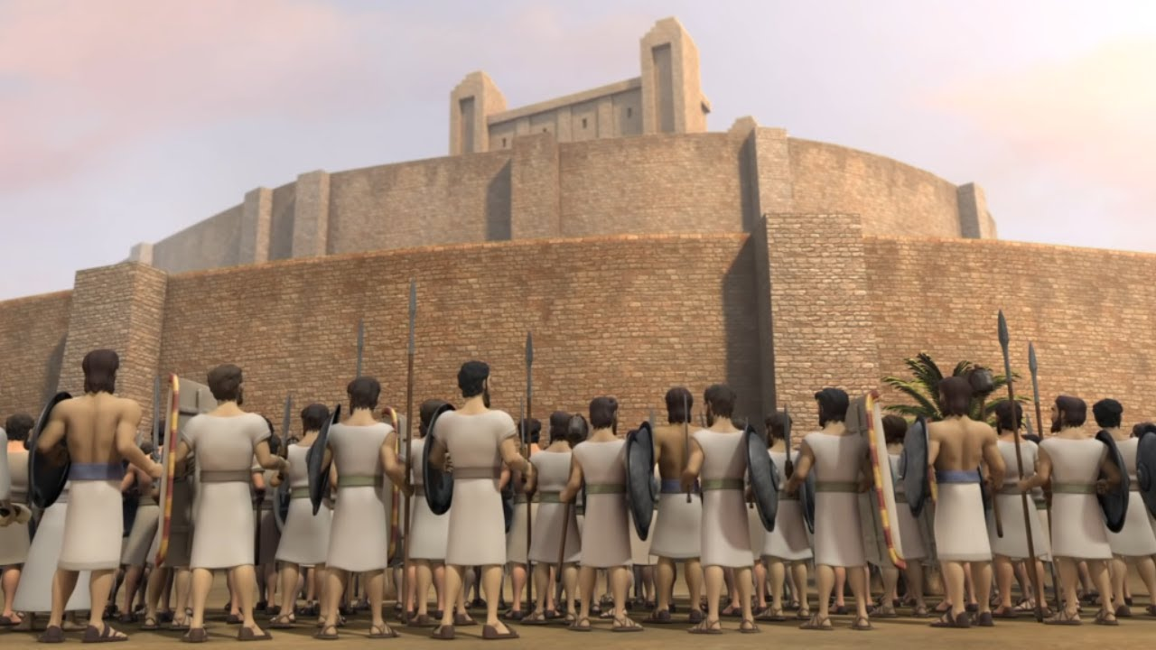
Lessons from Jericho
(Hebrews 11:30) By faith the walls of Jericho fell down after they were encircled for seven days.

Slide 2
Obstacles to enter the Promised Land
After 40 years in the wilderness – they are ready to take the land God promised to Abraham.
HOWEVER – 2 major obstacles were in their way:
CROSSING THE JORDAN RIVER
RIGHT AWAY THEY FACE JERICHO

Slide 3
Obstacles to enter the Promised Land
(Hebrews 11:30) By faith the walls of Jericho fell down after they were encircled for seven days.
In the battle for Jericho there are some lessons we must learn.

Slide 4
1 The job before us is not easy
The last 40 years were not easy.
Now the task of taking the land.
“Must I be carried to the skies On flowery beds of ease? While others fought to gain the prize And sailed through bloody seas.”
They would have to do their part.
Living the Christian life is not easy.

Slide 5
2 The Great power of God
They would need God’s power to win.
They knew it was beyond they ability.
They would have to do their part.
They they would need to trust God’s power.
We must learn to trust the power of God to will our battles.

Slide 6
3 They would have to fight to stay
They had to conquer the land.
They had to keep fighting to keep the land.
Some wanted to stay on the other side of the Jordan River.
Some wanted to return to Egypt.
Those who oppose us will cause us trouble.
We must keep fighting.

Slide 7
4 Opposition to us does not mean we are wrong
God and His people have always be opposed and rejected.
Satan wants us to think if we are opposed, we must be wrong.
Satan questions our motives.
Satan questions our attitude.

Slide 8
5 GOD’S HATRED FOR SIN
Why did God drive out the inhabitants?
Because of the sinfulness, rebellion, and rejection of God.
This lesson is repeated with Achan.
Have we learned how much God HATES SIN?

Slide 9
6 THE INFLUENCE OF SIN IN THE CAMP
Why did Israel suffer death and loss with the kings of Ai?
Sin was in the camp – Achan
After the sin was removed – Isarel won the battle with Ai.

Slide 10
7 THE IMPORTANCE OF FAITH
Israel had to learn the importance of faith and the need to obey God.
God gave very specific commands.
They were to do God’s things; God’s way.
They must take God at His word, even when it does not make sense.

Slide 11
8 GIVING IS CONDITIONAL
God gave them the city – but there were conditions they had to meet.
Salvation is a gift from God.
But there are conditions we must meet.

Slide 12
ISREAL LEARNED SOME LESSONS
What about us?
Have we learned these lessons?
WE CAN, WE MUST, LEARN THE SAME GREAT LESSONS TODAY.

