Slide 1
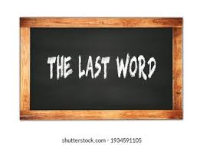

Slide 2
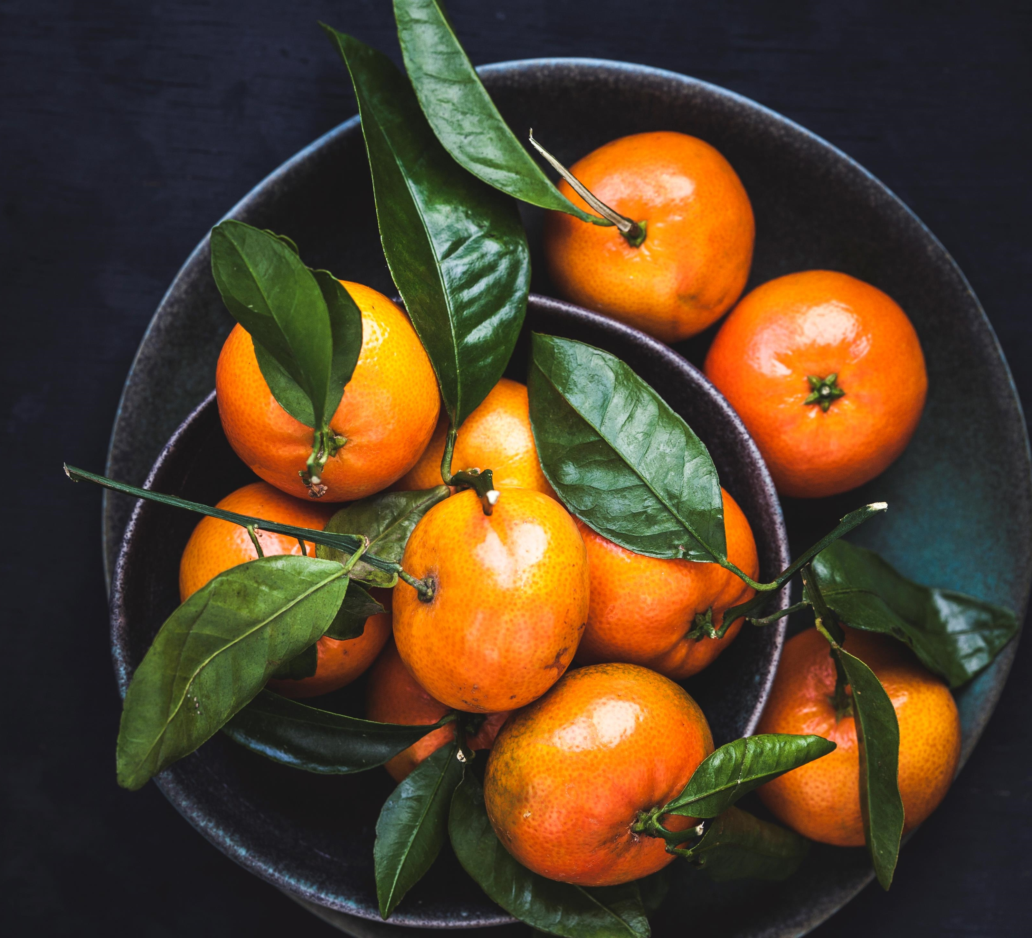
The last supper
A “last word” study

Slide 3
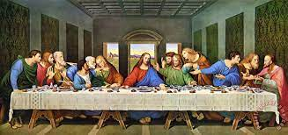
We are not talking about:
Many think of the last supper as the last meal Jesus ate with the apostles before his death.

Slide 4
Eating is important in the life of christ
Jesus told several parables about dinner invitations
Man without a wedding garment
10 Virgins
Excuses for not coming
Do not sit at the head table

Slide 5
Eating is important in the life of christ
Jesus accepted many dinner invitations
Simon the leper
Martha and Mary
Zaccheus
Wedding feast – (first miracle)

Slide 6
All are invited (given opportunity to come)
(Matthew 11:28) Come to Me, all you who labor and are heavy laden, and I will give you rest.
(Matthew 11:29) Take My yoke upon you and learn from Me, for I am gentle and lowly in heart, and you will find rest for your souls.
(Matthew 11:30) For My yoke is easy and My burden is light."

Slide 7
All are invited (given opportunity to come)
(Revelation 22:17) And the Spirit and the bride say, "Come!" And let him who hears say, "Come!" And let him who thirsts come. Whoever desires, let him take the water of life freely.
(Revelation 3:20) Behold, I stand at the door and knock. If anyone hears My voice and opens the door, I will come in to him and dine with him, and he with Me.

Slide 8
Many refuse to accept
Luke 14:16-24 – Parable of excuses
(Matthew 7:13) "Enter by the narrow gate; for wide is the gate and broad is the way that leads to destruction, and there are many who go in by it.
(Matthew 7:14) Because narrow is the gate and difficult is the way which leads to life, and there are few who find it.

Slide 9
Plan to come, but get sidetracked
2 Peter 2:20-22 – pig returns to the mud
(Hebrews 6:4) For it is impossible for those who were once enlightened, and have tasted the heavenly gift, and have become partakers of the Holy Spirit, (5) and have tasted the good word of God and the powers of the age to come, (6) if they fall away, to renew them again to repentance, since they crucify again for themselves the Son of God, and put Him to an open shame.

Slide 10
Plan to come, but get sidetracked
(Galatians 5:4) You have become estranged from Christ, you who attempt to be justified by law; you have fallen from grace.
(Hebrews 3:12) Beware, brethren, lest there be in any of you an evil heart of unbelief in departing from the living God;

Slide 11
Plan to come, but get sidetracked
(1 Timothy 4:1) Now the Spirit expressly says that in latter times some will depart from the faith, giving heed to deceiving spirits and doctrines of demons,
(1 Timothy 1:19) having faith and a good conscience, which some having rejected, concerning the faith have suffered shipwreck,

Slide 12
Some think they are coming, but they are not
(Matthew 7:21) "Not everyone who says to Me, 'Lord, Lord,' shall enter the kingdom of heaven, but he who does the will of My Father in heaven.
(Matthew 7:22) Many will say to Me in that day, 'Lord, Lord, have we not prophesied in Your name, cast out demons in Your name, and done many wonders in Your name?'
(Matthew 7:23) And then I will declare to them, 'I never knew you; depart from Me, you who practice lawlessness!'

Slide 13
Some think they are coming, but they are not
Matthew 25:41-46 – Did not feed, clothe, visit, offer help
(Luke 18:9) Also He spoke this parable to some who trusted in themselves that they were righteous, and despised others:

Slide 14
The last supper
(Revelation 19:9) Then he said to me, "Write: 'Blessed are those who are called to the marriage supper of the Lamb!' " And he said to me, "These are the true sayings of God."
Faithful Christians are invited to the “LAST SUPPER”

Slide 15
The last supper
(Revelation 19:17) Then I saw an angel standing in the sun; and he cried with a loud voice, saying to all the birds that fly in the midst of heaven, "Come and gather together for the supper of the great God,
(Revelation 19:18) that you may eat the flesh of kings, the flesh of captains, the flesh of mighty men, the flesh of horses and of those who sit on them, and the flesh of all people, free and slave, both small and great."
(Revelation 19:19) And I saw the beast, the kings of the earth, and their armies, gathered together to make war against Him who sat on the horse and against His army.

Slide 16
The last supper
(Revelation 19:20) Then the beast was captured, and with him the false prophet who worked signs in his presence, by which he deceived those who received the mark of the beast and those who worshiped his image. These two were cast alive into the lake of fire burning with brimstone.
(Revelation 19:21) And the rest were killed with the sword which proceeded from the mouth of Him who sat on the horse. And all the birds were filled with their flesh.

Slide 17
The last supper
This passage is not about a literal meal of eating people (cannibalism).
It is about the total victory of God and His people over all the enemies who fought against God.
We may suffer now – but in the end – God wins!
Faithful Christians – Win!

Slide 18
The last supper
You are invited to the marriage supper of the Lamb.
You will eat with Christ – OR – you will be eaten.
You are an invited guest at the dinner
OR you ARE the dinner.

