Slide 1
Joseph forgave his brothers
HOW COULD HE DO THAT?

Slide 2
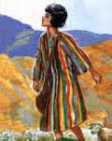
The story of Joseph
Almost half of the book of Genesis is the story of one man – Joseph
He father gave him a coat of many colors
This made his brothers jealous

Slide 3
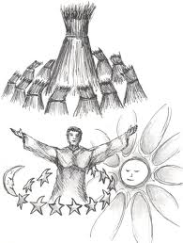
The story of Joseph
His dreams added to their hatred
The sheaves of wheat bow down to Joseph
The stars bow down to Joseph
They are ready to kill him.

Slide 4
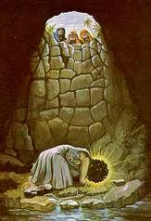
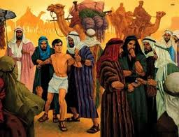
The story of Joseph
Instead, they put him in a pit to die
Then they sold into slavery in Egypt

Slide 5
Focus on Forgiveness
¹⁵ When Joseph's brothers saw that their father was dead, they said, "Perhaps Joseph will hate us, and may actually repay us for all the evil which we did to him." ¹⁶ So they sent messengers to Joseph, saying, "Before your father died he commanded, saying, Genesis 50:15-16

Slide 6
Focus on Forgiveness
¹⁷ 'Thus you shall say to Joseph: "I beg you, please forgive the trespass of your brothers and their sin; for they did evil to you." ' Now, please, forgive the trespass of the servants of the God of your father." And Joseph wept when they spoke to him. ¹⁸ Then his brothers also went and fell down before his face, and they said, "Behold, we are your servants." Genesis 50:17-18

Slide 7
Focus on Forgiveness
¹⁹ Joseph said to them, "Do not be afraid, for am I in the place of God? ²⁰ But as for you, you meant evil against me; but God meant it for good, in order to bring it about as it is this day, to save many people alive. ²¹ Now therefore, do not be afraid; I will provide for you and your little ones." And he comforted them and spoke kindly to them. Genesis 50:19-21

Slide 8
How could Joseph forgive them?
THEY HATED HIM - But when his brothers saw that their father loved him more than all his brothers, they hated him and could not speak peaceably to him. Genesis 37:4

Slide 9
How could Joseph forgive them?
ATTEMPTED MURDER - Come therefore, let us now kill him and cast him into some pit; and we shall say, 'Some wild beast has devoured him.' We shall see what will become of his dreams!" Genesis 37:20

Slide 10
How could Joseph forgive them?
SOLD INTO SLAVERY - Then Midianite traders passed by; so the brothers pulled Joseph up and lifted him out of the pit, and sold him to the Ishmaelites for twenty shekels of silver. And they took Joseph to Egypt. Genesis 37:28

Slide 11
How could Joseph forgive them?
FALSELY ACCUSED - ¹⁶ So she kept his garment with her until his master came home. ¹⁷ Then she spoke to him with words like these, saying, "The Hebrew servant whom you brought to us came in to me to mock me; Genesis 39:16-17

Slide 12
How could Joseph forgive them?
FALSELY ACCUSED - ¹⁹ So it was, when his master heard the words which his wife spoke to him, saying, "Your servant did to me after this manner," that his anger was aroused. ²⁰ Then Joseph's master took him and put him into the prison, a place where the king's prisoners were confined. And he was there in the prison. Gen 39:19-20

Slide 13
How could Joseph forgive them?
BUTLER FORGOT HIM - ¹⁴ But remember me when it is well with you, and please show kindness to me; make mention of me to Pharaoh, and get me out of this house. ¹⁵ For indeed I was stolen away from the land of the Hebrews; and also I have done nothing here that they should put me into the dungeon." Genesis 40:14-15
Yet the chief butler did not remember Joseph, but forgot him. Genesis 40:23

Slide 14
How could Joseph forgive them?
2 YEARS IN PRISON - Then it came to pass, at the end of two full years, that Pharaoh had a dream; and behold, he stood by the river. Genesis 41:1
WHOSE FALUT IS ALL OF THIS MISFORTUNE? – HIS BROTHERS!
AND NOW THEY COME ASKING FOR FORGIVENESS

Slide 15
Joseph’s Attitude - Providence
⁴ And Joseph said to his brothers, "Please come near to me." So they came near. Then he said: "I am Joseph your brother, whom you sold into Egypt. ⁵ But now, do not therefore be grieved or angry with yourselves because you sold me here; for God sent me before you to preserve life. Genesis 45:4-5

Slide 16
Joseph’s Attitude - Providence
⁶ For these two years the famine has been in the land, and there are still five years in which there will be neither plowing nor harvesting. ⁷ And God sent me before you to preserve a posterity for you in the earth, and to save your lives by a great deliverance. ⁸ So now it was not you who sent me here, but God; and He has made me a father to Pharaoh, and lord of all his house, and a ruler throughout all the land of Egypt. Genesis 45:6-8

Slide 17
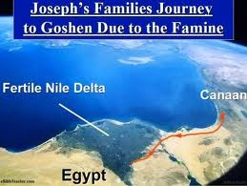
Joseph’s Attitude – Give Land
And Joseph situated his father and his brothers, and gave them a possession in the land of Egypt, in the best of the land, in the land of Rameses, as Pharaoh had commanded. Genesis 47:11

Slide 18
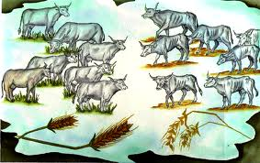
Joseph’s Attitude – Fed Them
Then Joseph provided his father, his brothers, and all his father's household with bread, according to the number in their families. Genesis 47:12
Not skinny cows now
They were fat cows

Slide 19
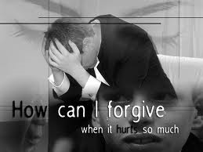
What would you do?
¹⁴ "For if you forgive men their trespasses, your heavenly Father will also forgive you. ¹⁵ But if you do not forgive men their trespasses, neither will your Father forgive your trespasses. Matthew 6:14-15

Slide 20
What would you do?
It fills us with awe to think that one condition of the forgiveness of our own sins is the forgiveness by us of sins committed against us. One of the most difficult duties of life is to forgive our fellows, yet the most essential thing that we pray for is contingent on it. Let us realize the fact, and act and pray accordingly.—Commentary on Matthew and Mark, J. W. McGarvey

Slide 21
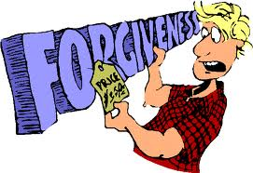
What would you do?
What you would have done?
Are we willing to forgive those who wrong us?
In order for God to forgive us, we must be willing to forgive others.
FORGIVENESS HAS A PRICE. ARE YOU WILLING TO PAY THE PRICE?

