Slide 1
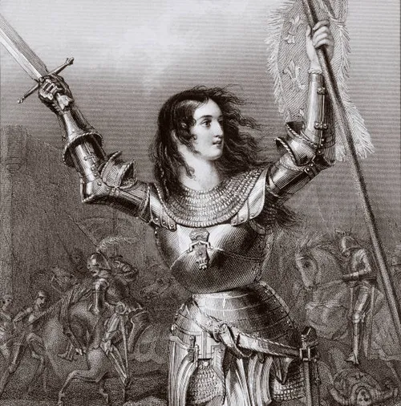
Was Joan of Arc Really Noah’s Wife?
HOW MUCH DO YOU KNOW ABOUT THE BIBLE?

Slide 2
Introduction
Even in our well educated world, many are still illiterate.
The Bible is often misunderstood.
Some examples:
12% believe Joan of Arc was Noah’s wife
38% believe the entire Bible was written in a few years after Christ.
11% think Isaiah is in the New Testament
49% believe the Bible says, “Money is root of all evil.”

Slide 3
Introduction
Even in our well educated world, many are still illiterate.
The history of the Bible is often misunderstood.
A couple more examples:
56% think the Bible teaches that the most important thing in life is to take care of family
75% believe the Bible says the God helps those who help themselves

Slide 4
It is possible to understand the Bible
(Joh 8:32) And you shall know the truth, and the truth shall make you free."
(1Co 2:12) Now we have received, not the spirit of the world, but the Spirit who is from God, that we might know the things that have been freely given to us by God.
(1Co 2:13) These things we also speak, not in words which man's wisdom teaches but which the Holy Spirit teaches, comparing spiritual things with spiritual.

Slide 5
It is possible to understand the Bible
(1Co 2:16) For "WHO HAS KNOWN THE MIND OF THE LORD THAT HE MAY INSTRUCT HIM?" But we have the mind of Christ.
(1Co 1:10) Now I plead with you, brethren, by the name of our Lord Jesus Christ, that you all speak the same thing, and that there be no divisions among you, but that you be perfectly joined together in the same mind and in the same judgment.

Slide 6
People Fail to Understand the Bible
WHAT ARE THE REASONS FOR THIS?
1 – They do not read / study the Bible.
57% do not read the Bible each week.
12% read the Bible daily (average is 7 minutes)
59% read the Bible “occasionally”
NOTE: This is down from 73% in 1980.

Slide 7
People Fail to Understand the Bible
WHAT ARE THE REASONS FOR THIS?
1 – They do not read / study the Bible.
2 – Bible is too difficult to understand.
31% say it is too difficult to read / understand.

Slide 8
People Fail to Understand the Bible
WHAT ARE THE REASONS FOR THIS?
1 – They do not read / study the Bible.
2 – Bible is too difficult to understand.
(Act 17:11) These were more fair-minded than those in Thessalonica, in that they received the word with all readiness, and searched the Scriptures daily to find out whether these things were so.
(2Ti 2:15) Be diligent to present yourself approved to God, a worker who does not need to be ashamed, rightly dividing the word of truth.

Slide 9
People Fail to Understand the Bible
WHAT ARE THE REASONS FOR THIS?
1 – They do not read / study the Bible.
2 – Bible is too difficult to understand.
3 – Many do not TRY to understand.
I don’t understand nuclear physics. Why?
(Joh 3:19) And this is the condemnation, that the light has come into the world, and men loved darkness rather than light, because their deeds were evil.

Slide 10
People Fail to Understand the Bible
WHAT ARE THE REASONS FOR THIS?
1 – They do not read / study the Bible.
2 – Bible is too difficult to understand.
3 – Many do not TRY to understand.
4 – Minds are cluttered with other things.
Thorny soil choked out by the world. (Matt. 13:22)
Martha too busy in the kitchen.
Contrast with Job - (Job 23:12) I have not departed from the commandment of His lips; I have treasured the words of His mouth More than my necessary food.

Slide 11
People Fail to Understand the Bible
WHAT ARE THE REASONS FOR THIS?
1 – They do not read / study the Bible.
2 – Bible is too difficult to understand.
3 – Many do not TRY to study the Bible.
4 – Minds are cluttered with other things.
5 – Some minds are closed. (Mat 13:15) FOR THE HEARTS OF THIS PEOPLE HAVE GROWN DULL. THEIR EARS ARE HARD OF HEARING, AND THEIR EYES THEY HAVE CLOSED, LEST THEY SHOULD SEE WITH THEIR EYES AND HEAR WITH THEIR EARS, LEST THEY SHOULD UNDERSTAND WITH THEIR HEARTS AND TURN, SO THAT I SHOULD HEAL THEM.'

Slide 12
People Fail to Understand the Bible
IF YOU WEAR SUNGLASSES IN THE HOUSE
YOUR WORLD WILL BE DARK.

