Slide 1
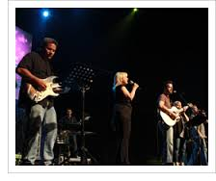
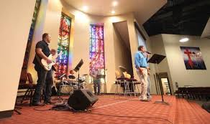
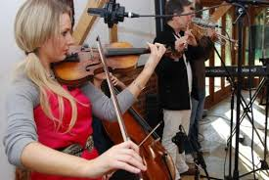
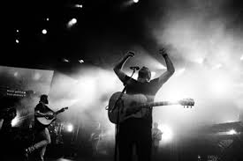
Does God care about Instruments in Worship?

Slide 2
Have you heard - - -
God does not care about music
Jesus did not die to save us from an organ
All these people can't be wrong
We should focus on more important things
Paul just preached the cross
I don't see any harm in it
I really like it

Slide 3
God is strict
God is stricter than you think
Adam and Eve in the garden

Slide 4
God is strict
God is stricter than you think
Adam and Eve in the garden
Lot's wife

Slide 5
God is strict
God is stricter than you think
Adam and Eve in the garden
Lot's wife
Picking up sticks on the Sabbath

Slide 6
God is strict
God is stricter than you think
Adam and Eve in the garden
Lot's wife
Picking up sticks on the Sabbath
Saul offering a sacrifice

Slide 7
God is strict
God is stricter than you think
Adam and Eve in the garden
Lot's wife
Picking up sticks on the Sabbath
Saul offering a sacrifice
Uzziah offered incense
And many other examples

Slide 8
NT Teaching
Hebrews 2:1-3 1 Therefore we must give the more earnest heed to the things we have heard, lest we drift away. 2 For if the word spoken through angels proved steadfast, and every transgression and disobedience received a just reward, 3 how shall we escape if we neglect so great a salvation, which at the first began to be spoken by the Lord, and was confirmed to us by those who heard Him

Slide 9
NT Teaching
Hebrews 4:1 Therefore, since a promise remains of entering His rest, let us fear lest any of you seem to have come short of it.
Hebrews 12:25 See that you do not refuse Him who speaks. For if they did not escape who refused Him who spoke on earth, much more shall we not escape if we turn away from Him who speaks from heaven

Slide 10
NT Teaching
Hebrews 10:28-29 28 Anyone who has rejected Moses' law dies without mercy on the testimony of two or three witnesses. 29 Of how much worse punishment, do you suppose, will he be thought worthy who has trampled the Son of God underfoot, counted the blood of the covenant by which he was sanctified a common thing, and insulted the Spirit of grace?

Slide 11
Presumption is serious
Numbers 14:44 But they presumed to go up to the mountaintop; nevertheless, neither the ark of the covenant of the Lord nor Moses departed from the camp.
Numbers 15:30 But the person who does anything presumptuously, whether he is native-born or a stranger, that one brings reproach on the Lord, and he shall be cut off from among his people.

Slide 12
Presumption is serious
Deuteronomy 1:42-44 42 And the Lord said to me, 'Tell them, "Do not go up nor fight, for I am not among you; lest you be defeated before your enemies." ' 43 So I spoke to you; yet you would not listen, but rebelled against the command of the Lord, and presumptuously went up into the mountain. 44 And the Amorites who dwelt in that mountain came out against you and chased you as bees do, and drove you back from Seir to Hormah.

Slide 13
Human wisdom is dangerous
I see no harm in it. I like it.
1 Corinthians 2:14 But the natural man does not receive the things of the Spirit of God, for they are foolishness to him; nor can he know them, because they are spiritually discerned.
2 Timothy 4:4 and they will turn their ears away from the truth, and be turned aside to fables.

Slide 14
Human wisdom is dangerous
I see no harm in it. I like it.
Neither did Nadab and Abihu
Neither did Uzzah
Neither did Saul of Tarsus

Slide 15
No Safety in Numbers
All those people can't be wrong
Noah's world (1 billion) – 8 were saved
Matthew 7:13-14 13 "Enter by the narrow gate; for wide is the gate and broad is the way that leads to destruction, and there are many who go in by it. 14 Because narrow is the gate and difficult is the way which leads to life, and there are few who find it.

Slide 16
No Safety in Numbers
Exodus 23:2 You shall not follow a crowd to do evil; nor shall you testify in a dispute so as to turn aside after many to pervert justice.

Slide 17
Hell demands caution
Matthew 8:12 But the sons of the kingdom will be cast out into outer darkness. There will be weeping and gnashing of teeth."
Study Luke 16:19-31 – Ask the rich man

