Slide 1
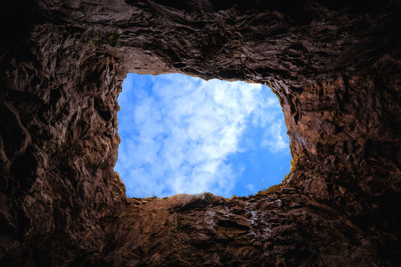
DON’T QUIT IN A PIT
PSALM 40:1-3

Slide 2
introduction
“In a pit” is a metaphor for – feeling blue, down, depressed, or trapped in a bad situation.
Down in the dumps – From an Egyptian king, Dumpos, who died in a state of deep depression.

Slide 3
PSALM 40:1-3
(Psalms 40:1) I waited patiently for the LORD; And He inclined to me, And heard my cry.
(Psalms 40:2) He also brought me up out of a horrible pit, Out of the miry clay, And set my feet upon a rock, And established my steps.
(Psalms 40:3) He has put a new song in my mouth—Praise to our God; Many will see it and fear, And will trust in the LORD.

Slide 4
DAVID WAS IN A PIT
Pit = deep hole in the ground
Often only a small opening for light, when covered there is total darkness
So was Jeremiah – (Jeremiah 18:20) Shall evil be repaid for good? For they have dug a pit for my life. Remember that I stood before You To speak good for them, To turn away Your wrath from them.

Slide 5
DAVID WAS IN A PIT
So was Joseph – (Genesis 37:21) But Reuben heard it, and he delivered him out of their hands, and said, "Let us not kill him."
(Genesis 37:22) And Reuben said to them, "Shed no blood, but cast him into this pit which is in the wilderness, and do not lay a hand on him"—that he might deliver him out of their hands, and bring him back to his father.

Slide 6
DAVID WAS rescued from the pit
(Psalms 40:2) He also brought me up out of a horrible pit, Out of the miry clay, And set my feet upon a rock, And established my steps.
The pit showed confinement, prison, darkness, despair, distress
(Psalms 6:6) I am weary with my groaning; All night I make my bed swim; I drench my couch with my tears.
(Psalms 56:8) You number my wanderings; Put my tears into Your bottle;

Slide 7
DAVID cried to god for help
(Psalms 40:1) I waited patiently for the LORD; And He inclined to me, And heard my cry.
Alone, hopeless, no way to save himself
Only God can get him out
(John 14:13) And whatever you ask in My name, that I will do, that the Father may be glorified in the Son.
(1 Peter 5:7) casting all your care upon Him, for He cares for you.

Slide 8
DAVID WAITED FOR GOD TO ANSWER
(Psalms 40:1) I waited patiently for the LORD; And He inclined to me, And heard my cry.
Wait patiently OR wait impatiently – but WAIT
Waiting requires humility and hope.
We do not know God’s timing or plan
(John 13:7) Jesus answered and said to him, "What I am doing you do not understand now, but you will know after this."

Slide 9
God brought DAVID out of the pit
(Psalms 40:2) He also brought me up out of a horrible pit, Out of the miry clay, And set my feet upon a rock, And established my steps.
He was brought UP
He was taken OUT
He was placed on a ROCK foundation
He was able to walk around again

Slide 10
God GAVE DAVID A NEW SONG
(Psalms 40:3) He has put a new song in my mouth—Praise to our God; Many will see it and fear, And will trust in the LORD.
A new song – a new hope, a new view on life
He is out of his despair, his depression is gone

Slide 11
OTHERS SAW AND BENEFITTED
(Psalms 40:3) He has put a new song in my mouth—Praise to our God; Many will see it and fear, And will trust in the LORD.
When we recover, others see the change in us
They give God the credit!

Slide 12
DON’T QUIT IN A PIT
(Galatians 6:9) And let us not grow weary while doing good, for in due season we shall reap if we do not lose heart.
Keep on keeping on.
Don’t give up.
Don’t quit in a pit!

