Slide 1
Important questions
How will you answer?
Do you accept what the Bible teaches?

Slide 2
DOES GOD EXIST?
Psalm 14:1 The fool has said in his heart, "There is no God." They are corrupt, They have done abominable works, There is none who does good.
Genesis 1:1 In the beginning God created the heavens and the earth.

Slide 3
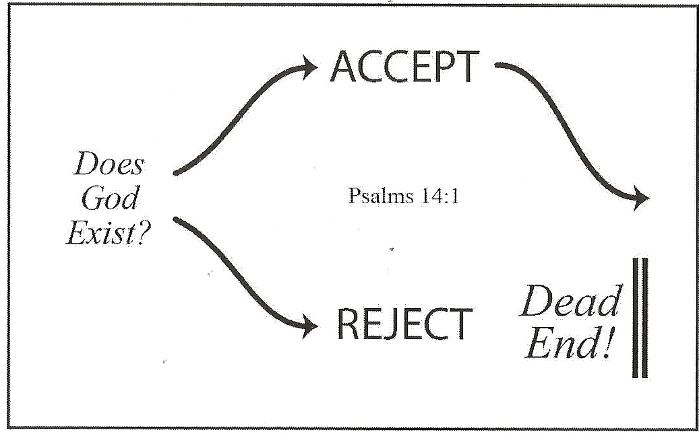

Slide 4
IS MAN IN THE IMAGE OF GOD?
Genesis 1:26-27 ²⁶ Then God said, "Let Us make man in Our image, according to Our likeness; let them have dominion over the fish of the sea, over the birds of the air, and over the cattle, over all the earth and over every creeping thing that creeps on the earth." ²⁷ So God created man in His own image; in the image of God He created him; male and female He created them.

Slide 5
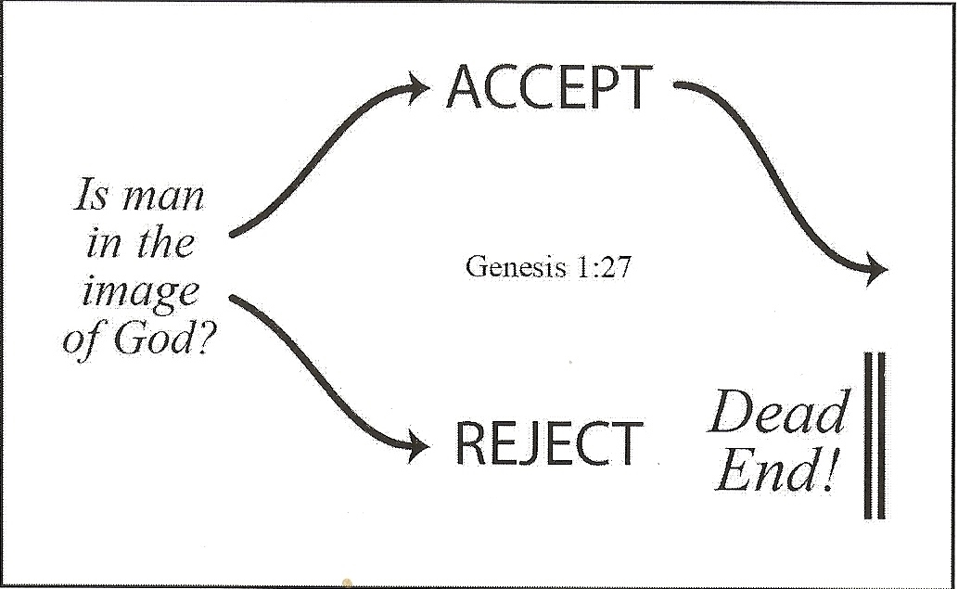

Slide 6
IS GOD CONCERNED ABOUT MAN?
Psalm 8:4-6 ⁴ What is man that You are mindful of him, And the son of man that You visit him? ⁵ For You have made him a little lower than the angels, And You have crowned him with glory and honor. ⁶ You have made him to have dominion over the works of Your hands; You have put all things under his feet
John 3:16-17 ¹⁶ For God so loved the world that He gave His only begotten Son, that whoever believes in Him should not perish but have everlasting life. ¹⁷ For God did not send His Son into the world to condemn the world, but that the world through Him might be saved.

Slide 7
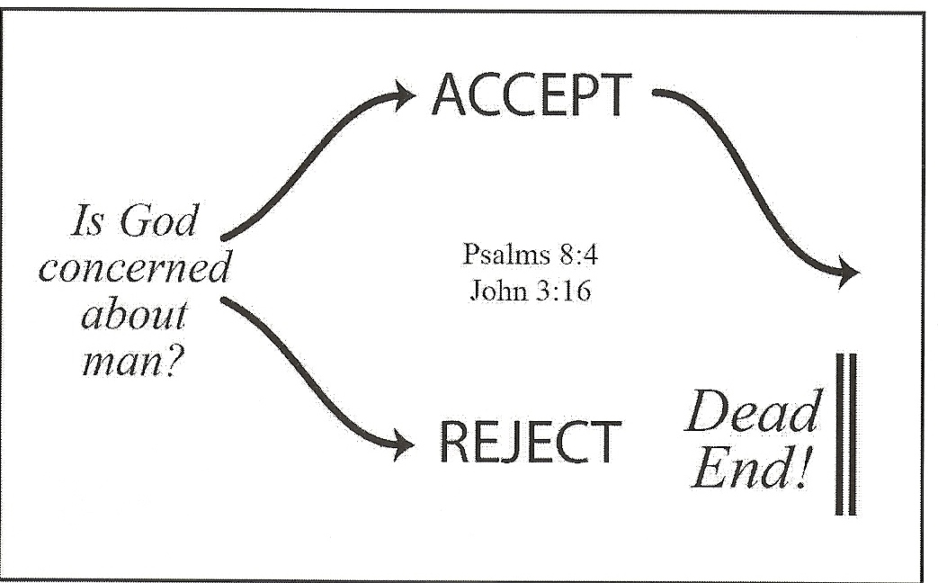

Slide 8
IS CREATION TRUE?
Psalm 33:6-9 ⁶ By the word of the Lord the heavens were made, And all the host of them by the breath of His mouth. ⁷ He gathers the waters of the sea together as a heap; He lays up the deep in storehouses. ⁸ Let all the earth fear the Lord; Let all the inhabitants of the world stand in awe of Him. ⁹ For He spoke, and it was done; He commanded, and it stood fast.

Slide 9
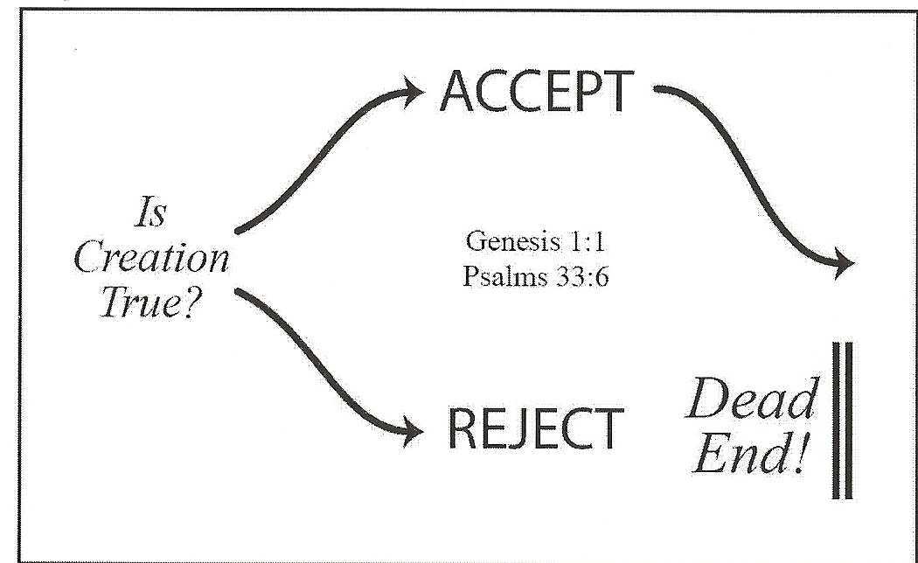

Slide 10
HAS GOD SPOKEN TO MAN?
2 Peter 1:20-21 ²⁰ knowing this first, that no prophecy of Scripture is of any private interpretation, ²¹ for prophecy never came by the will of man, but holy men of God spoke as they were moved by the Holy Spirit.
2 Timothy 3:16-17 ¹⁶ All Scripture is given by inspiration of God, and is profitable for doctrine, for reproof, for correction, for instruction in righteousness, ¹⁷ that the man of God may be complete, thoroughly equipped for every good work.

Slide 11
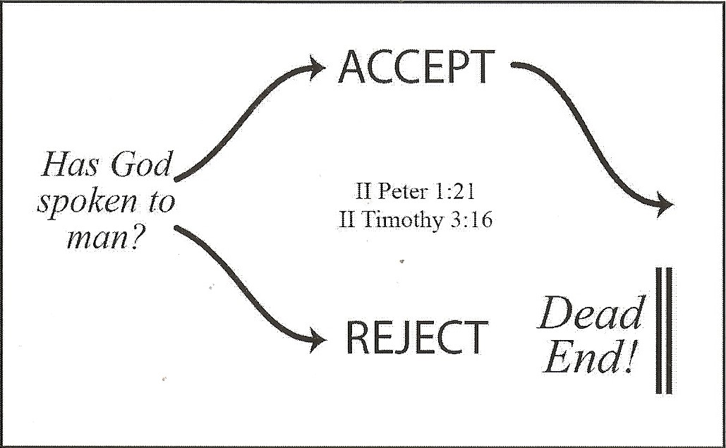

Slide 12
ARE THE PROMISES OF THE BIBLE TRUE?
2 Corinthians 1:20 For all the promises of God in Him are Yes, and in Him Amen, to the glory of God through us.
2 Peter 1:3-4 ³ as His divine power has given to us all things that pertain to life and godliness, through the knowledge of Him who called us by glory and virtue, ⁴ by which have been given to us exceedingly great and precious promises, that through these you may be partakers of the divine nature, having escaped the corruption that is in the world through lust.
1 John 2:25 And this is the promise that He has promised us--eternal life.

Slide 13
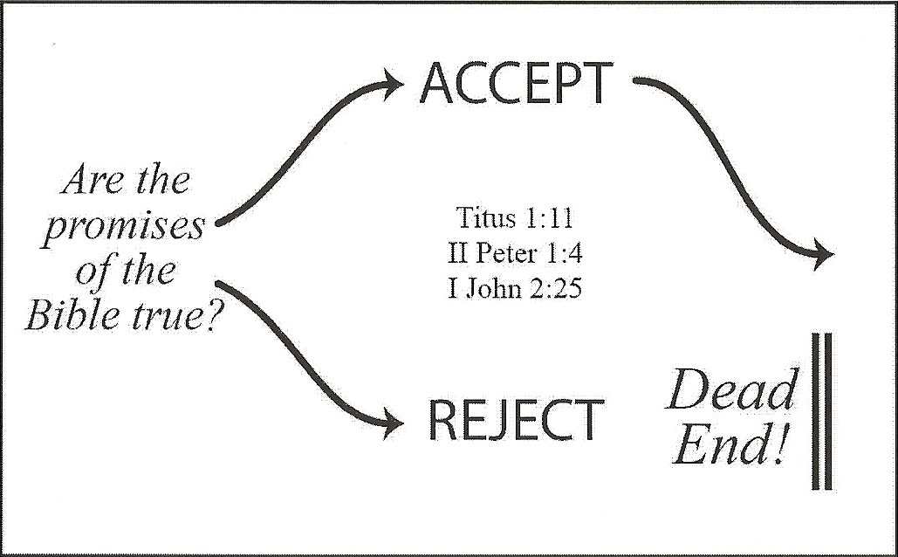

Slide 14
ACCEPT OR REJECT?
This is what the Bible teaches
Now you have a choice to believe and obey
OR reject and reach a Dead End

