Slide 1
I MAKE ME MAD
IT IS EASY TO BLAME OTHERS FOR OUR SIN.

Slide 2
Romans 7:18-20
¹⁸ For I know that in me (that is, in my flesh) nothing good dwells; for to will is present with me, but how to perform what is good I do not find. ¹⁹ For the good that I will to do, I do not do; but the evil I will not to do, that I practice. ²⁰ Now if I do what I will not to do, it is no longer I who do it, but sin that dwells in me.

Slide 3
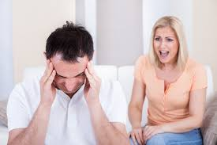
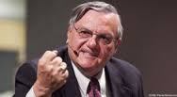
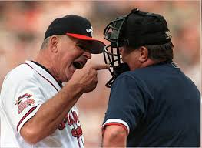
Who makes you mad?
Neighbor
Husband / Wife
Umpire
Politicians

Slide 4
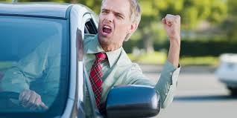
Who makes you mad?
Neighbor
Family member
At a public event
Politicians
Stranger in another car on highway

Slide 5
Who makes you sin?
2 Corinthians 10:12-13 ¹² For we dare not class ourselves or compare ourselves with those who commend themselves. But they, measuring themselves by themselves, and comparing themselves among themselves, are not wise. ¹³ We, however, will not boast beyond measure, but within the limits of the sphere which God appointed us--a sphere which especially includes you.

Slide 6
Who makes you sin?
James 1:13-16 ¹³ Let no one say when he is tempted, "I am tempted by God"; for God cannot be tempted by evil, nor does He Himself tempt anyone. ¹⁴ But each one is tempted when he is drawn away by his own desires and enticed. ¹⁵ Then, when desire has conceived, it gives birth to sin; and sin, when it is full-grown, brings forth death. ¹⁶ Do not be deceived, my beloved brethren.

Slide 7
Who makes you sin?
God
2 Peter 3:9 The Lord is not slack concerning His promise, as some count slackness, but is longsuffering toward us, not willing that any should perish but that all should come to repentance.

Slide 8
Who makes you sin?
God
Christ
Romans 5:6 & 8 For when we were still without strength, in due time Christ died for the ungodly.
But God demonstrates His own love toward us, in that while we were still sinners, Christ died for us.

Slide 9
Who makes you sin?
God
Christ
Friends
Job – wife and 3 friends
Job 2:9 Then his wife said to him, "Do you still hold fast to your integrity? Curse God and die!"

Slide 10
Who makes you sin?
God
Christ
Friends
Apostles
John 20:30-31 ³⁰ And truly Jesus did many other signs in the presence of His disciples, which are not written in this book; ³¹ but these are written that you may believe that Jesus is the Christ, the Son of God, and that believing you may have life in His name.

Slide 11
Who makes you sin?
1 Peter 5:8-9 ⁸ Be sober, be vigilant; because your adversary the devil walks about like a roaring lion, seeking whom he may devour. ⁹ Resist him, steadfast in the faith, knowing that the same sufferings are experienced by your brotherhood in the world.
God
Christ
Friends
Apostles
Satan

Slide 12
Who makes you sin?
Ephesians 6:11 Put on the whole armor of God, that you may be able to stand against the wiles of the devil.
James 4:7 Therefore submit to God. Resist the devil and he will flee from you.
God
Christ
Friends
Apostles
Satan

Slide 13
Who makes you lost?
Romans 14:10 But why do you judge your brother? Or why do you show contempt for your brother? For we shall all stand before the judgment seat of Christ.
John 5:28-29 ²⁸ Do not marvel at this; for the hour is coming in which all who are in the graves will hear His voice ²⁹ and come forth--those who have done good, to the resurrection of life, and those who have done evil, to the resurrection of condemnation. John 5:28-29

Slide 14
Who makes you lost?
Revelation 20:13 The sea gave up the dead who were in it, and Death and Hades delivered up the dead who were in them. And they were judged, each one according to his works.
2 Corinthians 5:10 For we must all appear before the judgment seat of Christ, that each one may receive the things done in the body, according to what he has done, whether good or bad.

Slide 15
Who is at fault – if I am lost?
We choose to be angry / remain calm.
We choose to sin / resist temptation.
We choose to be lost / saved.

