Slide 1
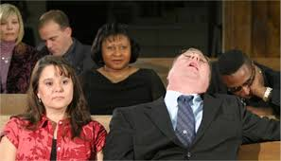
Ho-hum worship
SINGING
Worship should NOT be boring, hum-drum, HO-HUM!

Slide 2
Ho-hum worship (October series)
It is easy for us to sing, stand, sit, listen, partake, go home.
Are we just going through the motions?
My lessons in October will look at how we can avoid the ho-hum in worship.
Each sermon will examine another part of worship.

Slide 3
Isaiah 1:10-12
¹⁰ Hear the word of the Lord, You rulers of Sodom; Give ear to the law of our God, You people of Gomorrah: ¹¹ "To what purpose is the multitude of your sacrifices to Me?" Says the Lord. "I have had enough of burnt offerings of rams And the fat of fed cattle. I do not delight in the blood of bulls, Or of lambs or goats. ¹² "When you come to appear before Me, Who has required this from your hand, To trample My courts?

Slide 4
Isaiah 1:13-14
¹³ Bring no more futile sacrifices; Incense is an abomination to Me. The New Moons, the Sabbaths, and the calling of assemblies-- I cannot endure iniquity and the sacred meeting. ¹⁴ Your New Moons and your appointed feasts My soul hates; They are a trouble to Me, I am weary of bearing them.

Slide 5
Singing can become ho-hum
Singing is an important part of worship.
Colossians 3:16 Let the word of Christ dwell in you richly in all wisdom, teaching and admonishing one another in psalms and hymns and spiritual songs, singing with grace in your hearts to the Lord.
Ephesians 5:19 is a parallel passage

Slide 6
Singing can become ho-hum
Emphasis is often placed on the notes, key, tempo, quarter notes, etc.
The words are also important
New songs – we focus on the music to get it right
Old familiar songs – we sing from memory with little thought to the words we are singing

Slide 7
Singing can become ho-hum
Sometimes we are guilty of singing a song – unaware of the message in it.
We often sing songs with little understanding of the words
Some have said, “Poor singing is the best argument for instrumental music.”

Slide 8
How to keep singing alive
Remember WHO we worship: Our awesome God
Remember WHY we worship: He loves us and redeemed us
Remember HOW we worship: in spirit and truth
Remember to LISTEN to the words you sing

Slide 9
How to keep singing alive
Sing great songs with deep meaning
Know what part you sing – S, A, T, B
Soprano – higher notes for women
Alto – Lower notes for women
Tenor – Higher notes for men
Bass – Lower notes for men

Slide 10
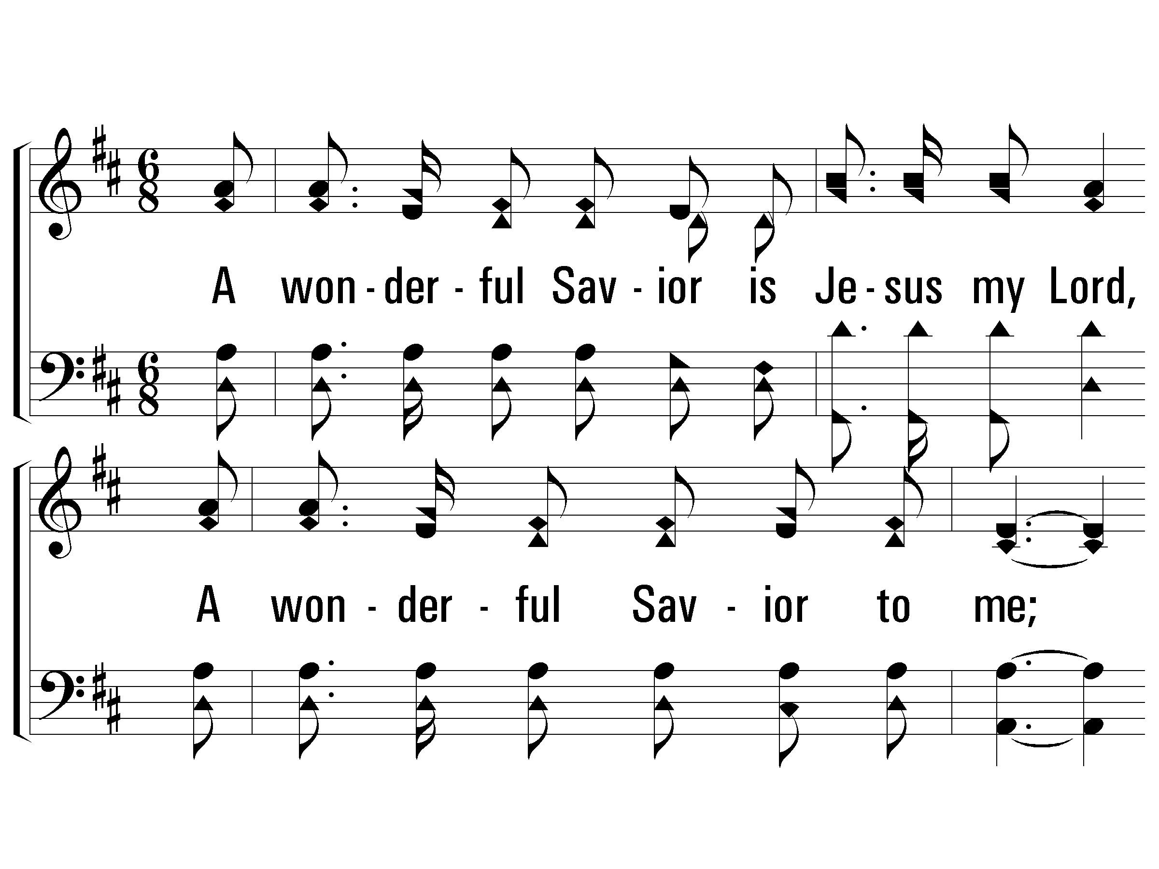
Follow your notes (up and down)

Slide 11
How to keep singing alive
Learn new songs – Most of us know less than 100 of the 900 songs in the songbook
Learn to use the projector – look up at screen instead of down into a book in your lap
Knowing all the details of reading music is not vital but some basics are helpful

Slide 12
Worship must not be ho-hum
1 Corinthians 14:15 What is the conclusion then? I will pray with the spirit, and I will also pray with the understanding. I will sing with the spirit, and I will also sing with the understanding.
In every part of worship – God must be honored, praised and glorified.

