Slide 1
God is not a Hanging Judge
Isaiah 40:1-2

Slide 2
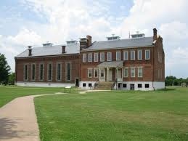
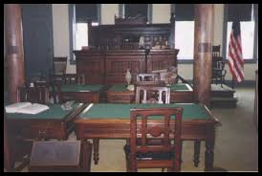
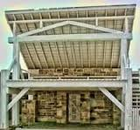
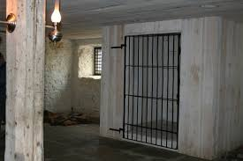
The Hanging Judge

Slide 3
The Hanging Judge
Judge Isaac Parker, (1838-1895) in Fort Smith, Arkansas
Was judge of Arkansas and the territory that would become Oklahoma.
In 21 years – 180 men condemned – 79 actually hung
God is not like that!

Slide 4
Isaiah 40:1-2
¹ "Comfort, yes, comfort My people!" Says your God. ² "Speak comfort to Jerusalem, and cry out to her, That her warfare is ended, That her iniquity is pardoned; For she has received from the Lord's hand Double for all her sins."

Slide 5
God blesses more than punishes
That her iniquity is pardoned; For she has received from the Lord's hand Double for all her sins.
Some think God double punished them.
God’s pardon is greater than the punishment.
Parents – learn – love more then punish

Slide 6
God Pardons
Pagan gods – angry, harsh, fickle, had to be appeased from their wrath
God is not like that

Slide 7
God Pardons
Micah 7:18 Who is a God like You, Pardoning iniquity And passing over the transgression of the remnant of His heritage? He does not retain His anger forever, Because He delights in mercy.

Slide 8
God Pardons
2 Chronicles 30:18b – 20 But Hezekiah prayed for them, saying, "May the good Lord provide atonement for everyone ¹⁹ who prepares his heart to seek God, the Lord God of his fathers, though he is not cleansed according to the purification of the sanctuary." ²⁰ And the Lord listened to Hezekiah and healed the people.

Slide 9
God Pardons Willingly
Nehemiah 9:17 They refused to obey, And they were not mindful of Your wonders That You did among them. But they hardened their necks, And in their rebellion They appointed a leader To return to their bondage. But You are God, Ready to pardon, Gracious and merciful, Slow to anger, Abundant in kindness, And did not forsake them.

Slide 10
God Pardons Willingly
2 Samuel 14:14 For we will surely die and become like water spilled on the ground, which cannot be gathered up again. Yet God does not take away a life; but He devises means, so that His banished ones are not expelled from Him.

Slide 11
God Pardons Willingly
Hebrews 12:10 For they indeed for a few days chastened us as seemed best to them, but He for our profit, that we may be partakers of His holiness.
Jonah knew God would pardon Nineveh

Slide 12
God Pardons Abundantly
Isaiah 55:7 Let the wicked forsake his way, And the unrighteous man his thoughts; Let him return to the Lord, And He will have mercy on him; And to our God, For He will abundantly pardon.
Psalm 130:7-8 ⁷ O Israel, hope in the Lord; For with the Lord there is mercy, And with Him is abundant redemption. ⁸ And He shall redeem Israel From all his iniquities.

Slide 13
God Pardons Abundantly
Abundant (plenteous – KJV)
Think about this - - -
When you pray at night asking God to forgive your sins
God has already pardoned millions today
How many sins has God pardoned for you?
Multiply that by all who sought forgiveness

Slide 14
God is not a hanging judge
God Pardons
God Pardons Willingly
God Pardons Abundantly

