Slide 1
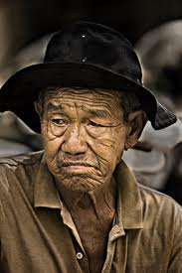
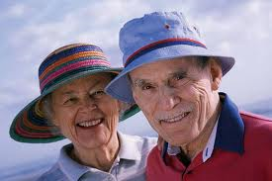
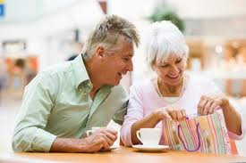
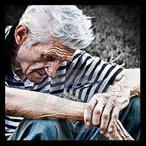
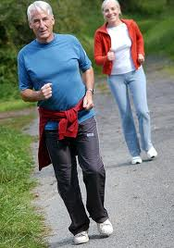
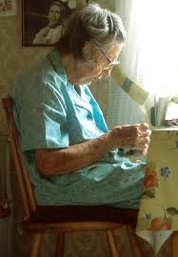
Growing Older Not Colder
What does the Bible teach
about getting older?

Slide 2
4 Stages of Life
You believe in Santa Claus
You don’t believe in Santa Claus
You are Santa Claus
You look like Santa Claus

Slide 3
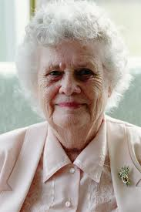
Grandma
Grandson – “How old are you, grandma?”
Grandma – “I am 39 and holding.” Grandson – “How old would you be if you let go?”

Slide 4
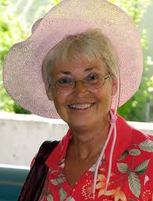
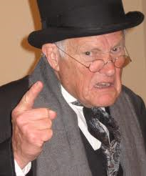
How should we age?
Some grow old with grace, beauty, and sweet dispositions.
Others grow old with anger, bitterness, and sour dispositions.

Slide 5
Typical feelings about aging
Uselessness – “I am over the hill. I am done, no good, useless.”
Guilt – “I have so many regrets. I wish I could do my life over.”

Slide 6
Typical feelings about aging
Bitterness and resentment
If my children had –
If I had married a different person –
Fear
The world is speeding up
We are slowing down

Slide 7
Ecclesiastes 12:1
Remember now your Creator in the days of your youth, Before the difficult days come, And the years draw near when you say, "I have no pleasure in them"

Slide 8
Ecclesiastes 12:1
Remember – The Hebrew word means “to act decisively” on behalf of God – not just reminisce about the past
This word includes – commitment, service, obey, live for Him, remain faithful

Slide 9
Physical Limitations
Ecclesiastes 12:3
Solomon describes:
In the day when the keepers of the house tremble, And the strong men bow down; When the grinders cease because they are few, And those that look through the windows grow dim;
Trembling – head, voice, hands
Strong men – legs become weaker
Grinders – teeth wear out, or must be removed
Windows – eyes dim, cataracts, glasses, bi-focals

Slide 10
Physical Limitations
Ecclesiastes 12:4
Solomon describes:
When the doors are shut in the streets, And the sound of grinding is low; When one rises up at the sound of a bird, And all the daughters of music are brought low;
Doors shut – Friends die, family passes away or moves away, houses sold, no one visits
Sound is low – hearing fails, turn up the TV, can’t hear the birds sing anymore

Slide 11
Physical Limitations
Ecclesiastes 12:5
Solomon describes:
Also they are afraid of height, And of terrors in the way; When the almond tree blossoms, The grasshopper is a burden, And desire fails. For man goes to his eternal home, And the mourners go about the streets.
Afraid – Greater fear of heights, danger, harm
Almond blossoms – gray hair
Grasshopper a burden – loss of strength, can’t carry what we used to do
Desire fails – I can’t, why wish I could?

Slide 12
Physical Limitations
Ecclesiastes 12:6
Solomon describes:
Remember your Creator before the silver cord is loosed, Or the golden bowl is broken, Or the pitcher shattered at the fountain, Or the wheel broken at the well.
Silver cord – The connection we have with family, friends, church
Broken – death breaks the ties we have in life
Bowl broken, Pitcher shattered, Wheel broken – these describe death that separates us

Slide 13
Physical Limitations
Ecclesiastes 12:7
Solomon describes:
Then the dust will return to the earth as it was, And the spirit will return to God who gave it.
Dust – Our body
We were made from dust of the ground
Our body will return to that dust when we die
Spirit – There is a part of man that does not die – is eternal – returns to God

Slide 14
You have a choice
Growing OLD
Is not a choice
It is part of the life cycle
We start aging at birth
Growing COLD
Is a choice
You can become sweet, kind, gentle
You can become bitter, resentful, harsh

Slide 15
You have a choice
REMEMBER YOUR CREATOR
You are not just a body that wears out
You are an eternal spirit
We must continue to act, serve, work, obey, live – for God.
THE CHRISTIAN’S RETIREMENT PLAN IS OUT OF THIS WORLD!

