Slide 1
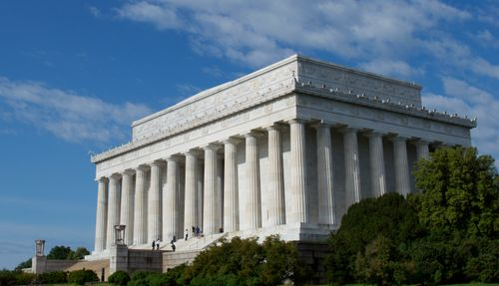
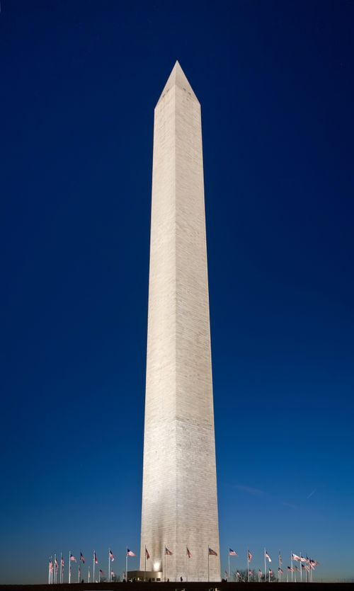
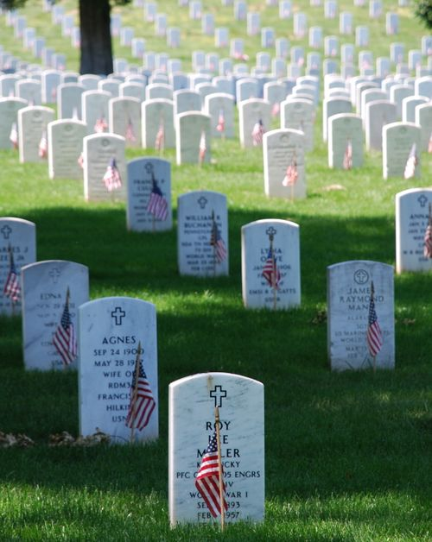
The Greatest Memorial

Slide 2
Memorial Day
Every year, on the last Monday in May
Began after the Civil War to honor Confederate dead.
Later it became a day to remember the lives of all who died in serving their country.
Today, we honor all who have died – family, friends, etc.
Years ago, it was called “Decoration Day” – A day to put flowers or other decorations on the graves.

Slide 3
Memorial Definition
That which keep alive the memory of someone or some event.
From the Greek word meaning mindful or remember
It is seen in what we say or do to honor the person or event.

Slide 4
Memorials in the Bible
32 times in the Bible
Rainbow - (Genesis 9:13) I set My rainbow in the cloud, and it shall be for the sign of the covenant between Me and the earth. (14) It shall be, when I bring a cloud over the earth, that the rainbow shall be seen in the cloud; (15) and I will remember My covenant which is between Me and you and every living creature of all flesh; the waters shall never again become a flood to destroy all flesh.

Slide 5
Memorials in the Bible
Passover - (Exodus 12:14) 'So this day shall be to you a memorial; and you shall keep it as a feast to the LORD throughout your generations. You shall keep it as a feast by an everlasting ordinance.

Slide 6
Memorials in the Bible
Sabbath - (Deuteronomy 5:12-14) 'Observe the Sabbath day, to keep it holy, as the LORD your God commanded you. (13) Six days you shall labor and do all your work, (14) but the seventh day is the Sabbath of the LORD your God. In it you shall do no work: you, nor your son, nor your daughter, nor your male servant, nor your female servant, nor your ox, nor your donkey, nor any of your cattle, nor your stranger who is within your gates, that your male servant and your female servant may rest as well as you.
(Exodus 20:8) "Remember the Sabbath day, to keep it holy.

Slide 7
The Greatest Memorial – The Lord’s Supper
Greater than any person, event or thing. Greater than any monument, stone or shrine.
It was begun by Jesus as a memorial to His suffering for sins.
(Luke 22:19) And He took bread, gave thanks and broke it, and gave it to them, saying, "This is My body which is given for you; do this in remembrance of Me."

Slide 8
1) The Right Participants
Who is to participate in the Lord’s Supper?
(Mat 26:29) But I say to you, I will not drink of this fruit of the vine from now on until that day when I drink it new with you in My Father's kingdom."
(Act 2:41) Then those who gladly received his word were baptized; and that day about three thousand souls were added to them.
(Act 2:42) And they continued steadfastly in the apostles' doctrine and fellowship, in the breaking of bread, and in prayers.
(Act 20:7) Now on the first day of the week, when the disciples came together to break bread, Paul, ready to depart the next day, spoke to them and continued his message until midnight.

Slide 9
2) The Right Spirit or mind
(Joh 4:24) God is Spirit, and those who worship Him must worship in spirit and truth.“
(1Corinthians 11:23-29) For I received from the Lord that which I also delivered to you: that the Lord Jesus on the same night in which He was betrayed took bread; (24) and when He had given thanks, He broke it and said, "Take, eat; this is My body which is broken for you; do this in remembrance of Me.“ (25) In the same manner He also took the cup after supper, saying, "This cup is the new covenant in My blood. This do, as often as you drink it, in remembrance of Me.“ (26) For as often as you eat this bread and drink this cup, you proclaim the Lord's death till He comes. (27) Therefore whoever eats this bread or drinks this cup of the Lord in an unworthy manner will be guilty of the body and blood of the Lord. (28) But let a man examine himself, and so let him eat of the bread and drink of the cup. (29) For he who eats and drinks in an unworthy manner eats and drinks judgment to himself, not discerning the Lord's body.

Slide 10
2) The Right Spirit Past Present Future
Notice the PAST tense
(25) In the same manner He also took the cup after supper, saying, "This cup is the new covenant in My blood. This do, as often as you drink it, in remembrance of Me.“

Slide 11
2) The Right Spirit Past Present Future
Notice the PRESENT tense
(28) But let a man examine himself, and so let him eat of the bread and drink of the cup.

Slide 12
2) The Right Spirit Past Present Future
Notice the FUTURE tense
(26) For as often as you eat this bread and drink this cup, you proclaim the Lord's death till He comes.

Slide 13
3) The Right Time
(Act 20:7) Now on the first day of the week, when the disciples came together to break bread, Paul, ready to depart the next day, spoke to them and continued his message until midnight.

Slide 14
4) The Right Elements
Unleavened bread
Fruit of the vine
(Luke 22:19) And He took bread, gave thanks and broke it, and gave it to them, saying, "This is My body which is given for you; do this in remembrance of Me."
(Mark 14:25) Assuredly, I say to you, I will no longer drink of the fruit of the vine until that day when I drink it new in the kingdom of God."

Slide 15
Conclusion
The Lord’s Supper is the Greatest of all Memorials
It is a remembrance of Jesus sacrifice on the cross.
It is a proclamation that Jesus lives.
We must examine ourselves that we may partake of it in a well pleasing manner.

Slide 16
Conclusion
We must examine ourselves that we may partake of it in a well pleasing manner.
WARNING!
(1Corinthians 11:29) For he who eats and drinks in an unworthy manner eats and drinks judgment to himself, not discerning the Lord's body.

