Slide 1
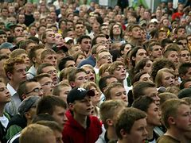
A Gathering of Strangers
The levels of relationships and worship

Slide 2
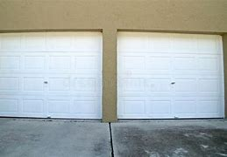
Do you know your neighbor?
We go from house to attached garage, open the garage door with a remote opener from inside the car, go to drive-thru for breakfast, and go back in the house the same way.
We text instead of talk.
We are losing contact with people and with God.

Slide 3
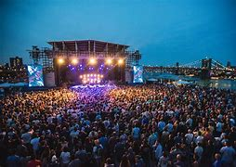
3 Levels of Relationships
Celebration
It does not matter who else is there
You don’t know who they are
You don’t care what problems they have

Slide 4
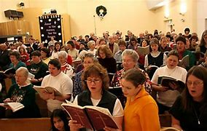
3 Levels of Relationships
Congregation
You know many by name or face
Hear announcements about them
Speak to them before and after the assembly

Slide 5
3 Levels of Relationships
Cell
Small group, eat together
Go out to eat in a small group
Talk, listen, understand how they feel

Slide 6
3 Levels of Relationships
In the life of Jesus
Celebration – feed 5,000, taught multitudes
Congregation – house full and overflowing to hear Him
Cell – 12 Apostles, Mary, Martha and Lazarus

Slide 7
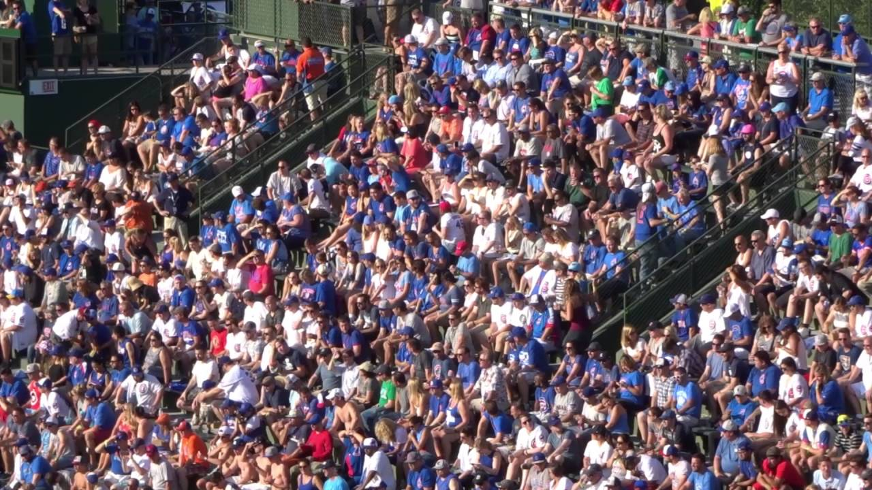
4 Levels of Worship
1 Ballgame
You go to see the show, concert, ballgame
IMPORTANT – the game or the show
NOT IMPORTANT – Who is there, issues in their lives, recent illness, death in family
Do you go for the show, then go home?

Slide 8
4 Levels of Worship
2 Wal-Mart
Look for the bargains
Run into a friend, small talk for a minute
Back to looking for the bargains
Christianity is not cheap.
Christ is not on ½ price sale.

Slide 9
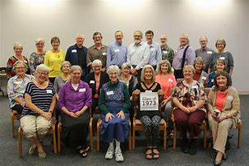
4 Levels of Worship
3 Class Reunion
Find out who is divorced, re-married, number of children or grandchildren
Learn who has moved and where, who died
Catch up on the news, who is a success, who is not
At a class reunion, most of your time is noticing how others have changed, look OLD

Slide 10
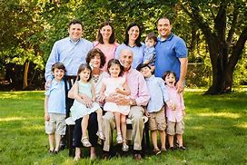
4 Levels of Worship
4 Family
Have fellowship with the family of God
Enjoy the time together
Benefit by growing your faith
Improve your spiritual life, help with problems in life

Slide 11
Relationships and Worship
As social beings, we need relationships, friends, and family.
As spiritual beings, we need fellowship with God in worship.

