Slide 1
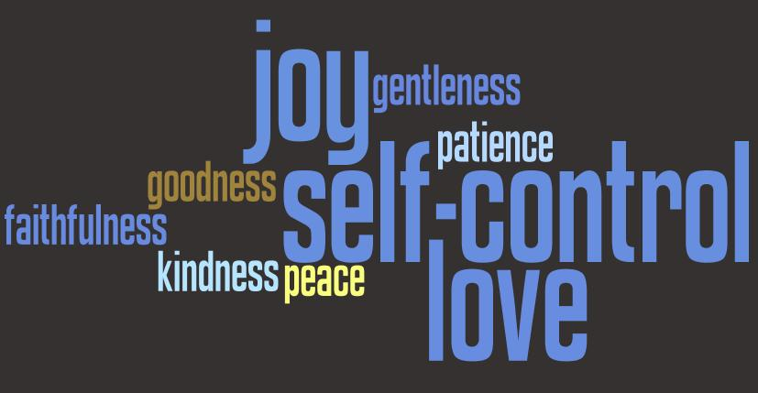
Fruit
of
the
Spirit

Slide 2
Works of the Flesh are (plural)
Galatians 5:19-21
Here is a long list of sinful behaviors
Any one of them is sin
Any one will cause you to be lost
You don't have to do all or multiple of them

Slide 3
Fruit of the Spirit (singular)
Galatians 5:22-26
One fruit – not each a different fruit
Apple = peel, meat, core, seeds
Orange = peel, sections
Which part can you leave out?

Slide 4
Observations
Contrast the two ways – flesh / Spirit

Slide 5
Observations
Contrast the two ways – flesh / Spirit
Learn the meaning of “flesh”

Slide 6
Observations
Contrast the two ways – flesh / Spirit
Learn the meaning of “flesh”
Understand “walk in the Spirit”

Slide 7
Sections of the Fruit
Love
Colossians 3:14 But above all these things put on love, which is the bond of perfection.

Slide 8
Sections of the Fruit
Love
Joy
Knowing that you are right with God

Slide 9
Sections of the Fruit
Love
Joy
Peace
Tranquility with self
Tranquility with others
Tranquility with God

Slide 10
Sections of the Fruit
Love
Joy
Peace
Longsuffering
To bear with
Put up with
Patience

Slide 11
Sections of the Fruit
Love
Joy
Peace
Longsuffering
Kindness
Love suffers long
And is KIND
1 Corinthians 13:4

Slide 12
Sections of the Fruit
Love
Joy
Peace
Longsuffering
Kindness
Goodness
An attitude of seeking the good in others
Optimistic attitude

Slide 13
Sections of the Fruit
Love
Joy
Peace
Longsuffering
Kindness
Goodness
Faith
Faithfulness
Dependable
Not changing with the wind

Slide 14
Sections of the Fruit
Love
Joy
Peace
Longsuffering
Kindness
Goodness
Faith
Gentleness
Meekness (KJV)
Not weakness
Gentle strength
Steel and Velvet

Slide 15
Sections of the Fruit
Love
Joy
Peace
Longsuffering
Kindness
Goodness
Faith
Gentleness
Self-control
Temperance (KJV)
Mastery of your desires
Who is in the drivers seat?

Slide 16
Which will you choose?
Deuteronomy 30:19-20 19 I call heaven and earth as witnesses today against you, that I have set before you life and death, blessing and cursing; therefore choose life, that both you and your descendants may live; 20 that you may love the Lord your God, that you may obey His voice, and that you may cling to Him, for He is your life and the length of your days; and that you may dwell in the land which the Lord swore to your fathers, to Abraham, Isaac, and Jacob, to give them."

