Slide 1
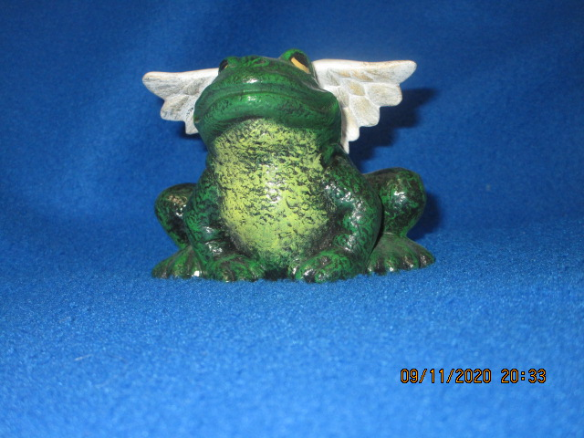
If Frogs Had Wings

Slide 2
Background
NY Jets had just won Super Bowl 3.
Reporter asked Jets quarterback, Joe Namath – What if the Colt quarterback had seen the wide open receiver in the end zone?
Joe Namath answered, “If frogs had wings they wouldn’t bump their bottoms when the jump.”

Slide 3
Background
Paul had a “what if” moment in 2 Corinthians 12:7-10.
What if this “thorn in the flesh” was removed?
Just think how much more I could do for the cause of Christ and the spread of the Gospel.

Slide 4
Introduction
In our lives, the “What Ifs” trouble us.
If I was ___________ . (younger, older, smarter, richer, healther, fill in the blank)
Reality is often rejected in favor of conditions and circumstances that do not exist.
Failure to accept reality can lead to many real failures.

Slide 5
When conditions are not good – If only times would get better
Many just quit, give up, feel that it is hopeless.
(Jeremiah 20:9) Then I said, "I will not make mention of Him, Nor speak anymore in His name." But His word was in my heart like a burning fire Shut up in my bones; I was weary of holding it back, And I could not.
God wants us to “overcome”
All 7 churches in Revelation 2-3 – given a promise if they overcome

Slide 6
When conditions are not good – If only times would get better
Some only see the distress around them
Peter could only see the waves
Others look to God who is in control
Distressing times break some

Slide 7
When conditions are not good – If only times would get better
In some, distress develops character
(James 1:2-4) My brethren, count it all joy when you fall into various trials, 3 knowing that the testing of your faith produces patience. 4 But let patience have its perfect work, that you may be perfect and complete, lacking nothing.

Slide 8
When conditions are good – If only this would last
When times are good, many don’t seem to need God.
I did this all by myself.
Pride grows
They think God is not involved
Physical things become more important

Slide 9
When conditions are good – If only this would last
(Amos 6:4-6) Who lie on beds of ivory, Stretch out on your couches, Eat lambs from the flock And calves from the midst of the stall; 5 Who sing idly to the sound of stringed instruments, And invent for yourselves musical instruments like David; 6 Who drink wine from bowls, And anoint yourselves with the best ointments, But are not grieved for the affliction of Joseph.

Slide 10
When conditions are ordinary – If only this was a special time.
Don’t overlook the value of the ordinary.
Let your light shine (Matthew 5:16)
Be faithful in service to God
(Luke 16:10) He who is faithful in what is least is faithful also in much; and he who is unjust in what is least is unjust also in much.
True change is proven in ordinary settings in life

Slide 11
When conditions are ordinary – If only this was a special time.
(Luke 16:29-31) Abraham said to him, 'They have Moses and the prophets; let them hear them.’ 30 And he said, 'No, father Abraham; but if one goes to them from the dead, they will repent.’ 31 But he said to him, 'If they do not hear Moses and the prophets, neither will they be persuaded though one rise from the dead.' "

Slide 12
Conclusion
Frogs get along fine without wings
Current situations or conditions are less important or valuable.
A relationship with God is the key to peace and eternal life.

