Slide 1
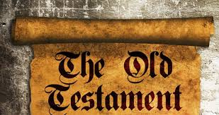
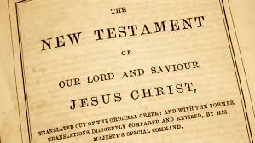
Why Do We Follow NT?

Slide 2
God’s Will today – ONLY in the New Testament
Old Covenant begins with IF Exodus 19:5
It was only for Israel –
Exodus 19:6
Israel broke the covenant – Jeremiah 31:31
God said He would make a New covenant

Slide 3
The Old Covenant was taken away
You became dead to the law – Romans 7:4
It would vanish away – Hebrews 8:13
He took away the first that He may establish the second – Hebrews 10:9

Slide 4
God says Why it was taken away
It was going to be fulfilled – Matthew 5:18
New covenant had better promises – Hebrews 8:6
Old covenant had faults – Hebrews 8:7
New priesthood required a new law – Hebrews 7:12
It did its job – Galatians 3:25

Slide 5
Bible says When it was taken away
It was nailed to the cross – Colossians 2:14
It died with Christ died

Slide 6
God says When the New covenant was in force
A will is in force upon the death of the testator – Hebrews 9:16-17
This is consistent with Colossians 2:14
Old nailed to cross
New was now in force

Slide 7
Why did God give the Old covenant?
It was a shadow of things to come – Hebrews 10:1
BETTER priesthood
BETTER promises
BETTER sacrifice for sin

Slide 8
Why did God give the Old covenant?
For our learning – Romans 15:4
As an example – 1 Corinthians 10:11
To bring us to Christ – Galatians 3:24

Slide 9
What about the 10 Commandments?
ALL of the 10 commandments are restated in the NT (except one).
No other gods – Matthew 4:10
No idols – 1 Corinthians 10:14

Slide 10
What about the 10 Commandments?
Taking God’s name in vain – Colossians 3:8
Honor parents – Ephesians 6:1-2
Do not kill – Matthew 5:22
Not commit adultery – Matthew 5:28
Do not steal – Ephesians 4:25

Slide 11
What about the 10 Commandments?
Not bear false witness – Ephesians 4:25
Not covet – Ephesians 5:3
Keep Sabbath NOT restated in the NT.
NT teaches – First day of the week – Acts 20:7; 1 Corinthians 16:1-2
Lord’s Day – Rev. 1:10

Slide 12
WE MUST FOLLOW THE NEW TESTAMENT WILL YOU OBEY THE NEW TESTAMENT?

