Slide 1
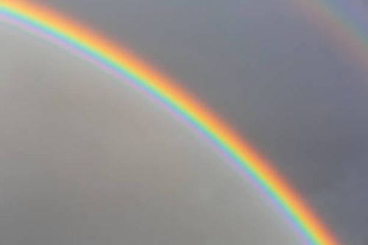
Keep your eye on the Rainbow
“You gotta stand a little rain if you gonna see the rainbow.”

Slide 2
INTRODUCTION
God put the rainbow in the sky.
So God will remember the promise
(2Co 1:20) For all the promises of God in Him are Yes, and in Him Amen, to the glory of God through us.

Slide 3
INTRODUCTION
We often doubt the promise of God.
(Gen 15:4) And behold, the word of the LORD came to him, saying, "This one shall not be your heir, but one who will come from your own body shall be your heir.“
(Gen 15:8) And he said, "Lord GOD, how shall I know that I will inherit it?"

Slide 4
INTRODUCTION
KEEP YOUR FOCUS ON
THE PROMISE
NOT ON THE PROBLEM

Slide 5
IS IT DIFFERENT FOR US?
Gideon – 300 men defeats an army of 32,000

Slide 6
IS IT DIFFERENT FOR US?
Gideon – 300 men defeats an army of 32,000
WHAT IF – God tells you to overthrow Russia with a paper clip and a rubber band?

Slide 7
IS IT DIFFERENT FOR US?
David – kills Goliath with a slingshot and a smooth stone

Slide 8
IS IT DIFFERENT FOR US?
David – kills Goliath with a slingshot and a smooth stone
WHAT IF – God tells you to go up to a large, strong man, squirt him with a water gun and dare him to step across the line?

Slide 9
IS IT DIFFERENT FOR US?
Moses – leads 3 million across the Red Sea with a long stick

Slide 10
IS IT DIFFERENT FOR US?
Moses – leads 3 million across the Red Sea with a long stick
WHAT IF – God tells you to go to Afghanistan, preach the gospel, and distribute Bibles. Would we look around: “God are you coming with me?”

Slide 11
GOD HAS PROMISED!
God loves you
(Isa 54:9) "For this is like the waters of Noah to Me; For as I have sworn That the waters of Noah would no longer cover the earth, So have I sworn That I would not be angry with you, nor rebuke you.
(Isa 54:10) For the mountains shall depart And the hills be removed, But My kindness shall not depart from you, Nor shall My covenant of peace be removed," Says the LORD, who has mercy on you.

Slide 12
GOD HAS PROMISED!
God forgives you
(Mat 26:27) Then He took the cup, and gave thanks, and gave it to them, saying, "Drink from it, all of you.
(Mat 26:28) For this is My blood of the new covenant, which is shed for many for the remission of sins.

Slide 13
GOD HAS PROMISED!
God will raise you to life
(1Cor. 15:19) If in this life only we have hope in Christ, we are of all men the most pitiable. (20) But now Christ is risen from the dead, and has become the first fruits of those who have fallen asleep. (21) For since by man came death, by Man also came the resurrection of the dead. (22) For as in Adam all die, even so in Christ all shall be made alive. (23) But each one in his own order: Christ the firstfruits, afterward those who are Christ's at His coming.

Slide 14
GOD HAS PROMISED!
You can live with God for Eternity
(John 14:1) "Let not your heart be troubled; you believe in God, believe also in Me. (2) In My Father's house are many mansions; if it were not so, I would have told you. I go to prepare a place for you. (3) And if I go and prepare a place for you, I will come again and receive you to Myself; that where I am, there you may be also. (4) And where I go you know, and the way you know.“ (5) Thomas said to Him, "Lord, we do not know where You are going, and how can we know the way?“ (6) Jesus said to him, "I am the way, the truth, and the life. No one comes to the Father except through Me.

Slide 15
Keep your eye on the Rainbow
Are you looking at your problem
or the rainbow?

